Slide 1
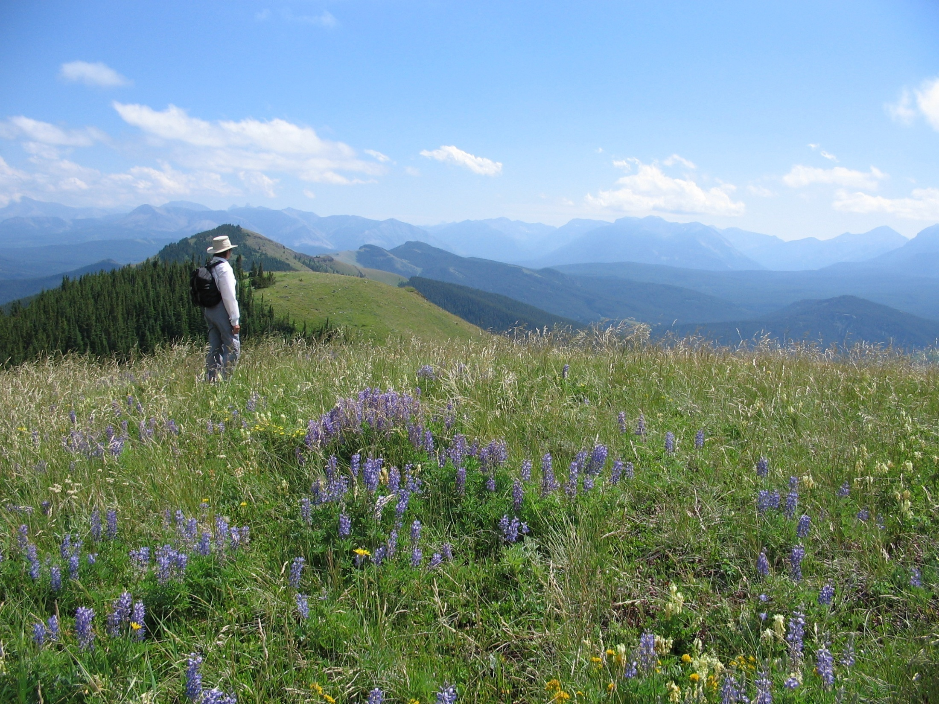
Foothills Restoration Forum
Foundation and Achievements
Notes:
Respect for the land
Respect for the rights embedded in a Multiple Use Landscape
Respect for each other, regardless of our personal objectives
Tell the story of Express, rough fescue growing on the right of way and Cheryl Bradley’s sobering comments regarding native plant communities

Slide 2
“A Grass Roots Initiative”
Notes:
GRF is comprised of individuals who deal with the field based issues of multiple use land management on a daily basis and tasked with making hard decisions.
Barry to make the linkage between the ecological tools used in grazing management with the need for improved industrial reclamation monitoring.

Slide 3
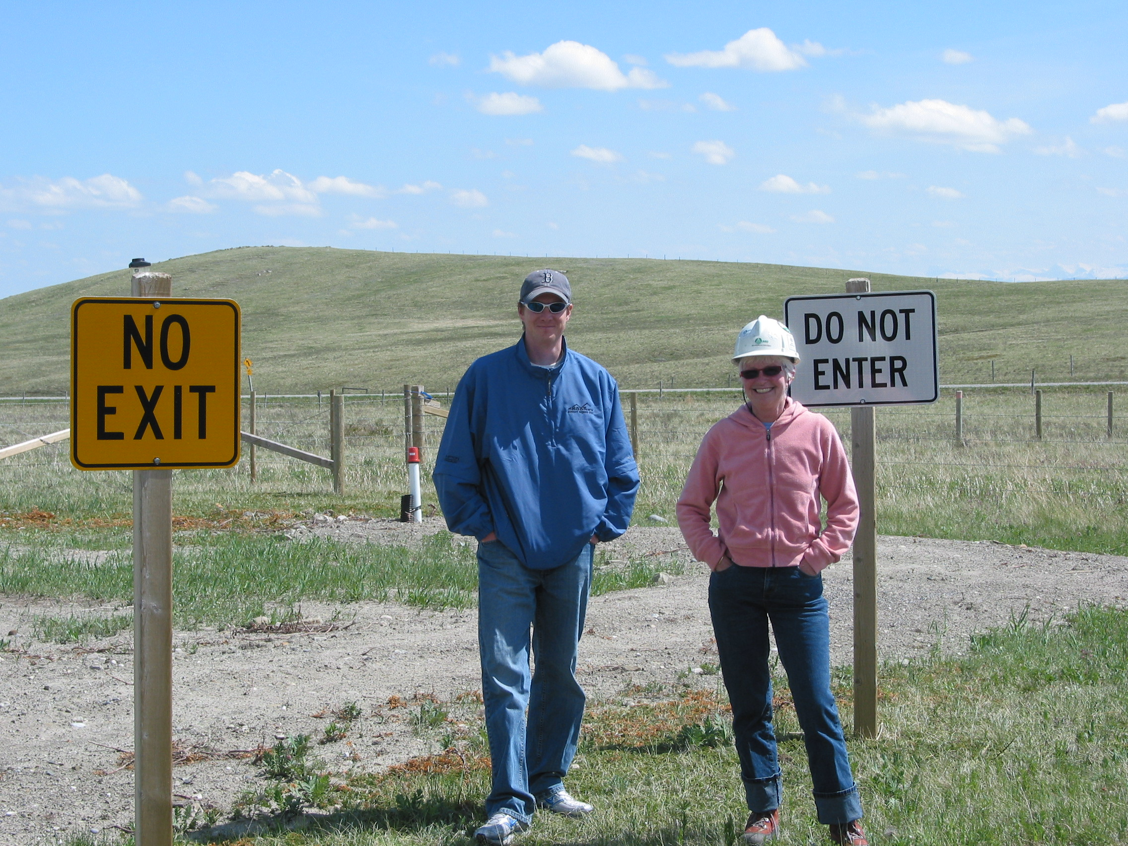
The Need for Conflict Resolution in a Multiple Use Landscape
Notes:
We come from very different backgrounds and points of view and we have come together to resolve issues through a collaborative approach based on peer reviewed science.
Compton Petroleum held mineral rights in large blocks on the Eastern Slopes.
Pekisko Landowners group opposed to exploratory drilling on the Waldron Ranch.
No proof of restoration success in rough fescue
Conditions for approval from Public Lands
This involved the facilitation of two key research projects: Peggy Desserud Warner, and Steve Tannas

Slide 4
Idea formed in 2006 from a multi-stakeholder meeting at Compton Petroleum Field Office
To create a forum to promote open information sharing amongst all stakeholders,
To promote stewardship, improved reclamation & restoration practices in Alberta’s Grasslands

Slide 5
Steering Committee
Barry Adams, SRD Head, Rangeland Resource Management Program
Mike Alexander, SRD Rangeland Management Specialist Montane/Foothills
David Green, Manager, SASCI
Jane Lancaster, Kestrel Research
Bruce Greenfield, Energy Resources Conservation Board
NOTE: Original Steering Committee also included:
Marilyn Neville, Gramineae Services Ltd.
Kurtis Averill, Compton Petroleum
Notes:
Our first Steering Committee

Slide 6
First Fall Info Session – November 2007
Maycroft Hall, 126 people attended representing a variety of stakeholders
Nominations for Technical Advisory Committee
Open mike session
Started FRF Mailing List
** Now Over 600 on Our List!
Notes:
Comprised of government agencies, industry, landowners, environmental consultants, conservation groups,

Slide 7
Technical Advisory Commitee
Comprised of 15-20 people representing industry, gov’t, NGOs, and landowners
Created Terms of Reference & Research Prospectus
Participate in research projects, workshops and document review as requested
Field Tours

Slide 8
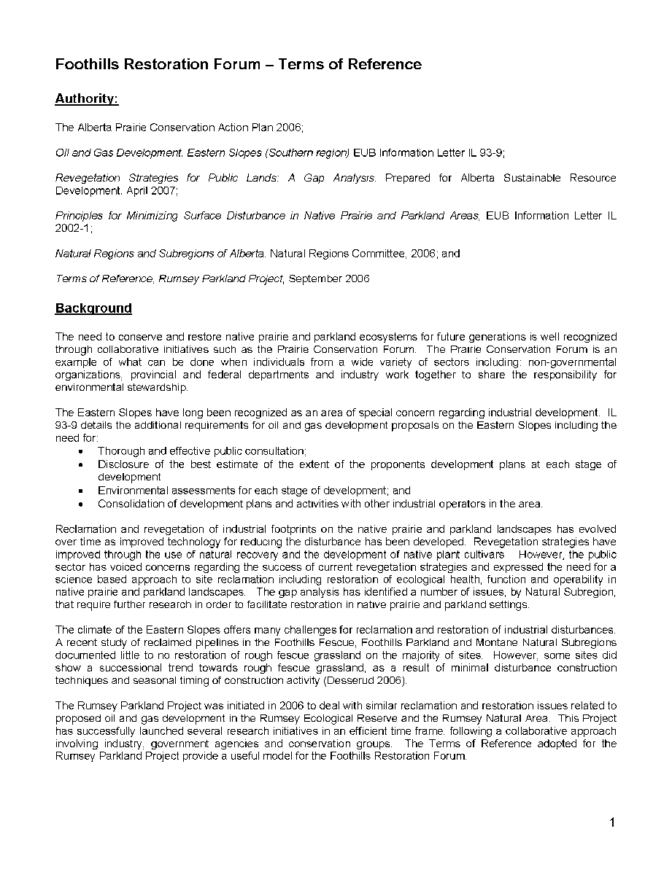
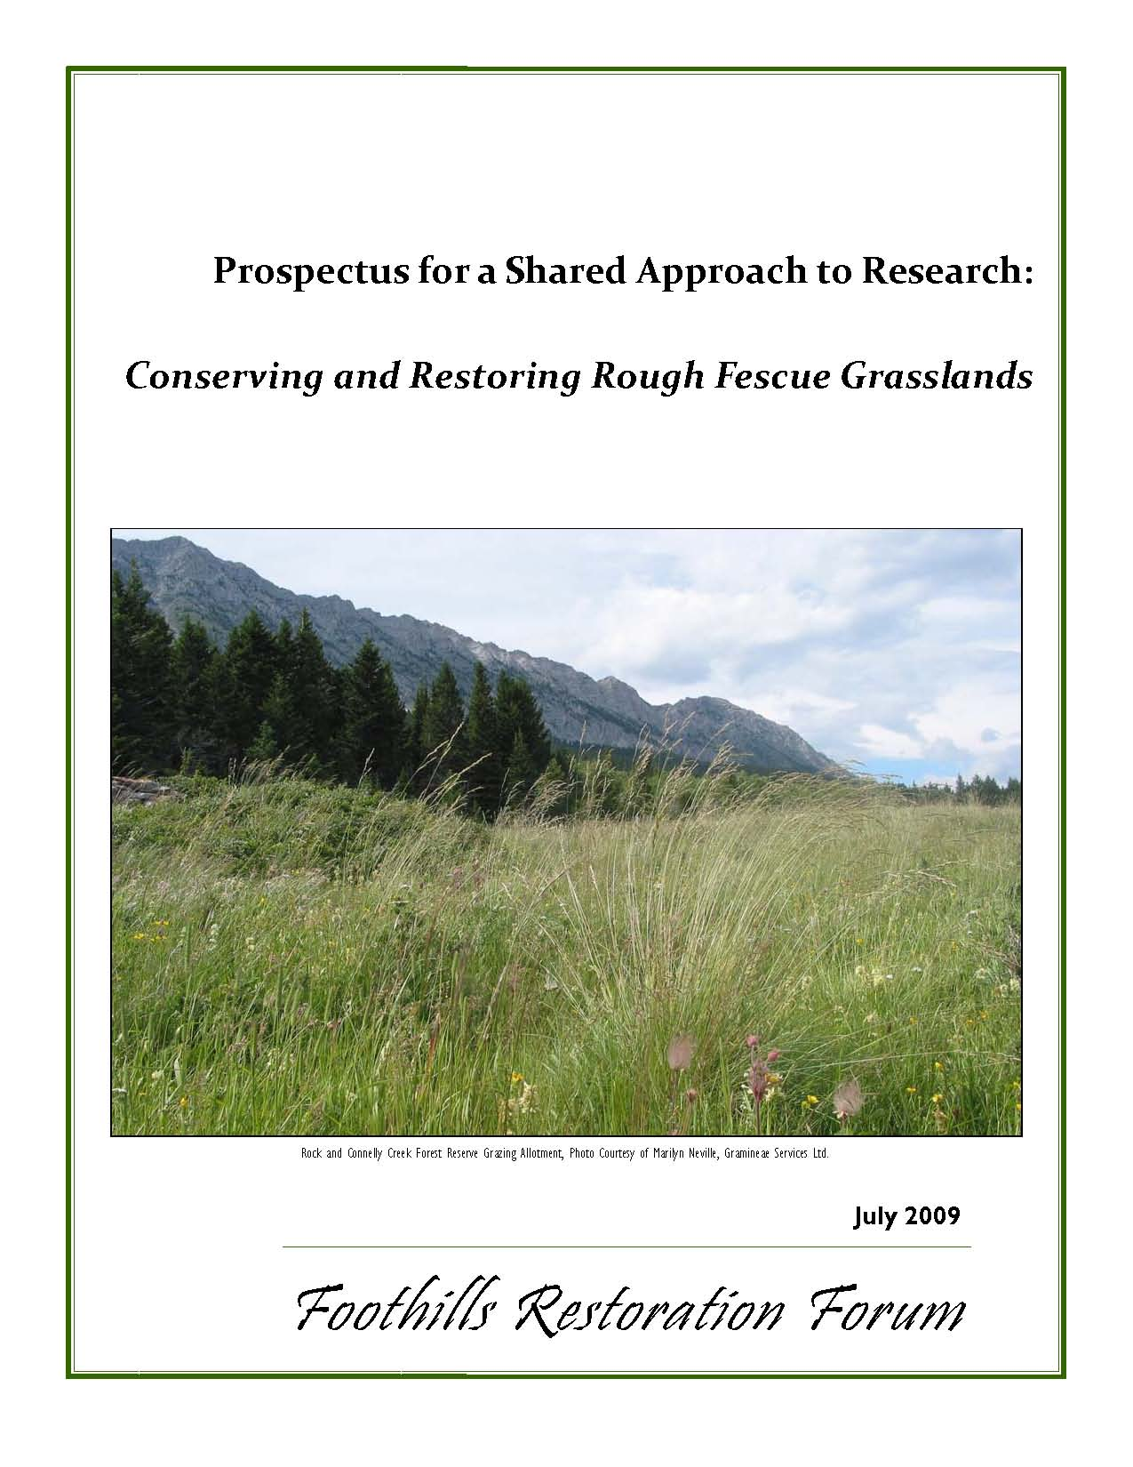
Terms of Reference – Research Prospectus
** Both Included in Handout Package **

Slide 9
Annual Activities & Outreach
Conference attendance to promote the FRF publication sales and current projects
Including: CLRA, AIA, ANPC, PCF, PCAP, AISC
Student Days – field days with college students, annual guest lectures, ‘Reclamation 101’
Tours & Other Activities on request from industry
Notes:
Saskatchewan Prairie Conservation Forum Native Prairie Reclamation and Restoration Workshop
Lethbridge College, and Medicine Hat College

Slide 10
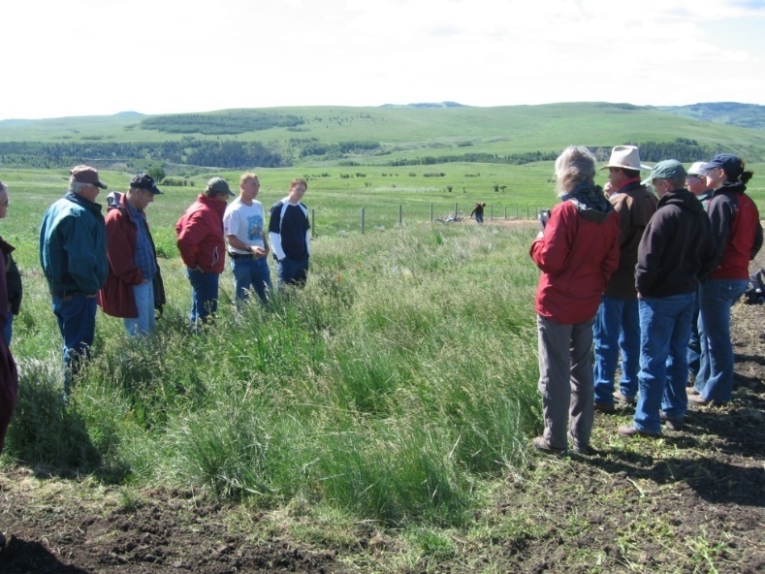
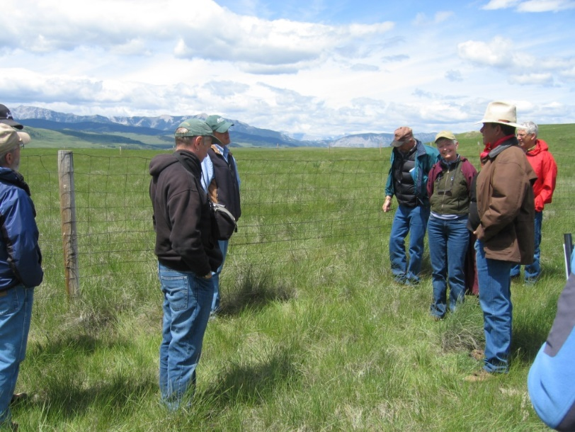
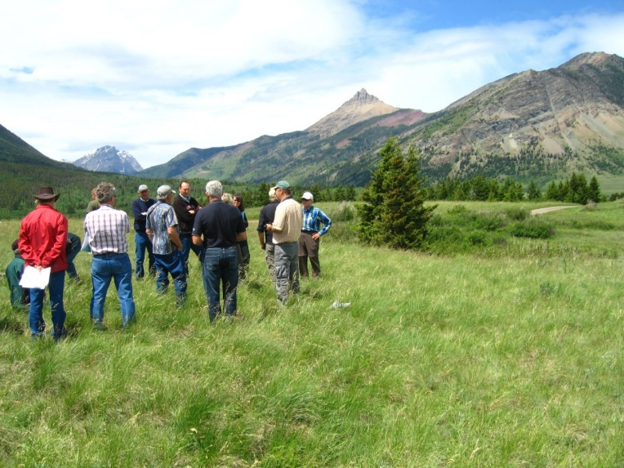
TAC Field Tours 2008 & 2009
Notes:
- Steve Tannas rough fescue research plots
- Reclaimed well site with rough fescue plugs
- SRD Waldron Reference Area, FFA2 Rough fescue-Idaho fescue-Low sedge plant community
- Review of detailed assessment for proposed wellsite
- Peggy Desserud’s east and west Maycroft pipeline sites
- Cows and Fish Riparian monitoring site, Callum Creek

Slide 11
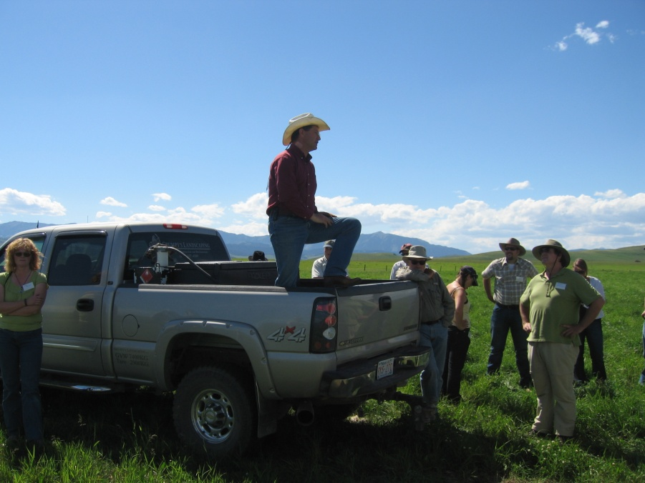
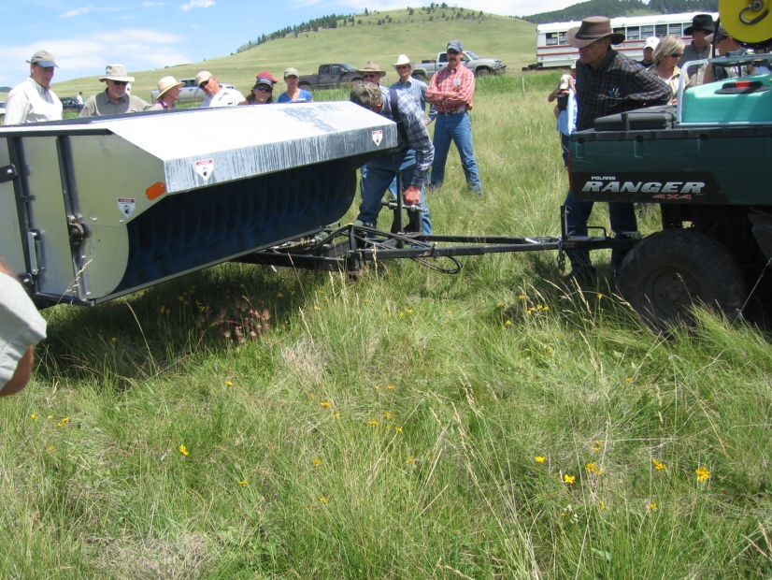
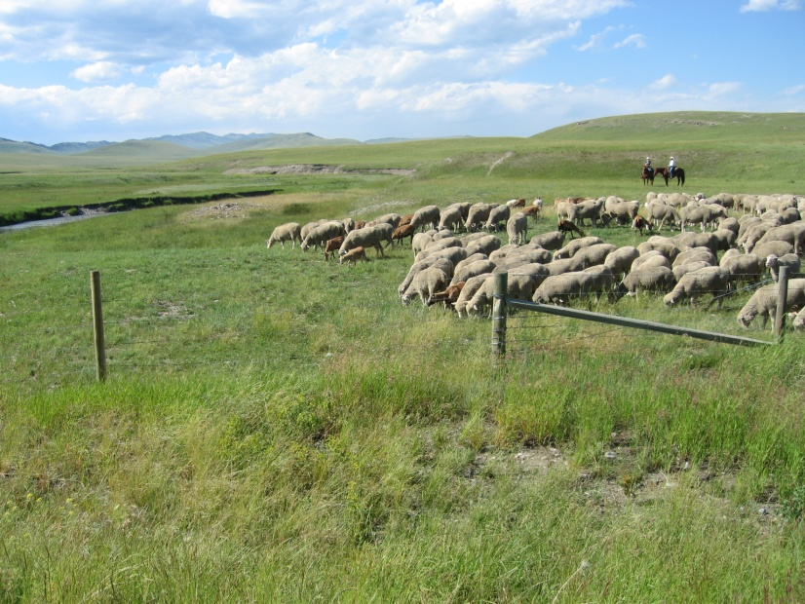
2010 Field Tour with Society of Range Management

Slide 12
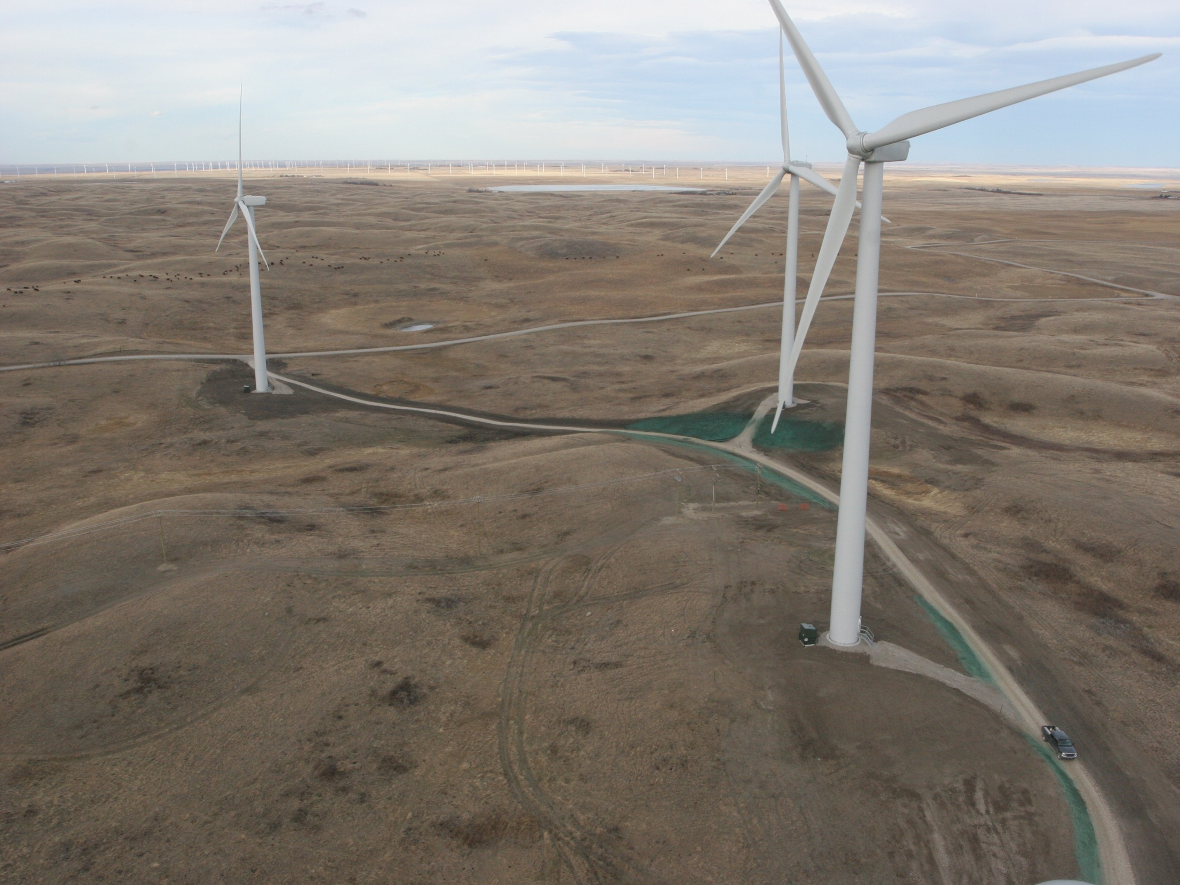
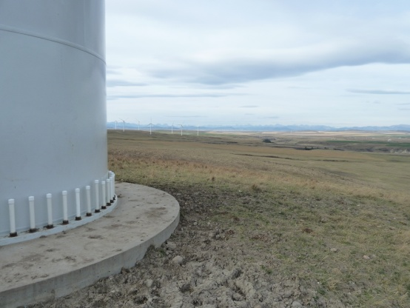
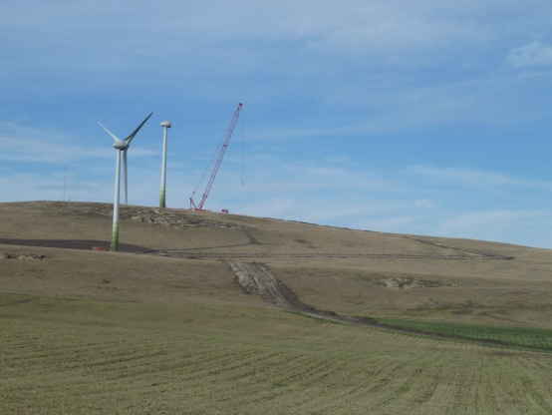
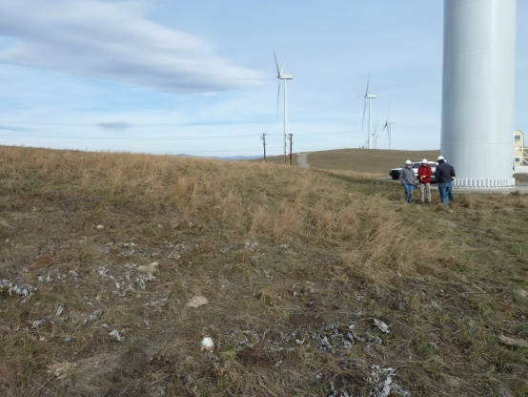
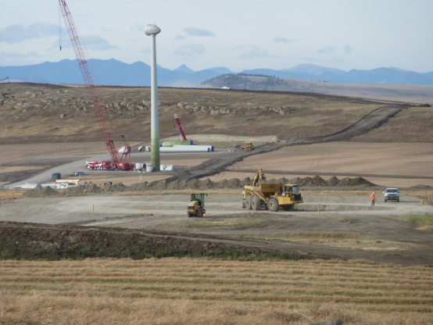
Kettles Hill Tour April 2011
Notes:
Focus on Wind Enegy projects. Kettles Hill CLRA fall tour
Field tours conducted annually fthrought ot 2015.

Slide 13
Education & Training
Tools for the Restoration Tool Box
Linkage to rangeland ecology
Readily accessible through the FRF Information Portal
Notes:
Barry to take this slide

Slide 14
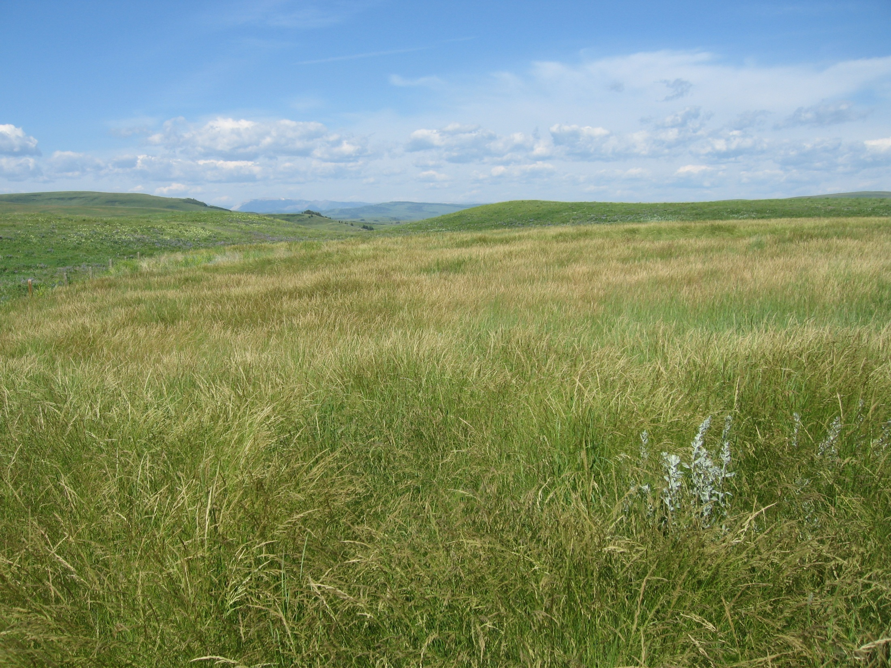
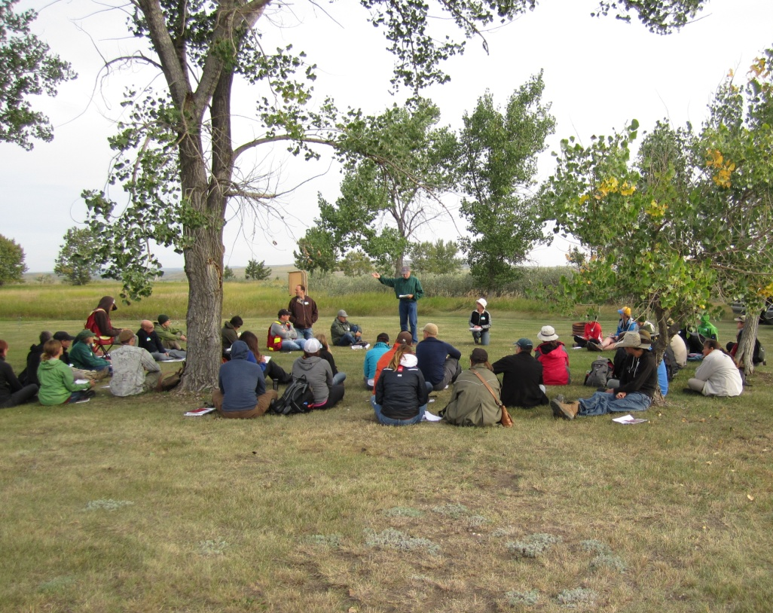
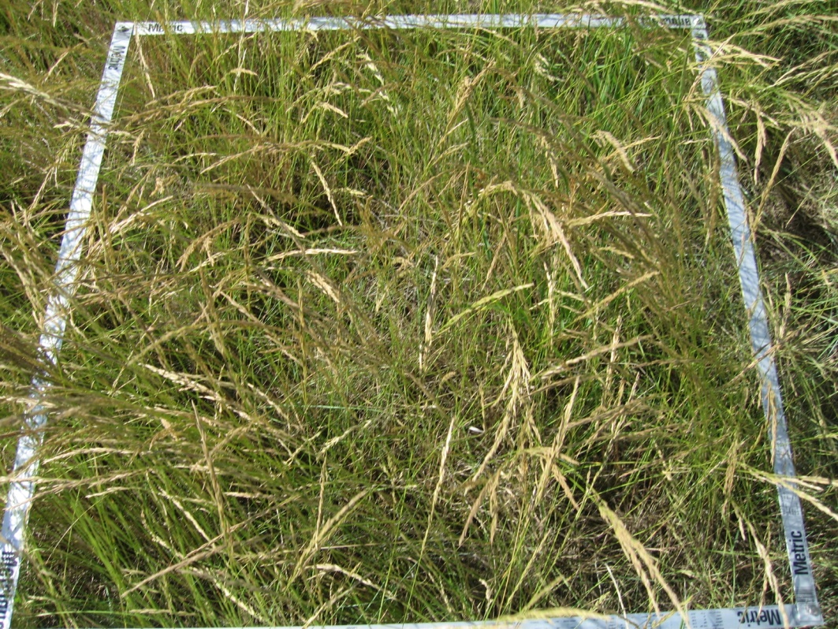
Range Health Assessment Training for Industry
Notes:
Inaugural Course June, 2011 at Stavely, Alberta
48 Students participated
Facilitated one day at Stavely again in 2012
44 Attendees
Flooding in June 2013 forced us to reschedule to September, held two courses, Stavely and Cypress Hills
66 Students participated
June 2014 Training days were postponed to September, courses at both Stavely and Elkwater
39 Students at Elkwater; 31 at Stavely
Parks Grant to support Range Health Assessment Training will help towards goal of operating on a cost recovery basis
Online Registration and Credit Card Payments via Paypal have significantly reduced our ‘no shows’ at events

Slide 15
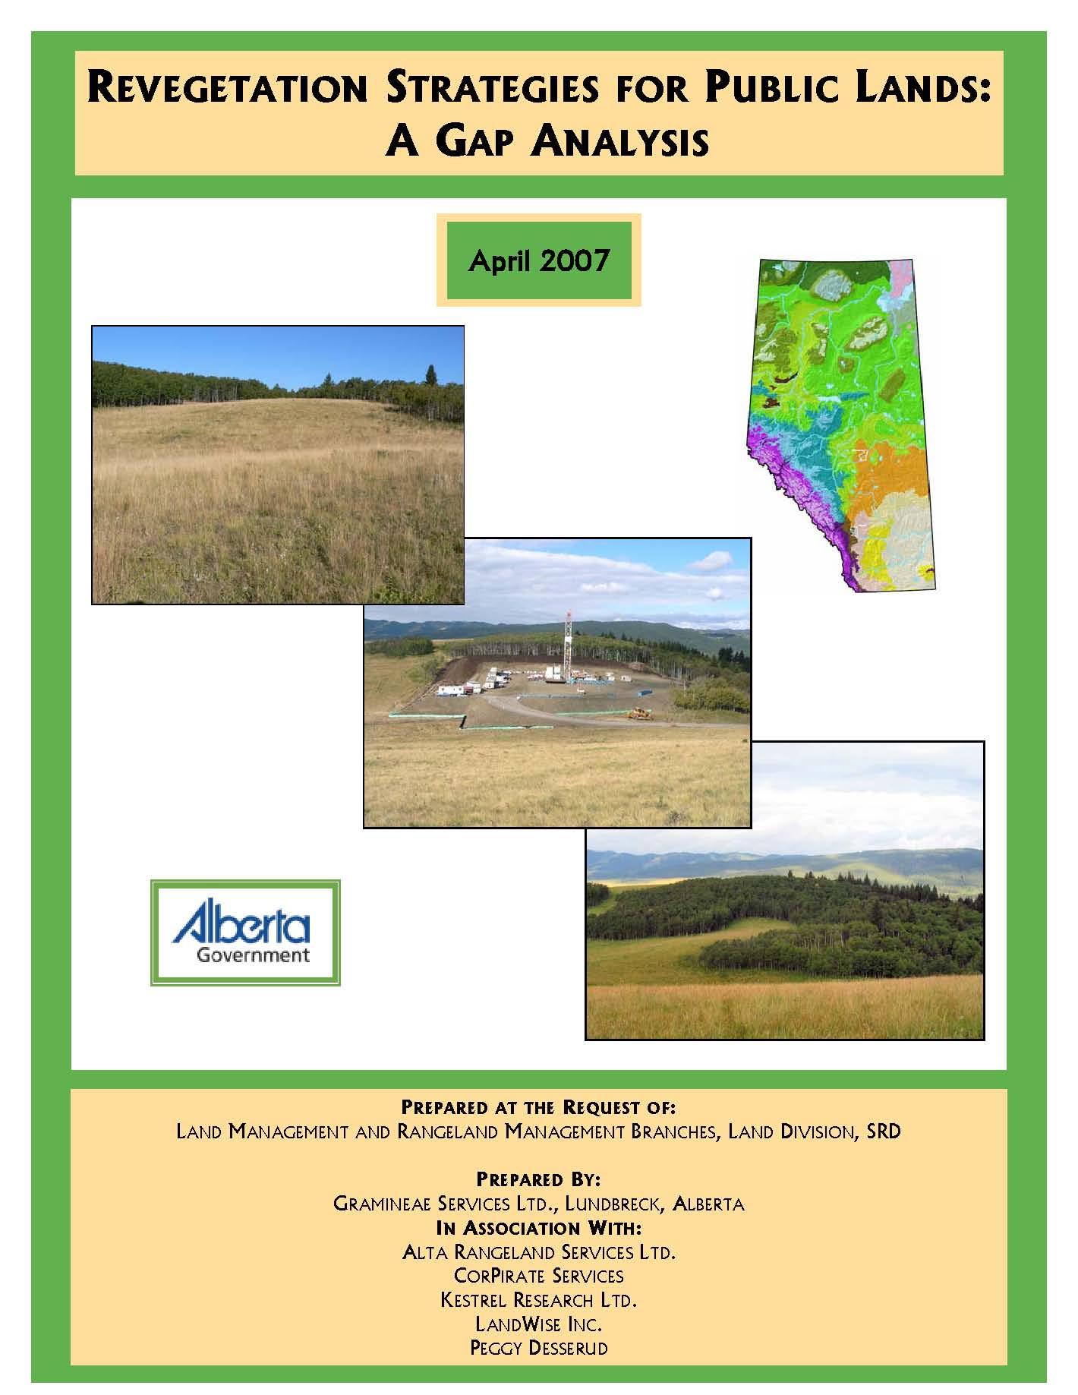
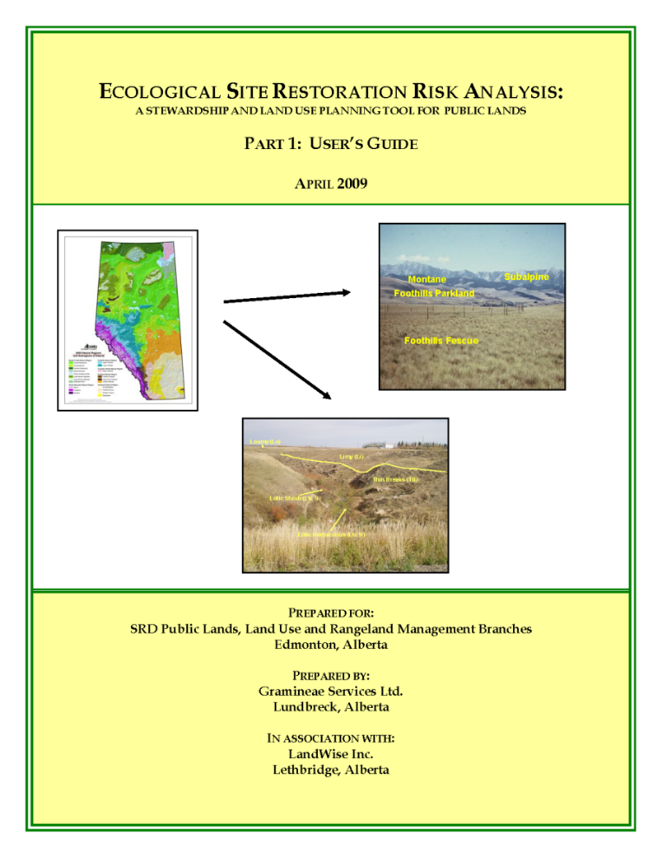
Achievements & Projects
Gap Analysis
Restoration Risk Analysis
Notes:
Marilyn
Determine the gaps in our knowledge regarding restoration success by Natural Subregion
Within each natural subregion determine the restoration risk associated with industrial disturbance by ecological range site site or ecological site.

Slide 16
Protective Notation Achieved
Foothills Fescue PNT
Notes:
Barry
Purpose is to notify industry of the environmental and economic risk associated with development in rough fescue grasslands
Applies to all industrial activity

Slide 17
Notes:
Barry
Provides industry with guidelines for assessment tools to avoid foothills fescue grasslands, the importance of limiting disturbance footprint and the challenges of plant community restoration

Slide 18
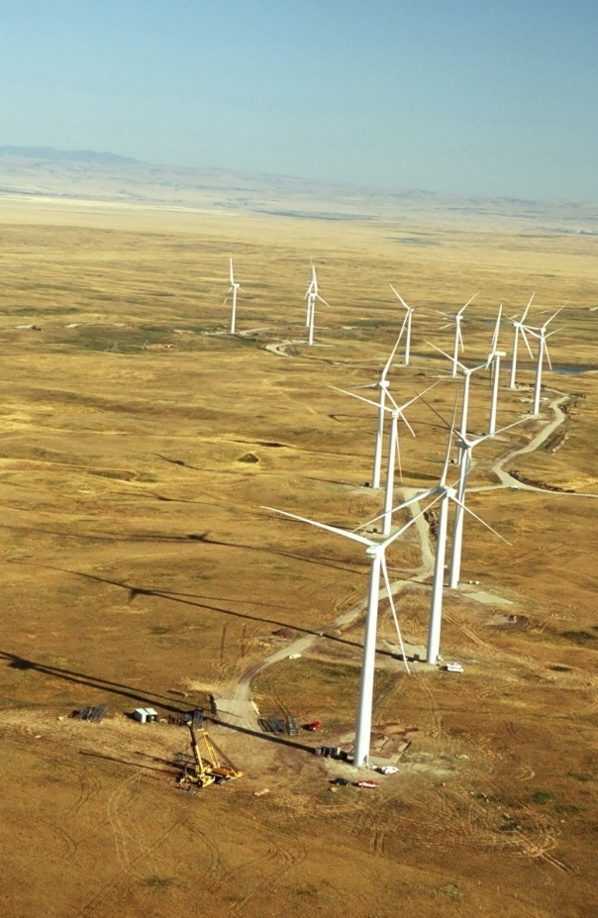
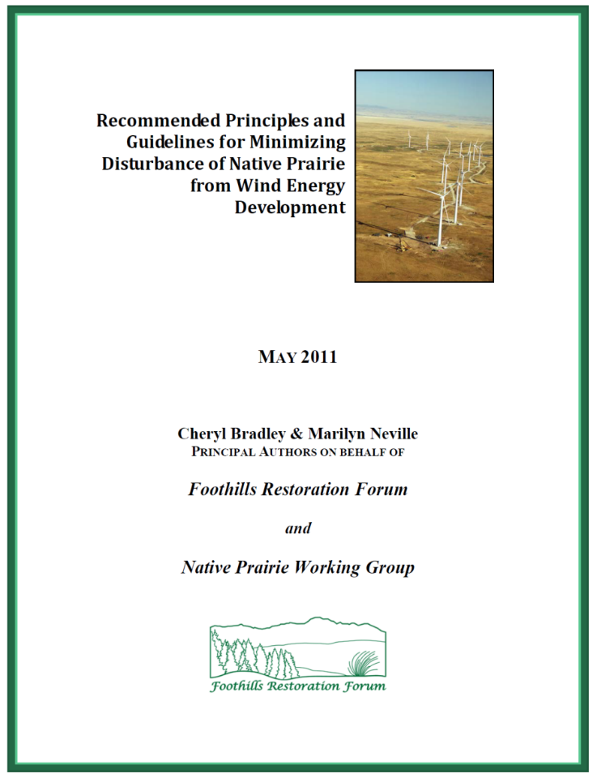
Recommended Principles and Guidelines for Minimizing Disturbance of Native Prairie from Wind Energy Development

Slide 19
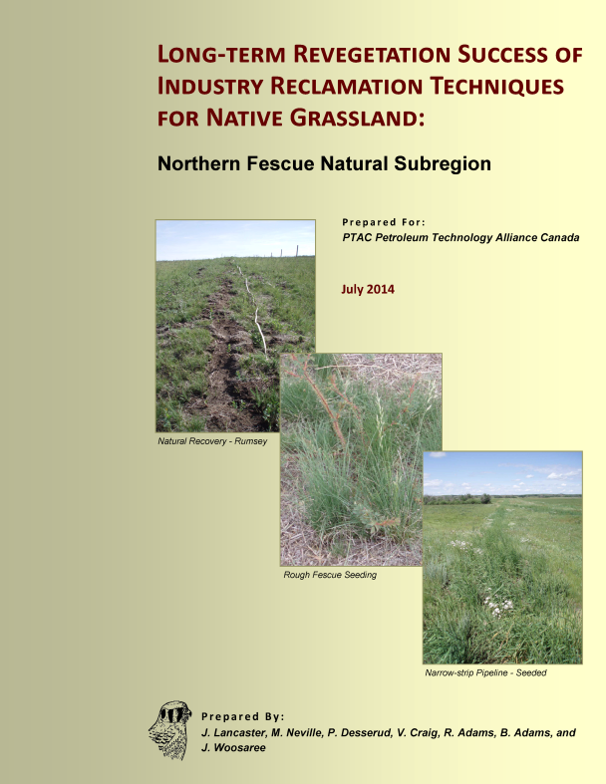
Long-Term Monitoring and Field Study Reports
Notes:
Express Pipeline
Husky Majorville and AEC Cypress and Maryflats NEB application
Northern Fescue , Peggy Desserud, Alberta Innovates, and Mae Elsinger

Slide 20
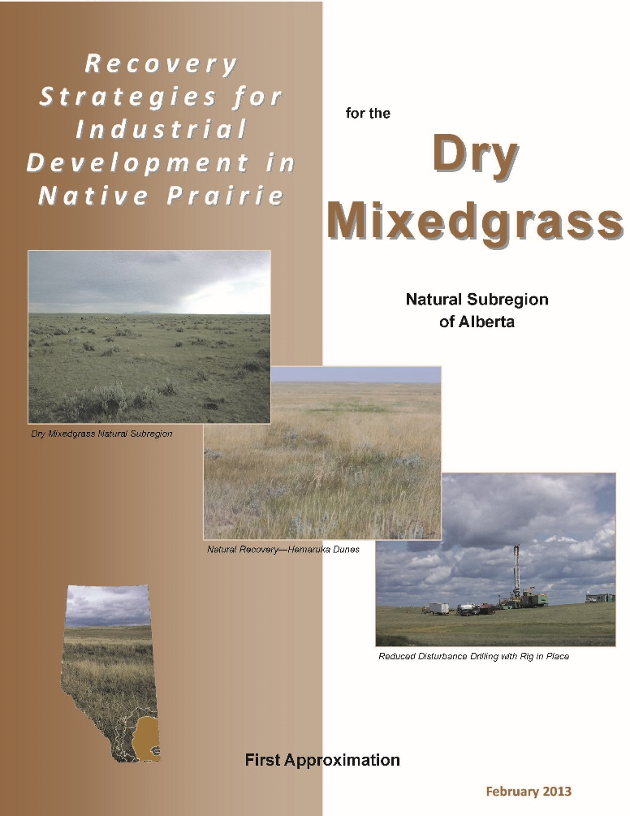
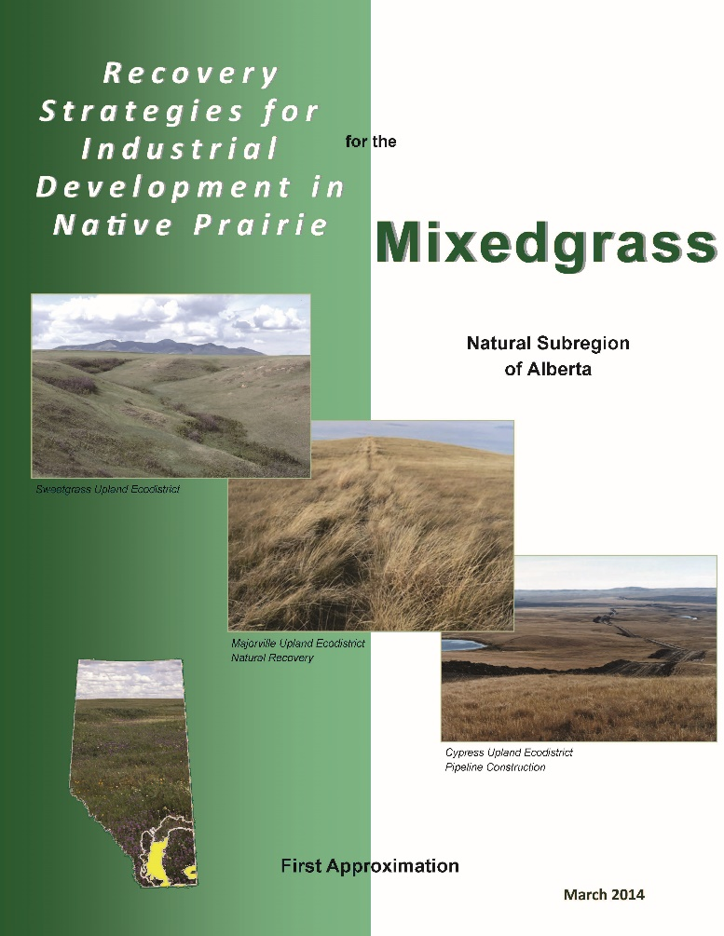
Recovery Strategies Documents
CLRA Alberta Chapter 2014 Annual General Meeting and Conference
Notes:
Multi-step, interactive process to incorporate Long-Term Monitoring Data with recent field studies, workshop multi-stakeholder input, and create Recovery Strategies Documents by Natural Subregion designed to work in conjunction with Plant Community Guides

Slide 21
Native Seed Cooperative Workshops
A feasibility study on the idea of a Native Seed Cooperative for Southern Alberta
A sub-committee to submit a gap analysis of the current ‘Analysis and Standards for Grading Native Seeds’
Creation of the Canadian Grasslands Native Plant Materials Exchange website
Notes:
Anne Smreciu Wild Rose Consulting
Native seed bank collection and propogating facility funded by consortium of the Oil Sands producers

Slide 22
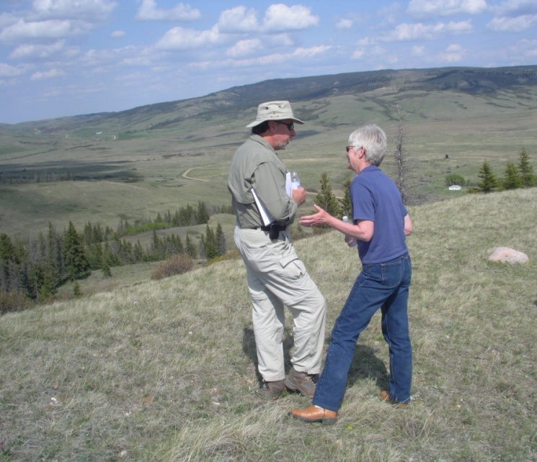
Time to pass the torch
“Where there’s a will, there’s a way!”

