Slide 1
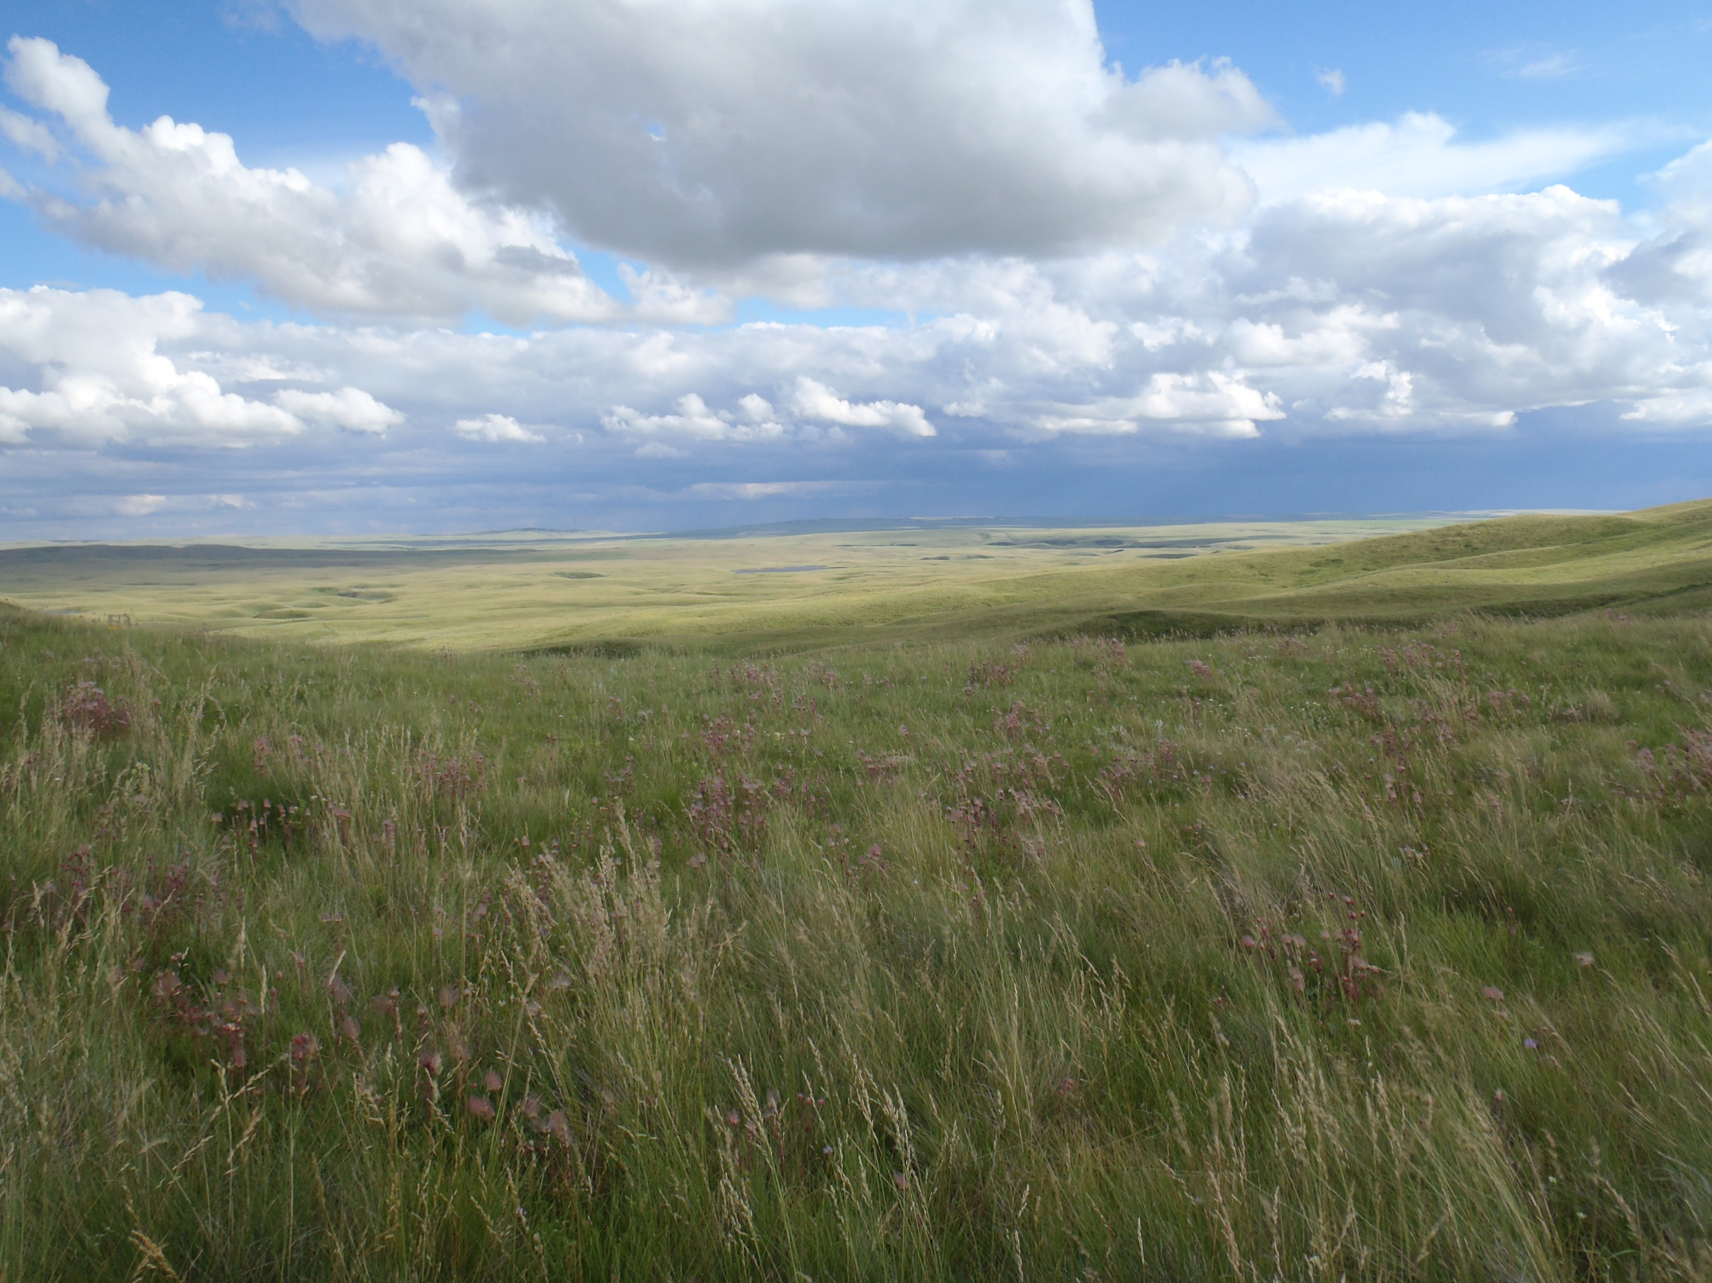
Welcome to the
Grassland Restoration Forum’s 19th Annual Fall Information Session “Case Studies”
Thank you to the Grassland Restoration Forum’s Ongoing Sponsors
Samuel Hanen Society for Resource Conservation

Slide 2
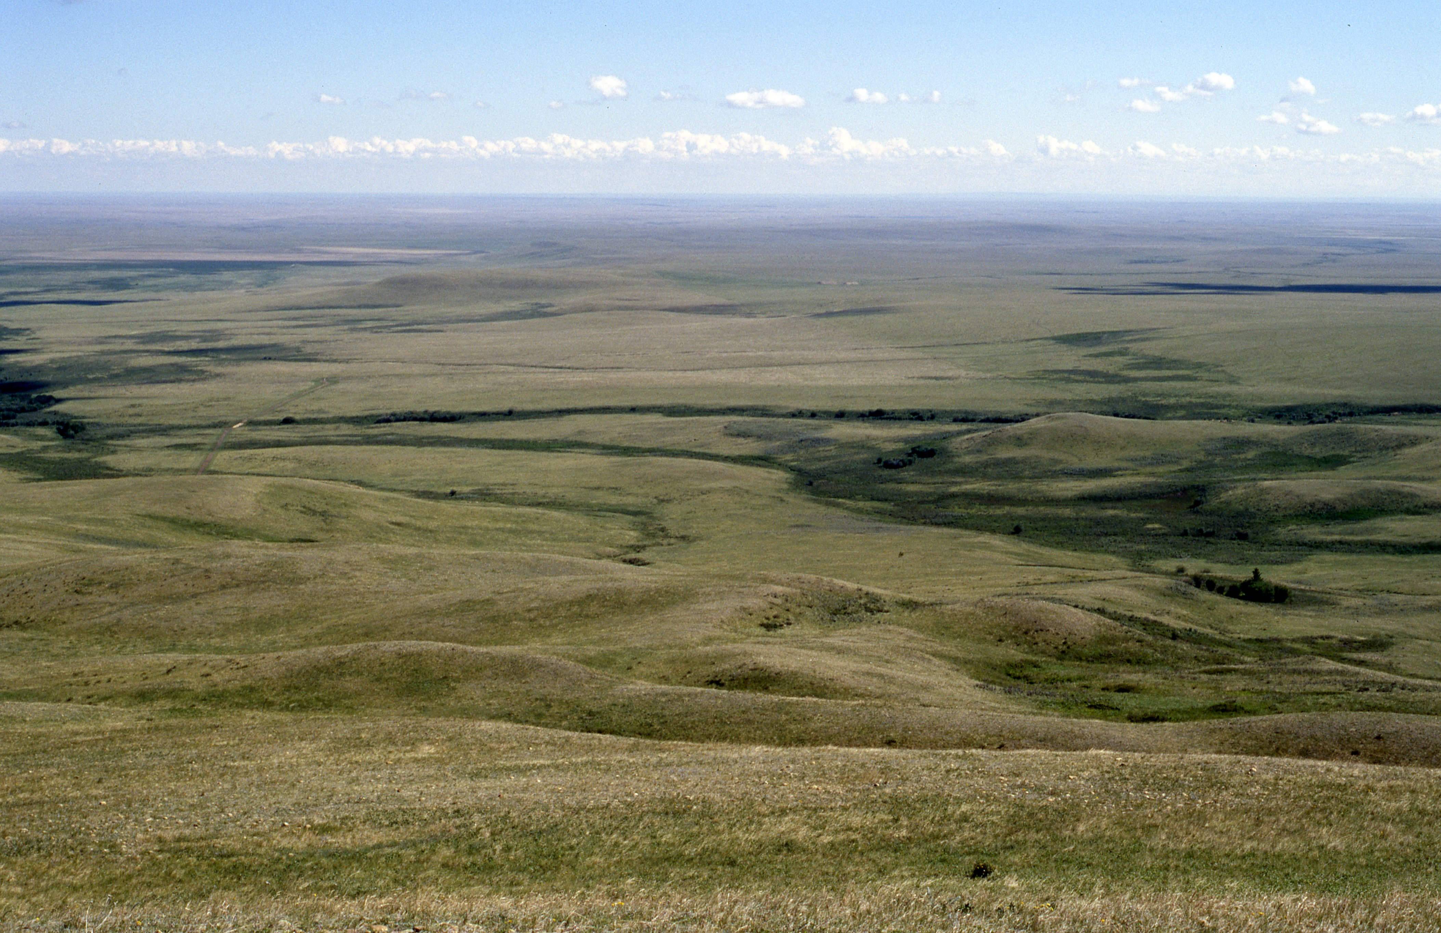
Thank you to our 2024 GRF Fall Information Session Sponsors
Gold Sponsor
Nature Conservancy of Canada, as part of the Weston Family Prairie Grassland Initiative
Lunch Sponsors
TC Energy Salix Resource Management Ltd.
Silver Sponsors
BrettYoung Jorgensen Land Management Ltd.
Friends of the Grassland Restoration Forum
ALCLA Native Plants, NAPA Pass Automotive (Blairmore, Alberta), Grumpy’s Greenhouse and Gardens Ltd.,
Kestrel Research Inc., Special Areas Board, Stantec, Sunshine Seeds, Sure Shot Environmental Ltd., Trace Associates Inc.

Slide 3
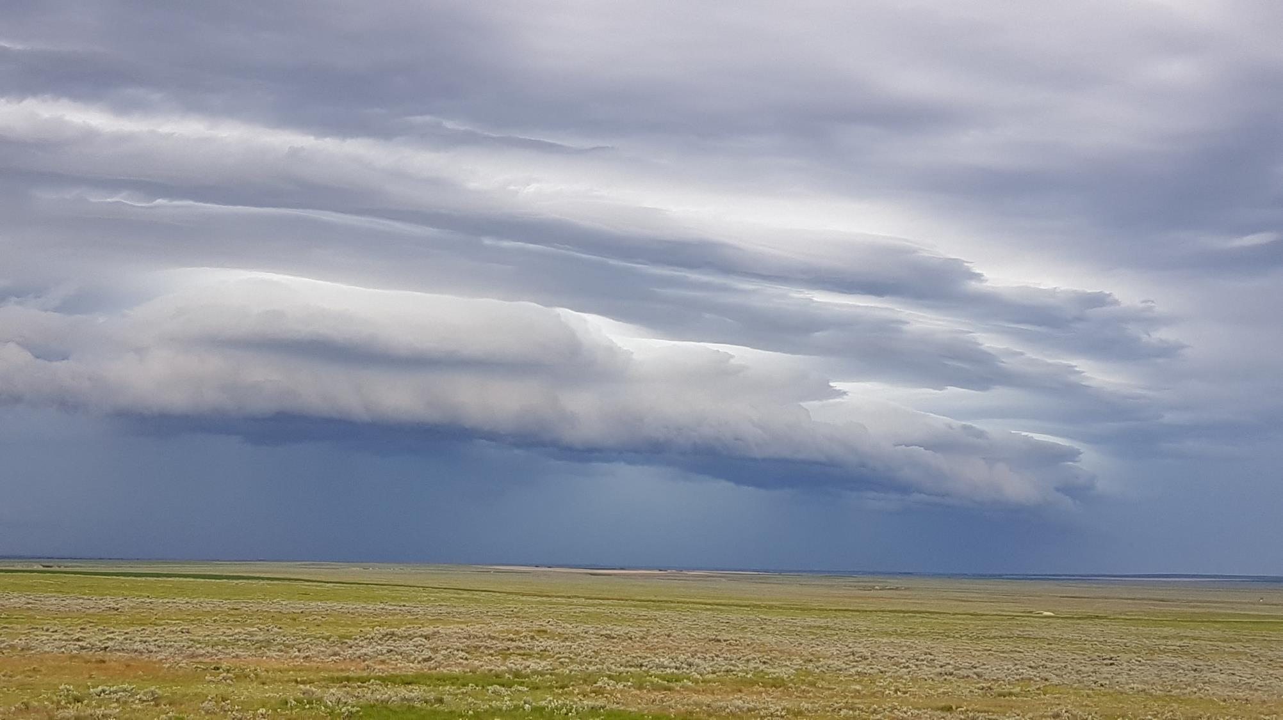
The Grassland Restoration
Forum
Mission:
To promote the conservation and restoration of native grasslands in Alberta through education, outreach and research to improve reclamation practice and foster stewardship. The GRF began in 2006 as a collaboration between members of provincial agencies, the ranching community, conservation organizations, First Nations, industry, plant ecologists and reclamation practitioners.

Slide 4
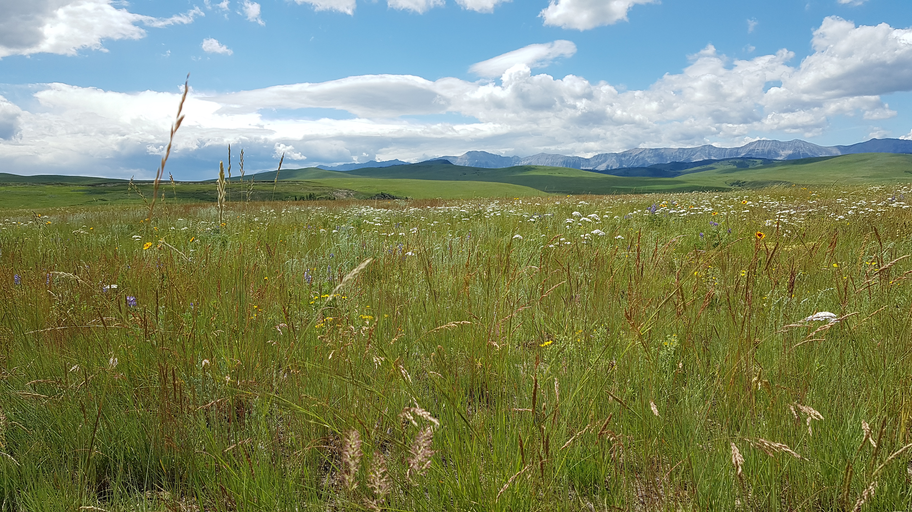
Gold Level Sponsor
Grassland Restoration Forum
Fall Information Session 2024

Slide 5
Thank You to our Lunch Sponsors!
GRF Fall Information Session 2024
November 14th
Claresholm, Alberta

Slide 6
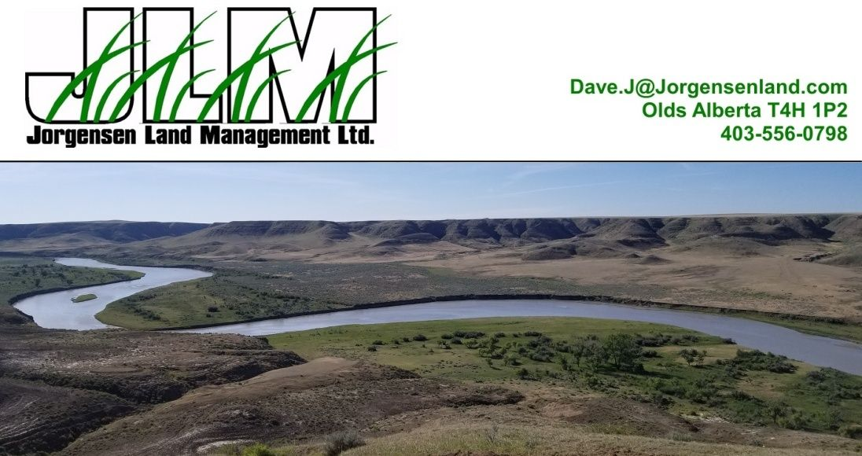
Silver Level Sponsor Grassland Restoration Forum Fall Information Session 2024

Slide 7
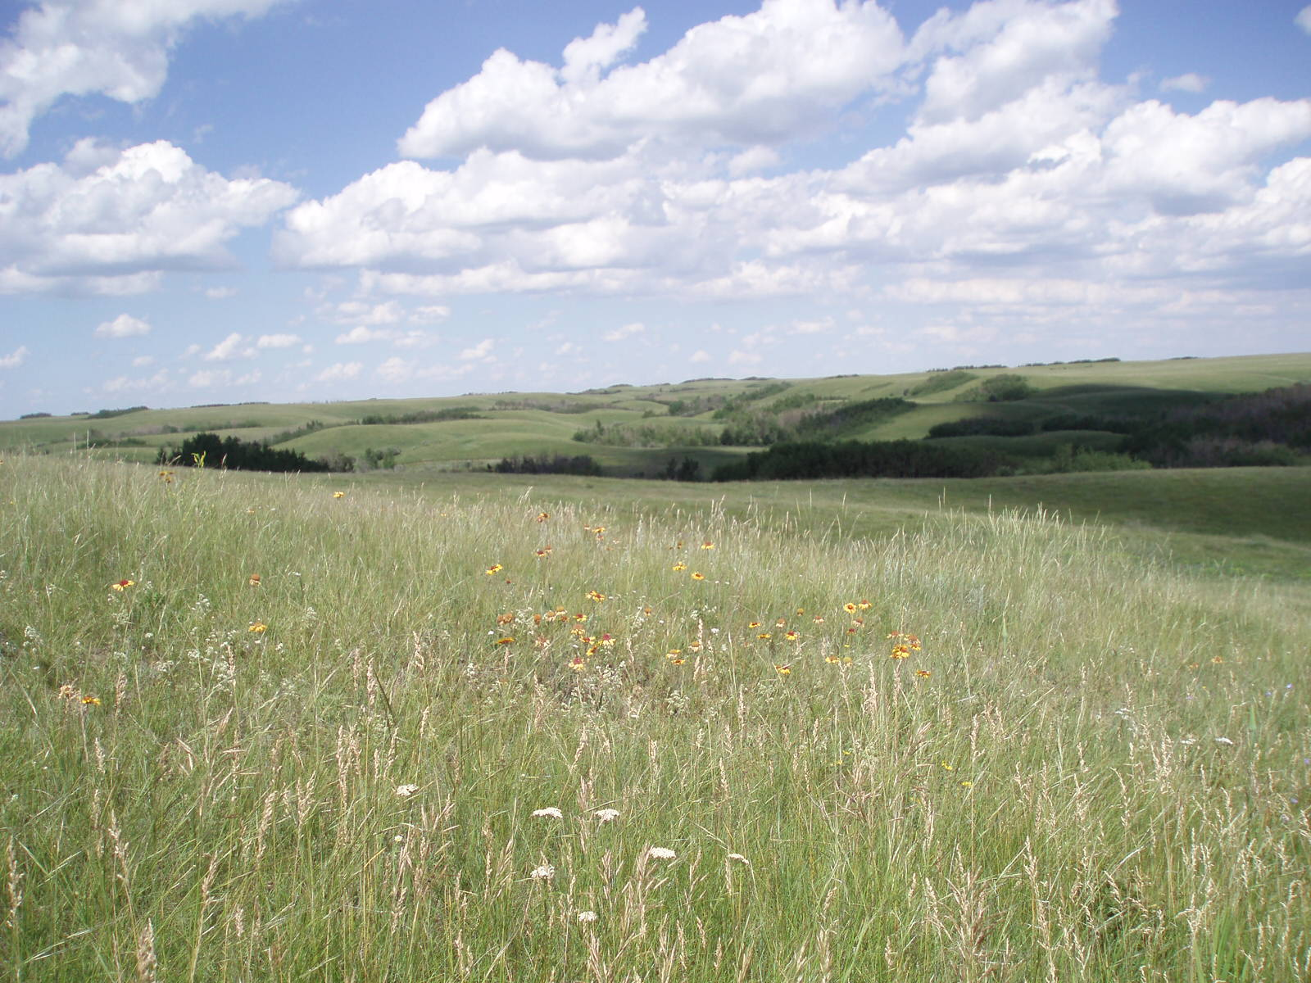
Silver Level Sponsor
Grassland Restoration Forum
Fall Information Session 2024

Slide 8
Thank You to our Friends of the
Grassland Restoration Forum Sponsors!

Slide 9
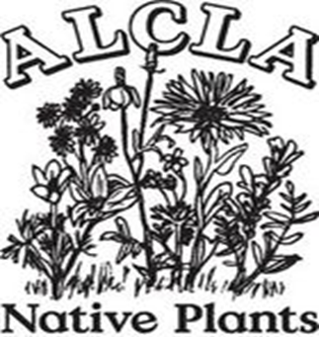
Meet the GRF 2024 Fall Information Session Booth Participants Today!
Tanya Klingsh - Artist

Slide 10
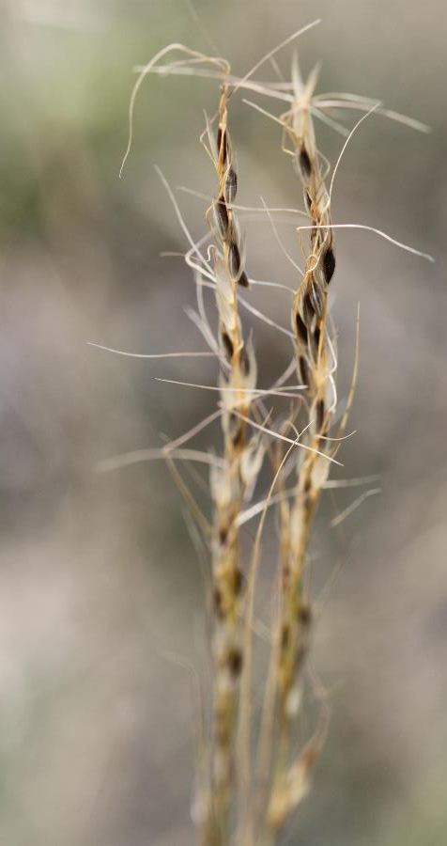
Want to Support GRF?
Etransfers can be sent to admin@sasci.ca
comment GRF.
Donations are gratefully used to keep programs moving by funding operations that are not covered by grants

Slide 11
Recommended Monitoring Protocols for Targeted Grazing
Targeted grazing is defined as the application of a specific kind of livestock at a determined season, duration, and intensity to accomplish defined vegetation or landscape goals.
Learn more in the GRF Information Portal

Slide 12
Targeted Grazing Resources
Targeted Grazing Resources on the GRF Information Portal
Targeted Grazing Plant and Animal Interactions 2022
Targeted Grazing Livestock Profiles 2022
Targeted Grazing Plant Fact Sheets 2022
Download Stock-poisoning Plants of Western Canada
Recommended Monitoring Protocols For Targeted Grazing Projects

Slide 13
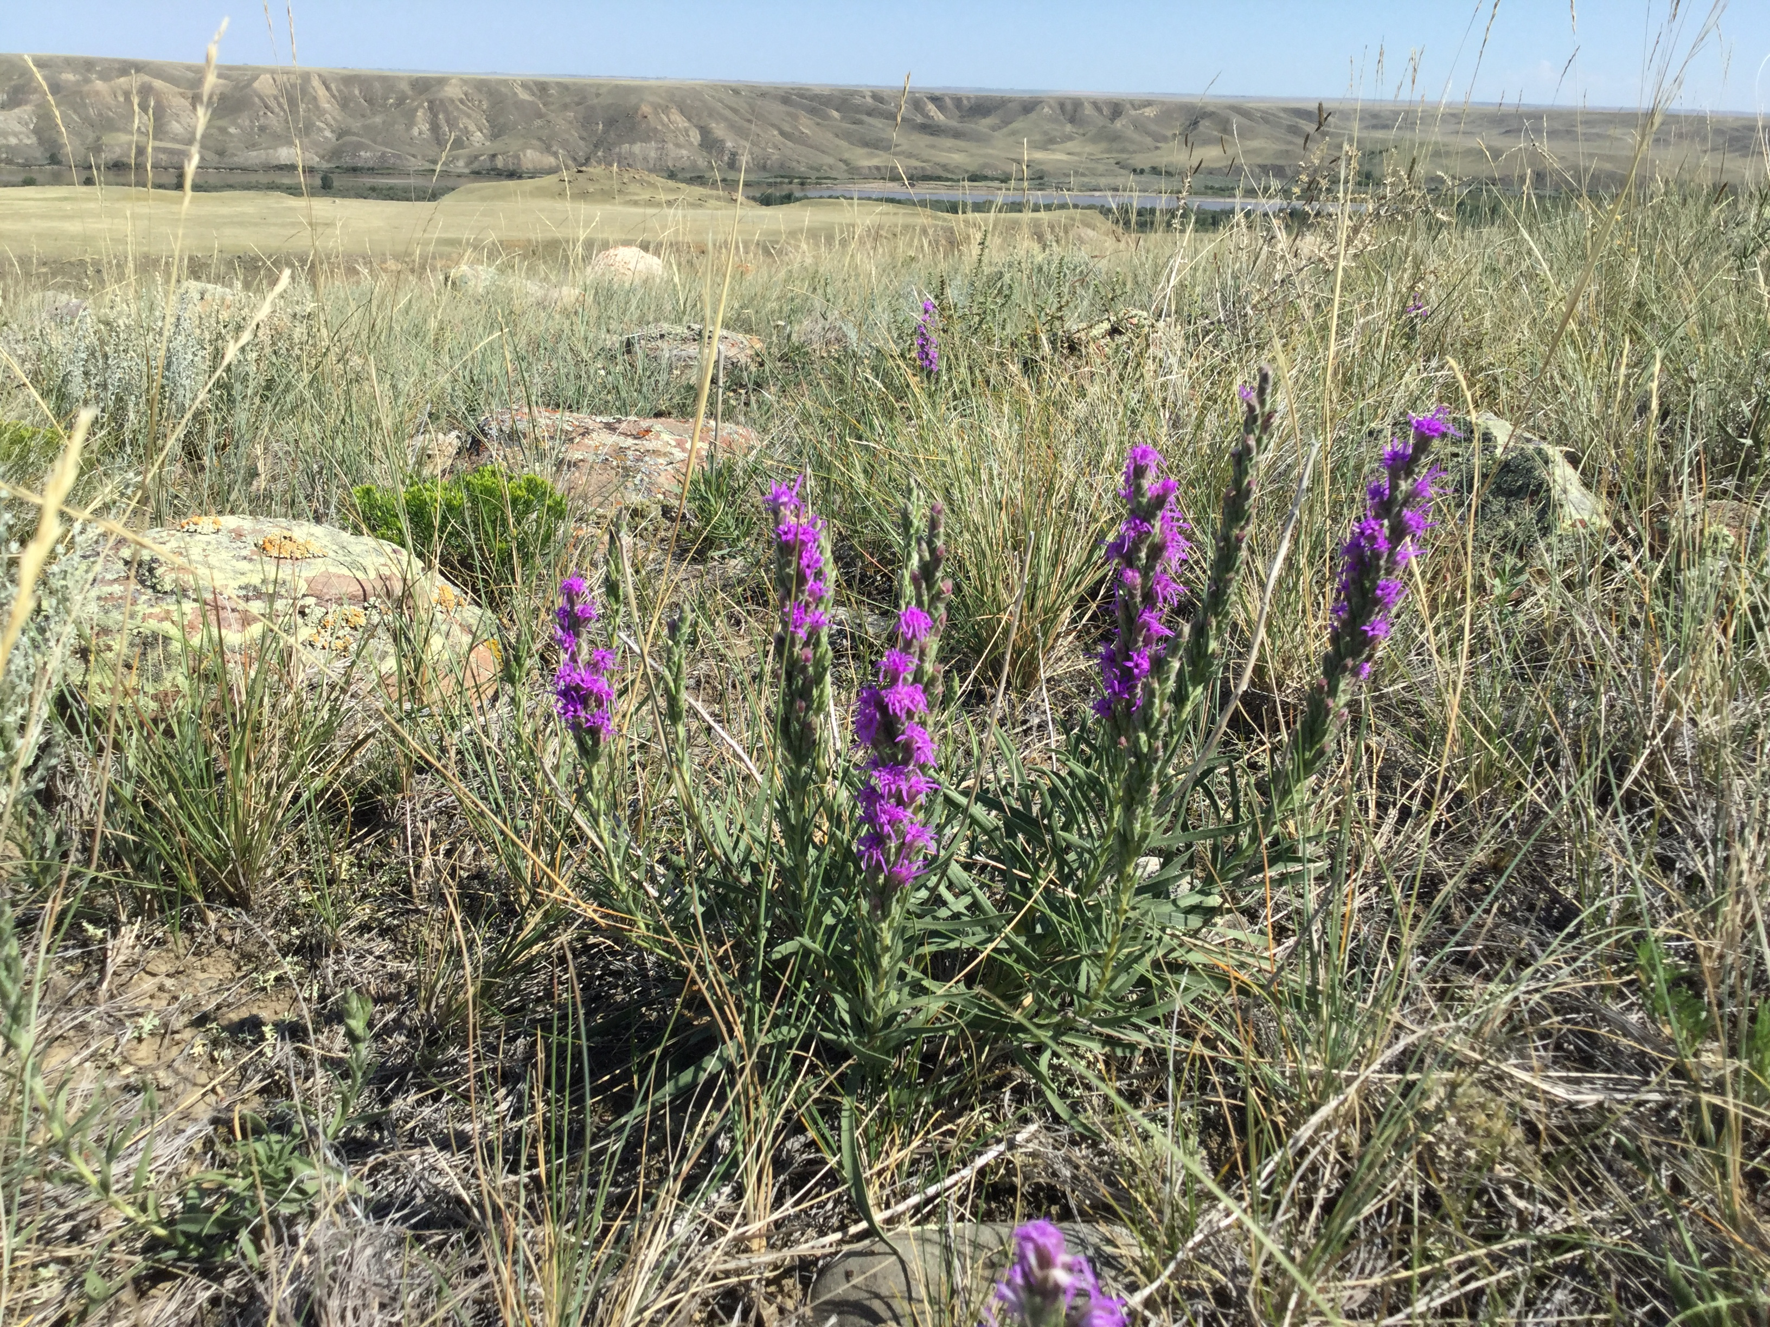
Gold Level Sponsor
Grassland Restoration Forum
Fall Information Session 2024

Slide 14
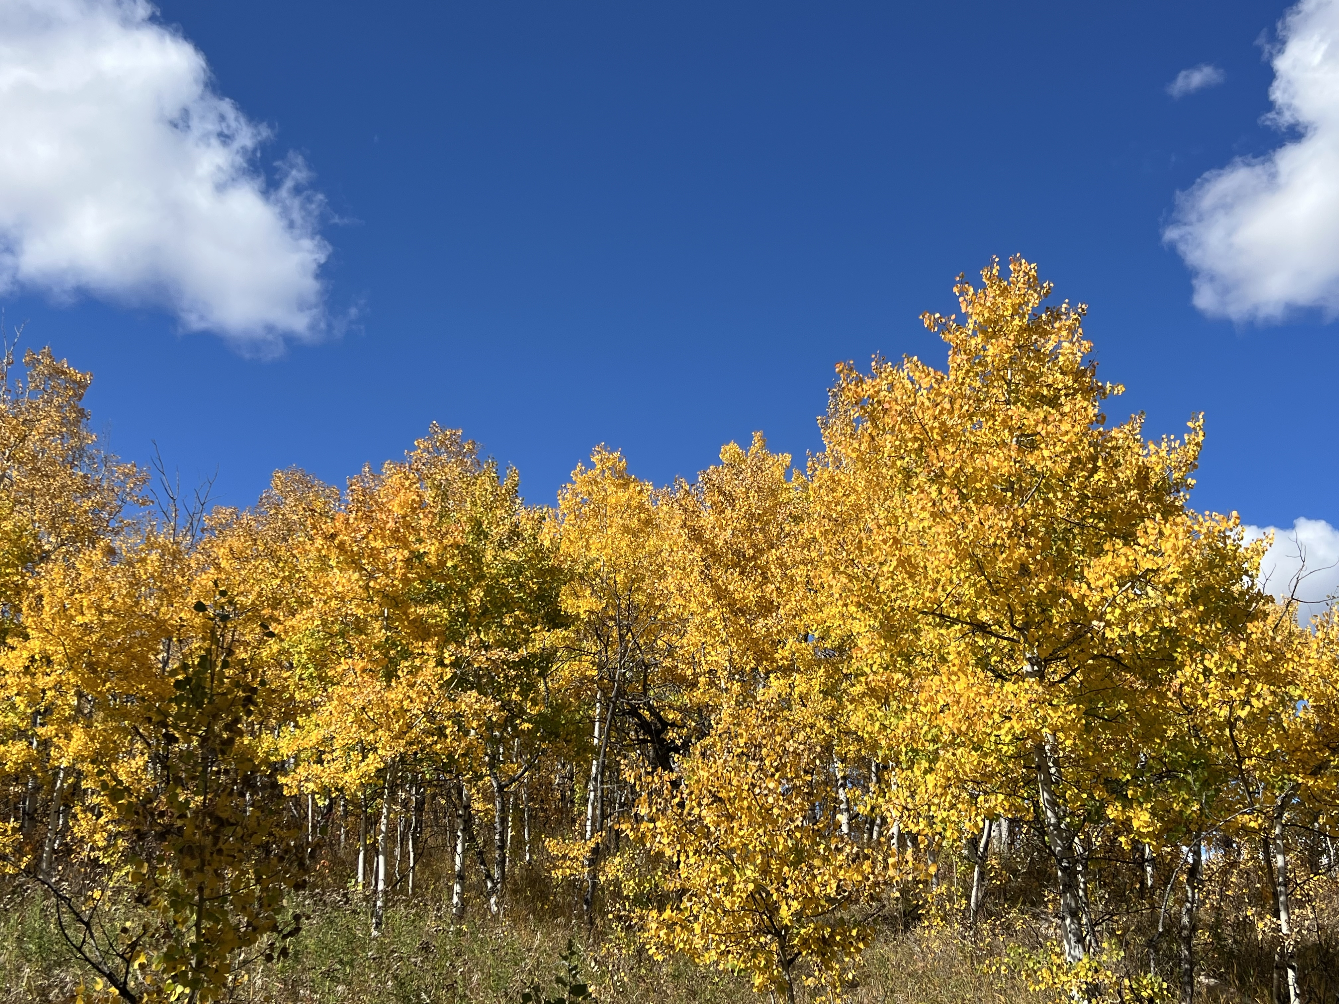
Thank You to our Lunch Sponsors!
GRF Fall Information Session 2024

Slide 15
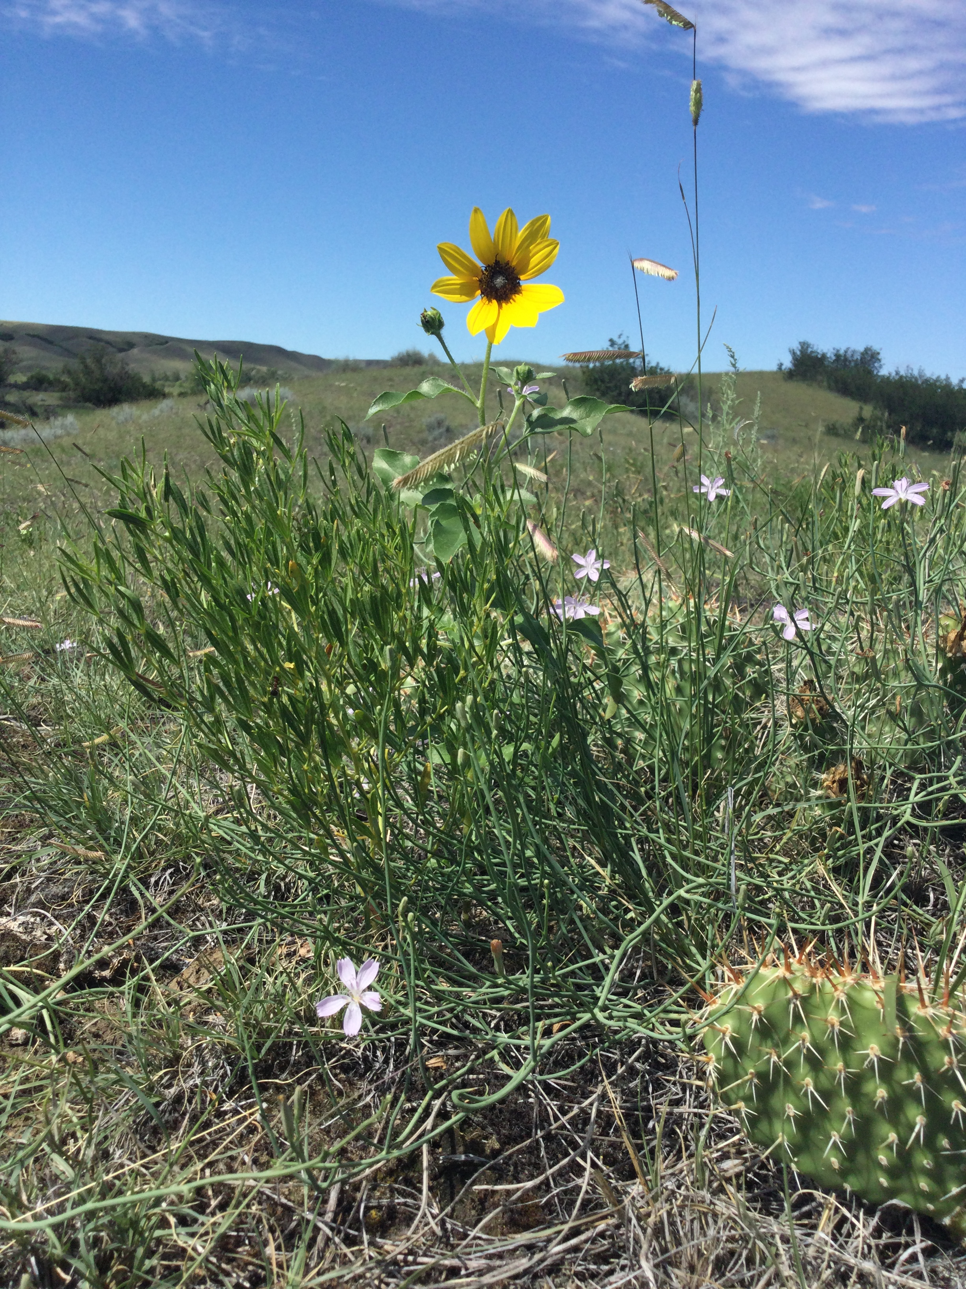
Not on the GRF Mailing List Yet? Sign up at: www.grasslandrestorationforum.ca Follow us on Instagram: @grasslandrestorationforum
Free GRF Winter Webinar Series Coming Early 2025!

Slide 16
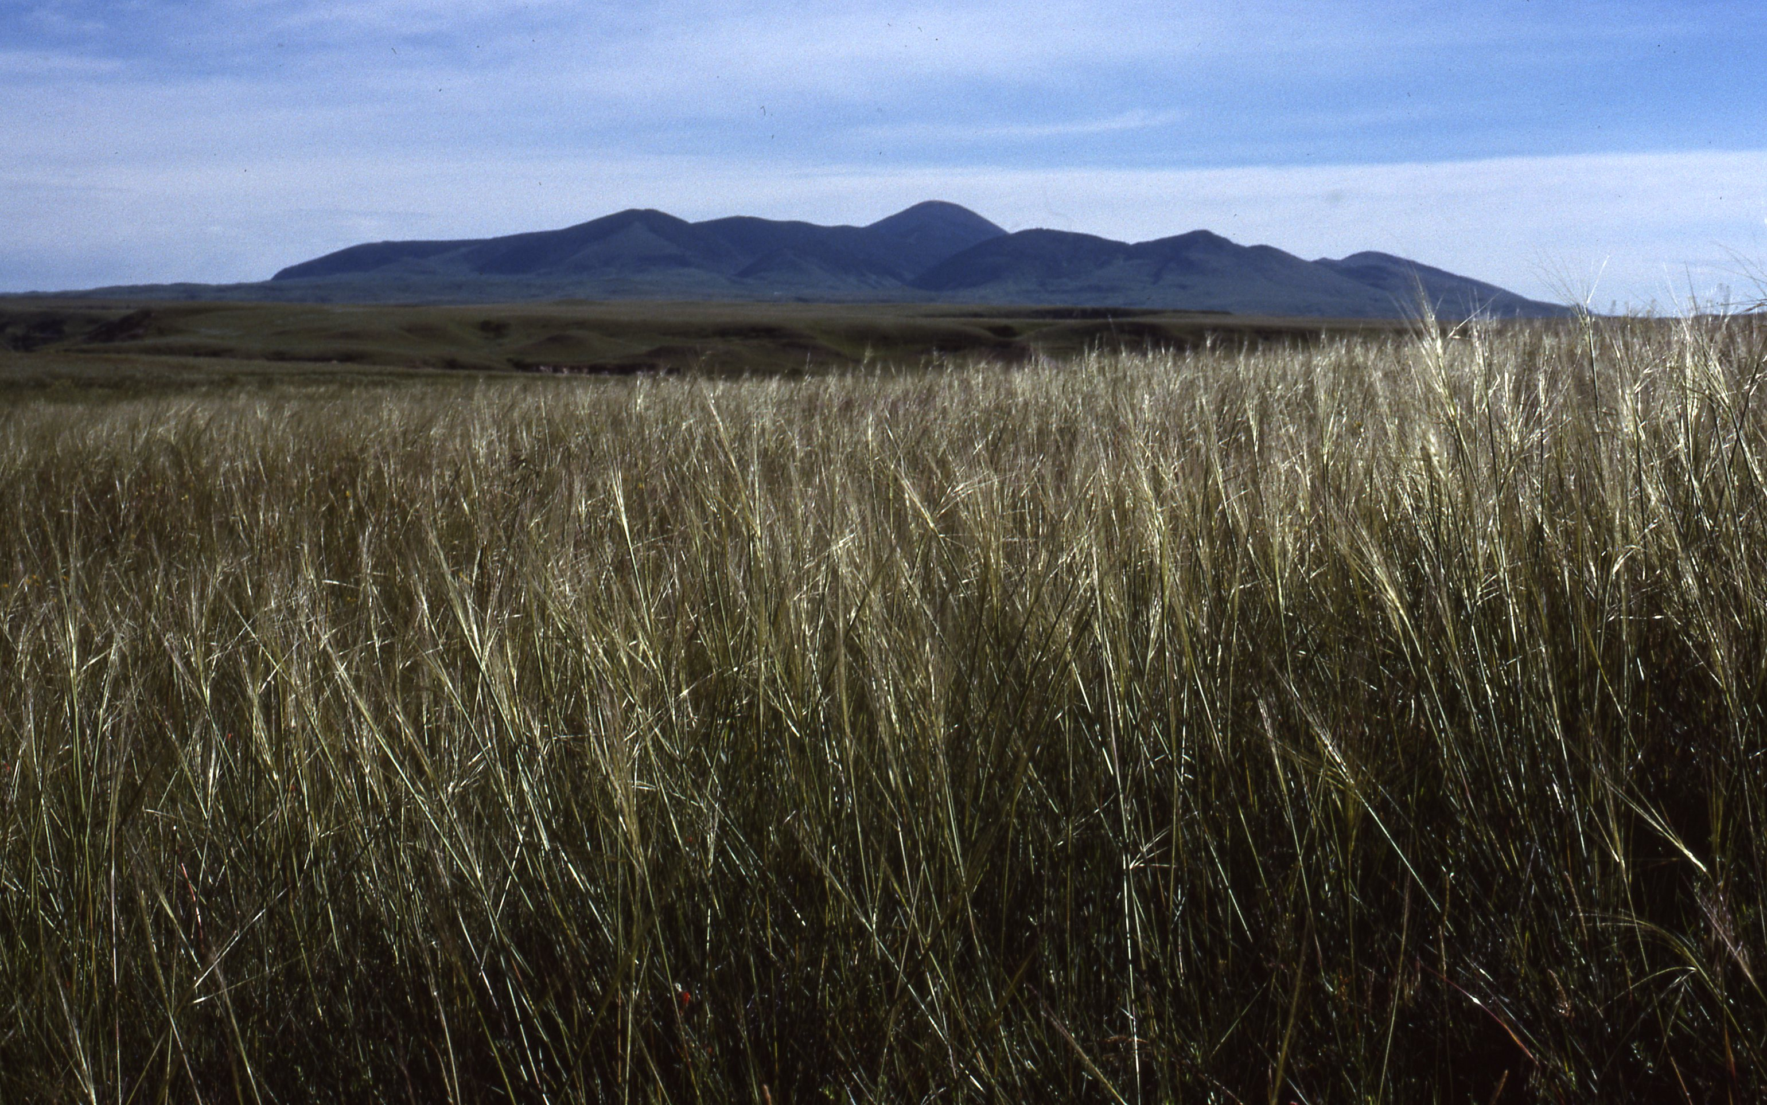
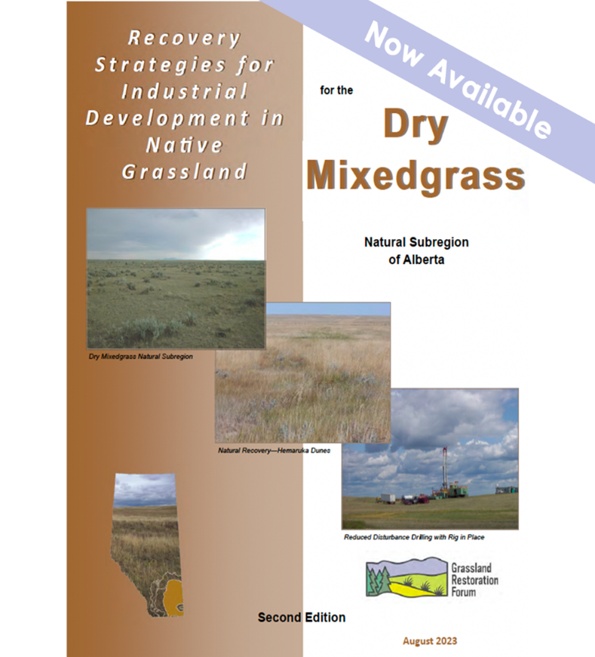
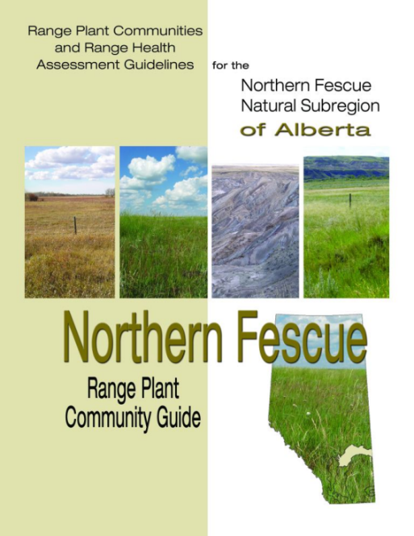
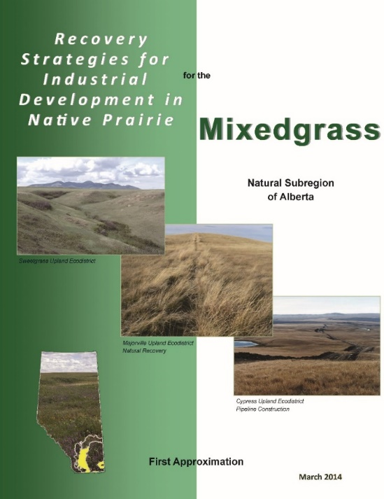
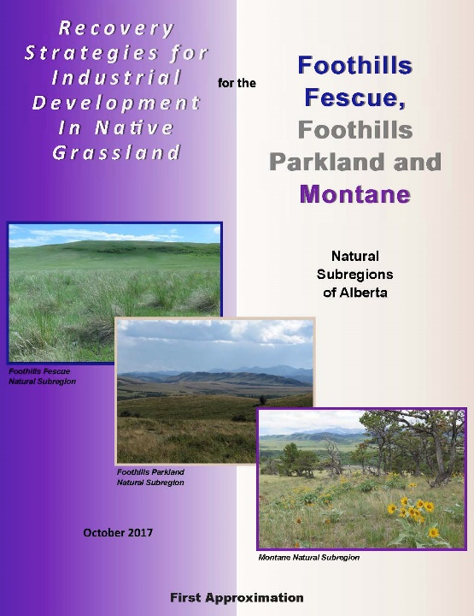
Recovery Strategies
www.grasslandrestorationforum.ca
Notes:
Create guidance based on evidence and experience
Provide expectations of time commitments and effort required to restore disturbances
Identify efficient and cost effective recovery strategies
Not meant to be prescriptive; plenty of room for creativity in reclamation practice.
Completed manuals for each NSR in grasslands and grasslands in surrounding foothills, parkland and montane
Available free as pdf or hard copy for subsidized price

Slide 17
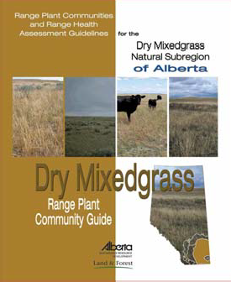
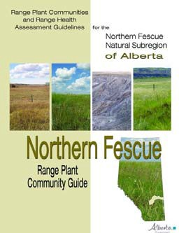
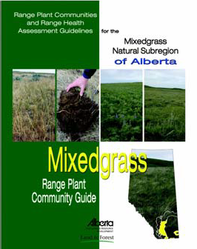
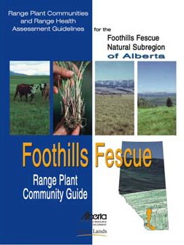
Range Plant Community Guides
www.grasslandrestorationforum.ca
Notes:
Create guidance based on evidence and experience
Provide expectations of time commitments and effort required to restore disturbances
Identify efficient and cost effective recovery strategies
Not meant to be prescriptive; plenty of room for creativity in reclamation practice.
Completed manuals for each NSR in grasslands and grasslands in surrounding foothills, parkland and montane
Available free as pdf or hard copy for subsidized price

Slide 19
Silver Level Sponsor Grassland Restoration Forum Fall Information Session 2024

Slide 20
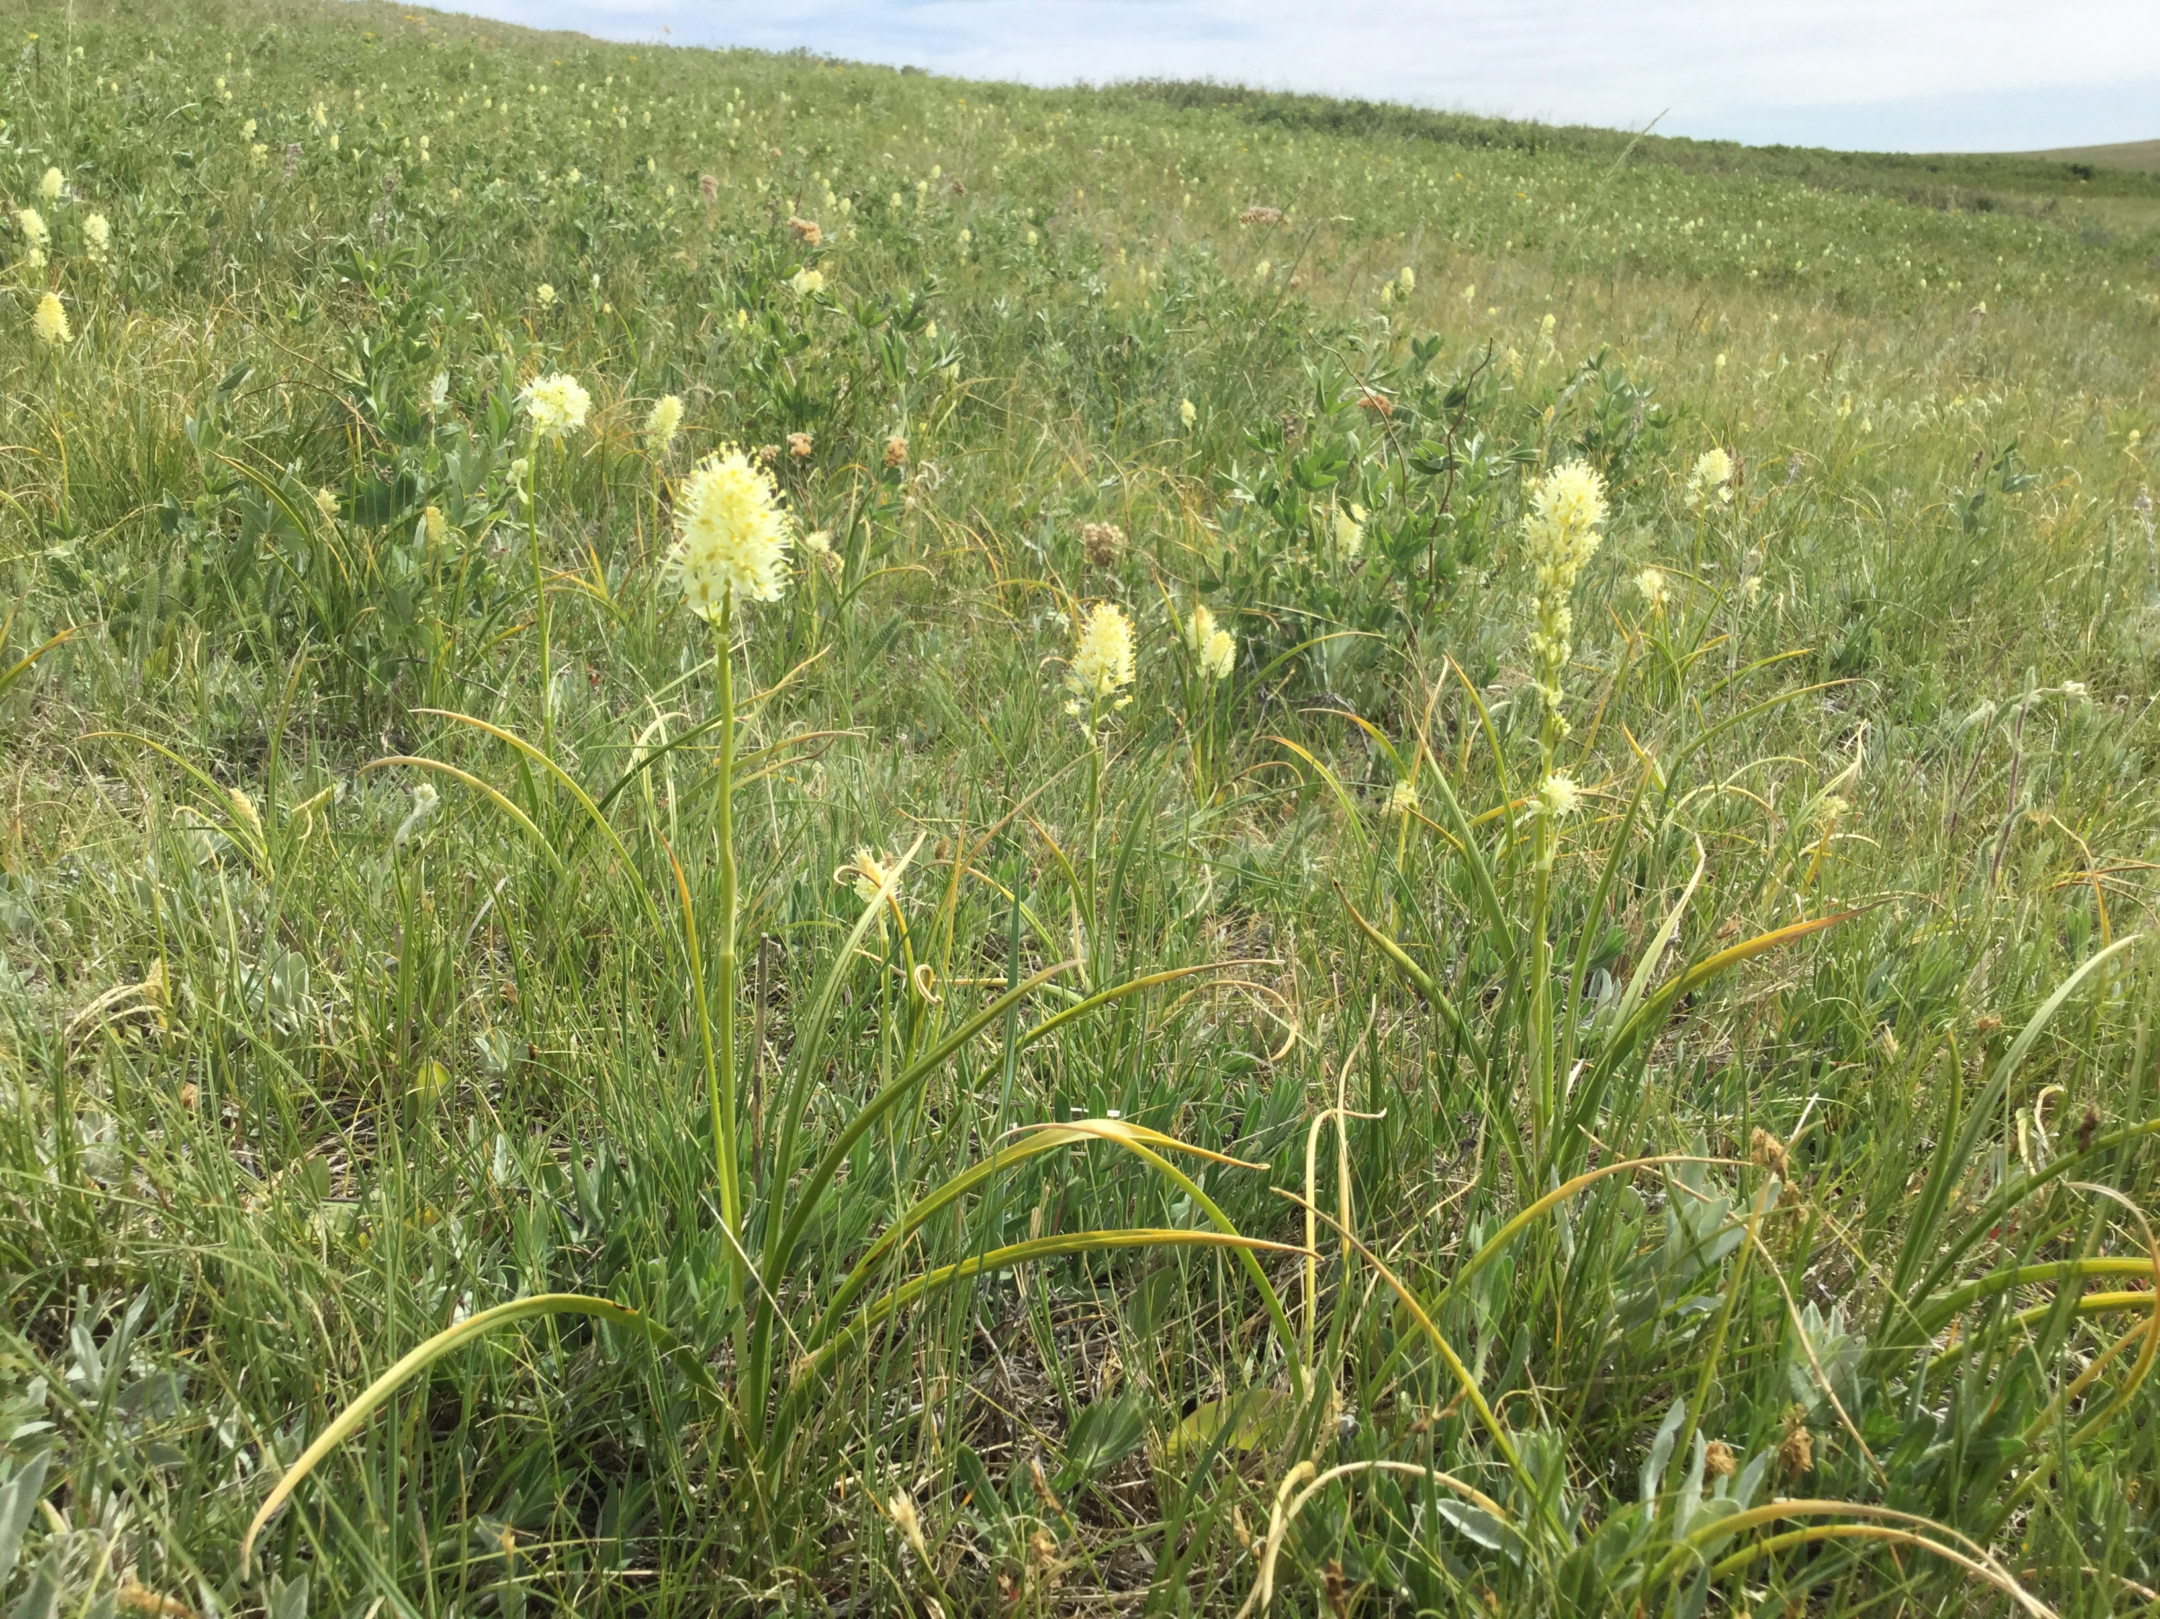
Silver Level Sponsor
Grassland Restoration Forum
Fall Information Session 2024

Slide 21
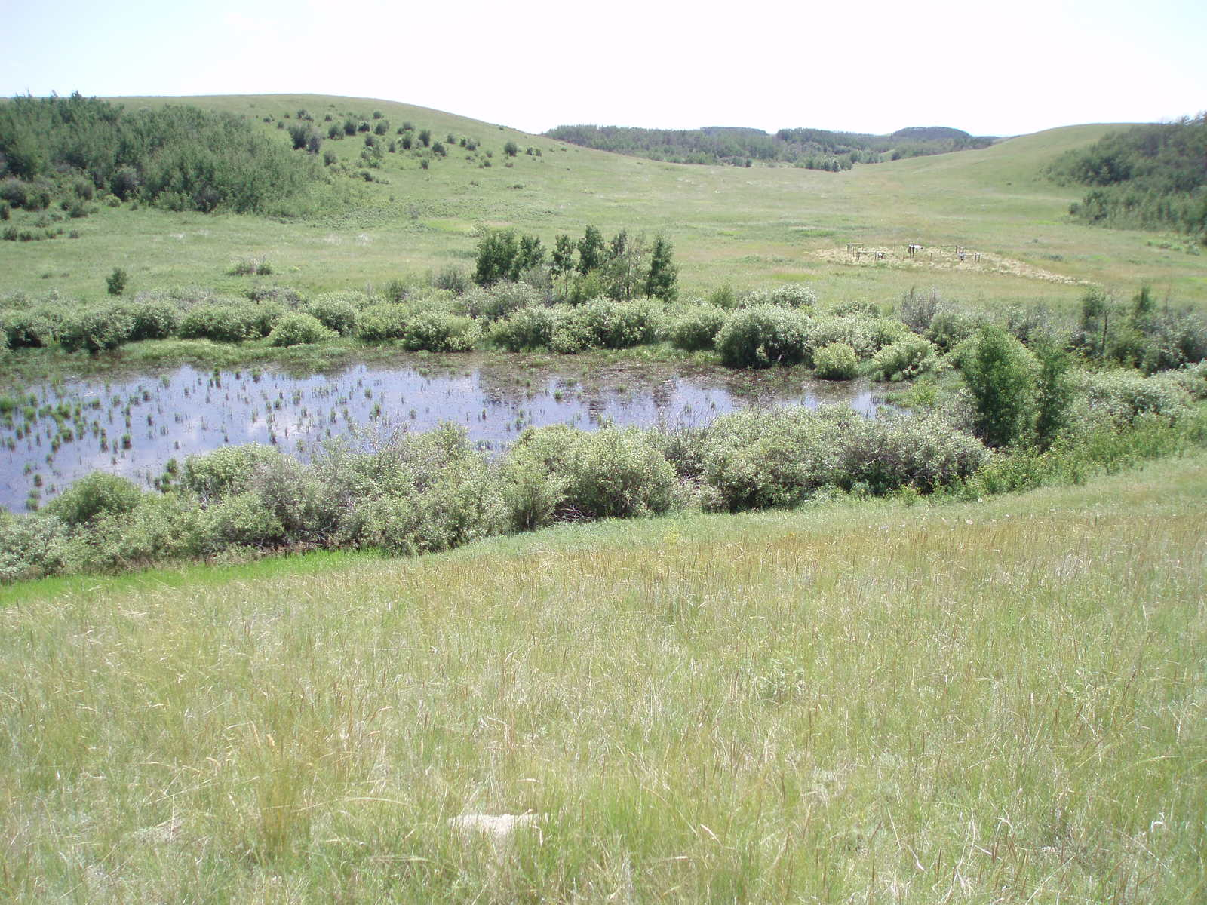
Gold Level Sponsor
Grassland Restoration Forum
Fall Information Session 2024

Slide 22
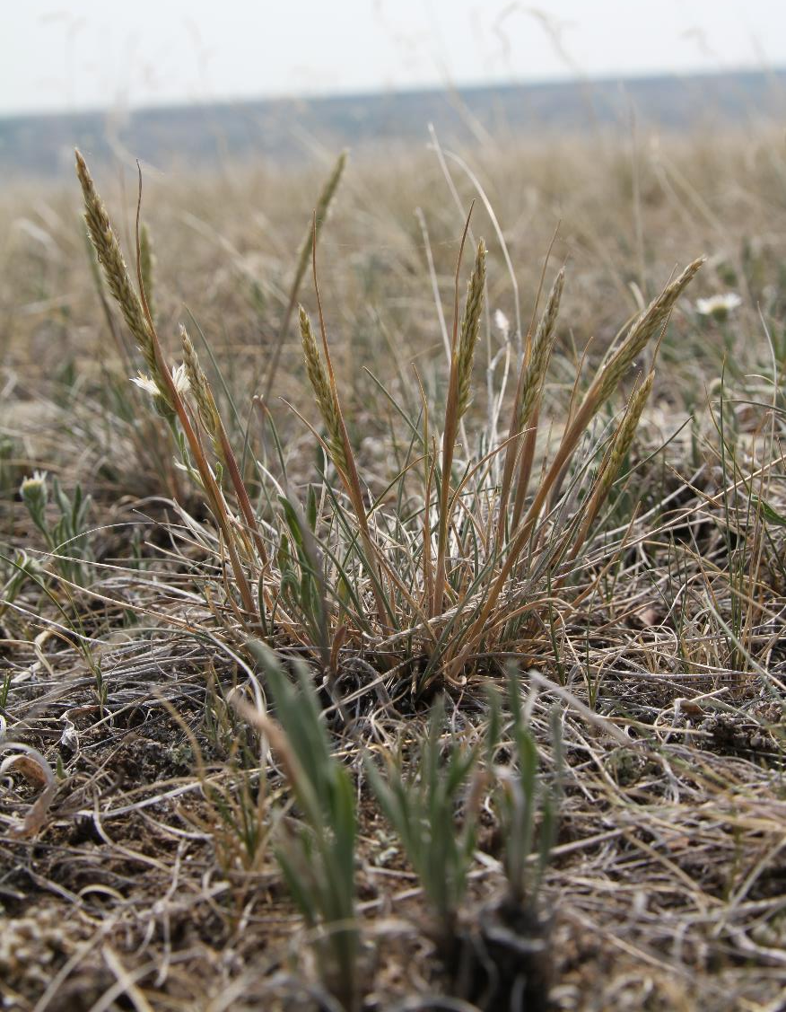
Concerned About Local Native Seed Supply In Alberta? So Are We
The Southern Alberta Native Seed Collaborative (SANSC), with support from the Grassland Restoration Forum, seeks to increase the availability of suitable, high quality, regionally adapted native seeds for use in restoration projects in Alberta.
Want to get involved?
www.grasslandrestorationforum.ca

Slide 23
Visit the Information Portal www.grasslandrestorationforum.ca

Slide 24
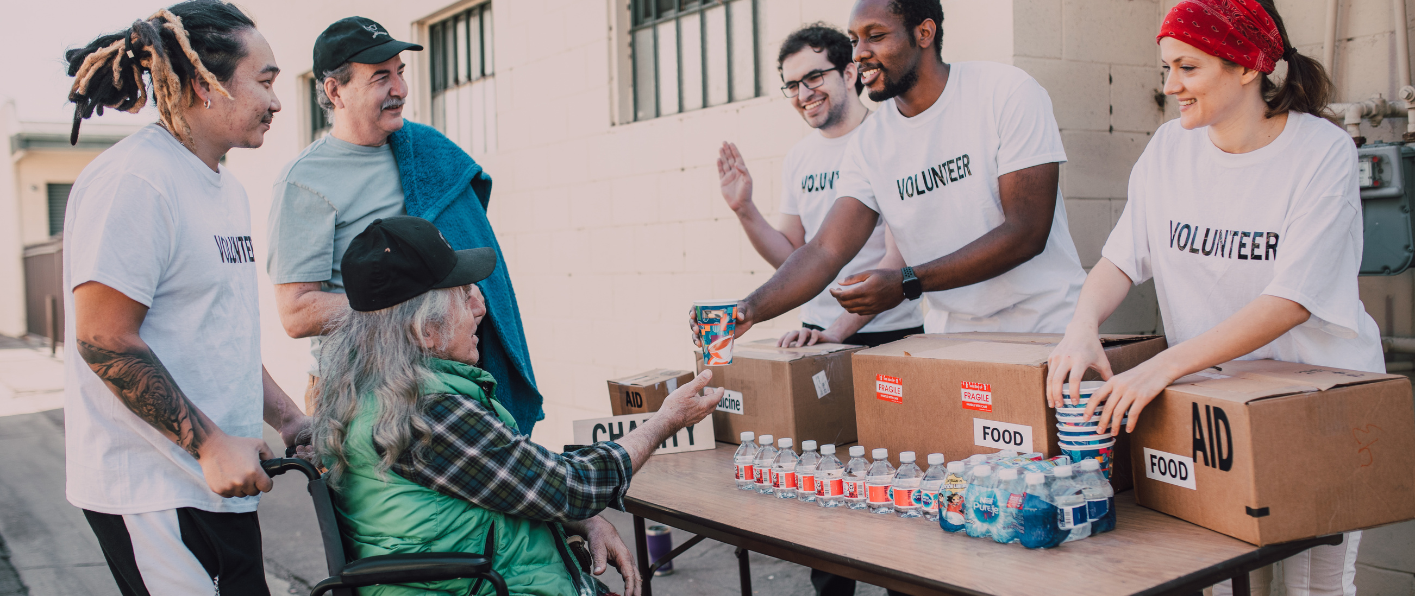
Native Seed Harvesting Information for Landholders
Check out this new primer under the Information Portal www.grasslandrestorationforum.ca

Slide 25
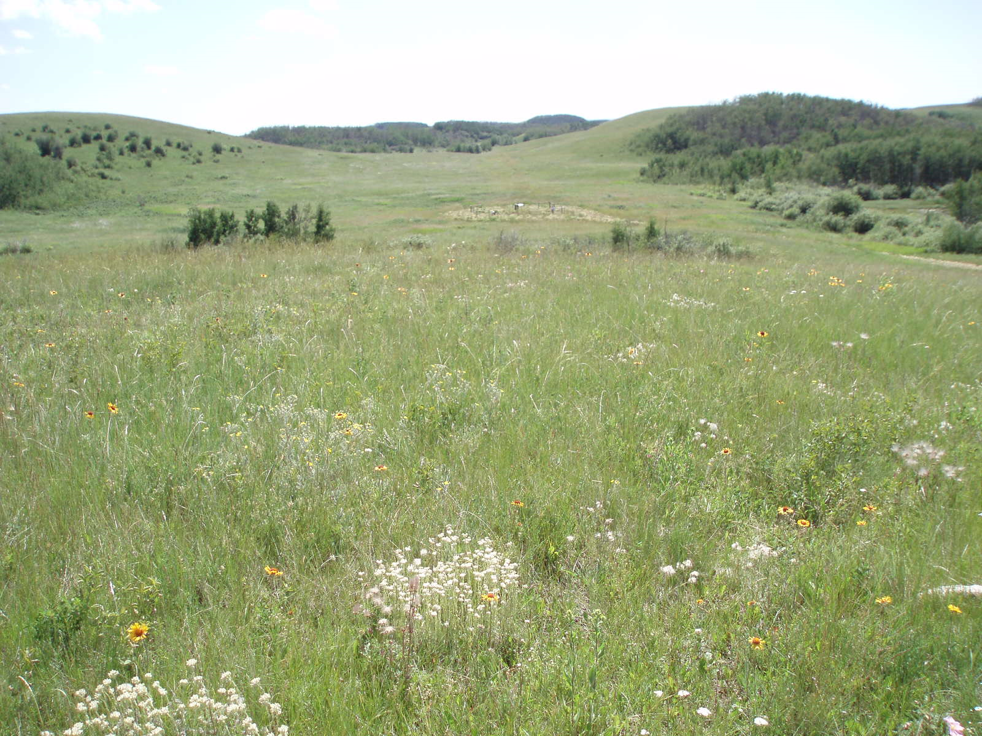
Thank you to the many volunteers
and GRF staff who made the
2024 Fall Information Session possible!
Ross Adams - Forestry and Parks, Government of Alberta (GOA)
Diana Boxma - AEP, GOA
Ashley Dettmer - BrettYoung
Sheryl Faminow - Retired
Jillian Kaufmann - TC Energy
Brian Lambert - North Shore Environmental Consultants
Jane Lancaster - Kestrel Research (GRF Coordinator)
Marshall McKenzie - Innotech Alberta
Lee Moltzan - Nature Conservancy of Canada (NCC)
Natasha Page - AEP, GOA
Tara Shackleton - Western Sky Land Trust (Conference Chair)
Alia Snively - NCC
Kyle Rast - Centre Peak Ground Repair
Donna Watt - Corpirate Services (GRF Resources Coordinator)
Kelli Woodman - Alberta Energy Regulator
And the many TAC members who jumped in where needed!
Notes:
Thank you to our Sponsors!

Slide 26
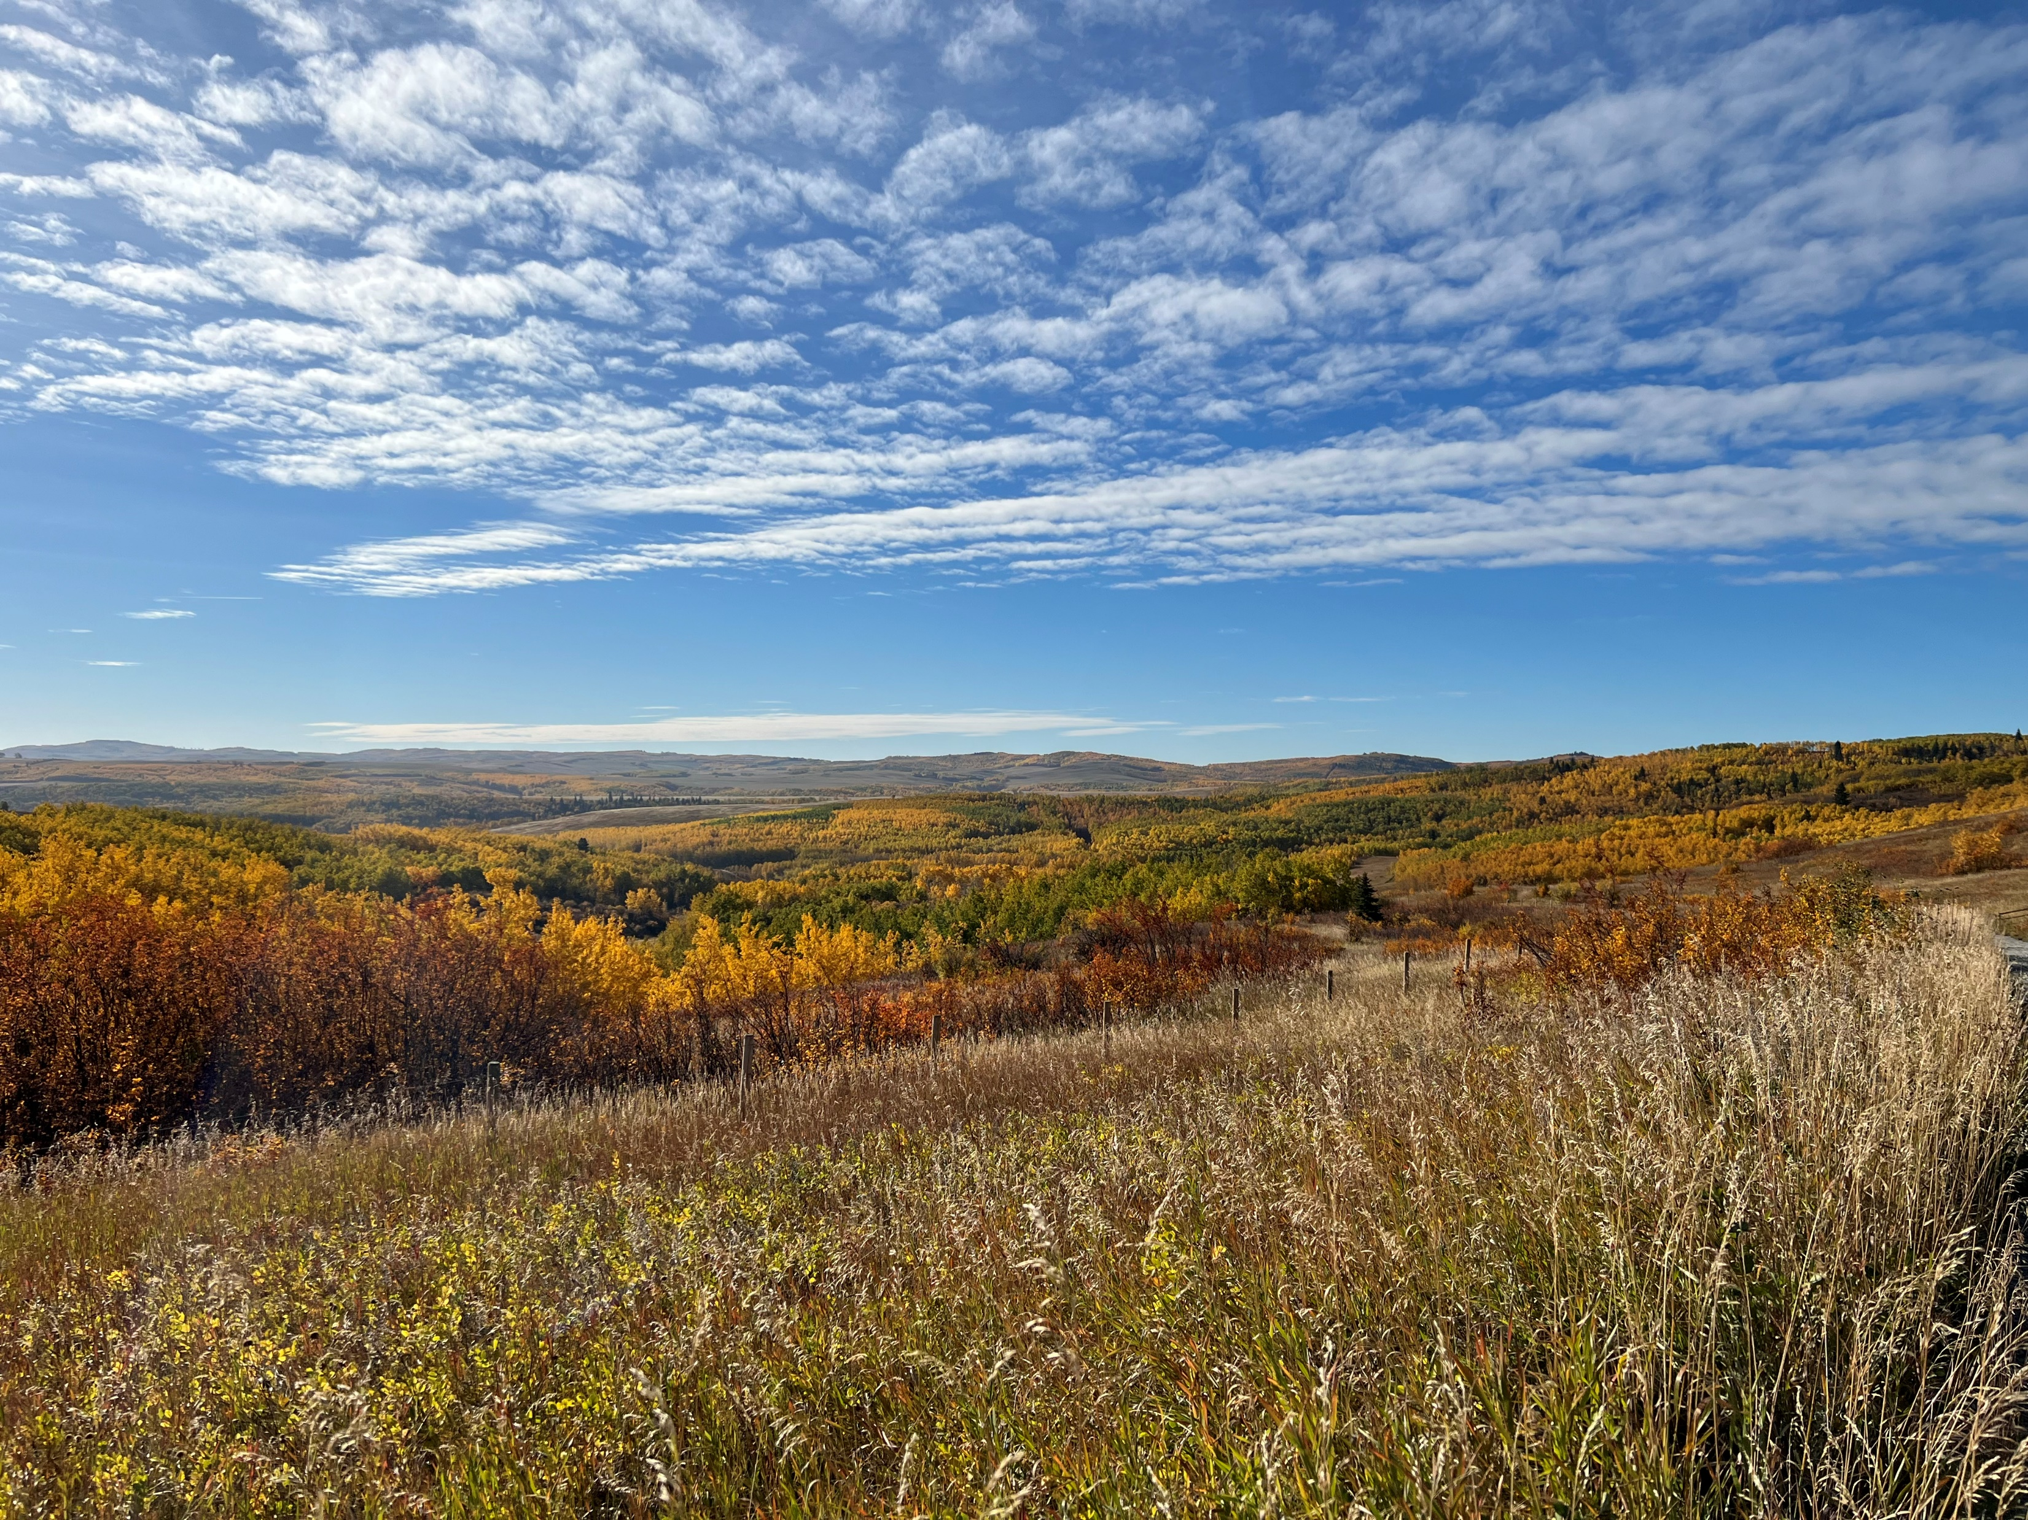
Gold Level Sponsor
Grassland Restoration Forum
Fall Information Session 2024

Slide 27
Support the Grassland Restoration Forum!
The GRF is a Non-Profit Organization administered through the Southern Alberta Sustainable Community Initiative (SASCI).
You can donate to the GRF by autodeposit to admin@sasci.ca
Donations are gratefully used for organizational expenses that cannot be covered by grants.

