Slide 1
Reclamation on the AltaLink 551L transmission line rebuild in Banff National park: Challenges And Lessons Learned

Slide 2
The project
57 km transmission line rebuild from Banff to Lake Louise in Banff NP
Construction over 5 yrs (2016-2020)
475 structures replaced
Varied terrain and microsites: rocky cliffs, dry steep slopes, valley bottom flat sites, wetlands
Notes:
The project: AltaLink rebuilt their 57 km transmission line from Banff to lake Louise between 2016 to 2020 as the transmission line was at the end of its life cycle. The new powerline was built on the same row with every structure (every pole) and the conductor being replaced over the course of the project. This project had a lot of logistical challenges with steep slopes, rocky cliffs, creek and wetland crossings and lots of challenging access issues.

Slide 3
Notes:
Avens has been involved since 2012 on this project. Avens was involved in the planning phase, we wrote the Environmental assessment, we did construction monitoring, and also wrote the reclamation plans. The reclamation on this project was a team effort between Avens, Grumpy’s greenhouses who grew the plants and Vitae Environmental that did the reclamation work. In the field I also did the reclamation monitoring on the project.

Slide 4
Project Activities
Cleared danger trees along the edges of the ROW (logging)
Built by-pass line for each section of the line (new temporary transmission line)
Constructed the new sections of line
Salvaged the temporary bypass line and structures and took them to the next section
Notes:
Danger tree clearing
Rebuild: During the rebuild the line was divided into 19 sections
During each construction season the sections to be built had a second temporary line built beside the permanent line so they could transfer power to the bypass and then rebuild the mainline when it was deenergized. This resulted in twice as much disturbance as there was as many bypass strs installed as there were mainline structures.
Once the rebuild was done in each section then the temporary bypass line was salvaged and moved to the next section.

Slide 5
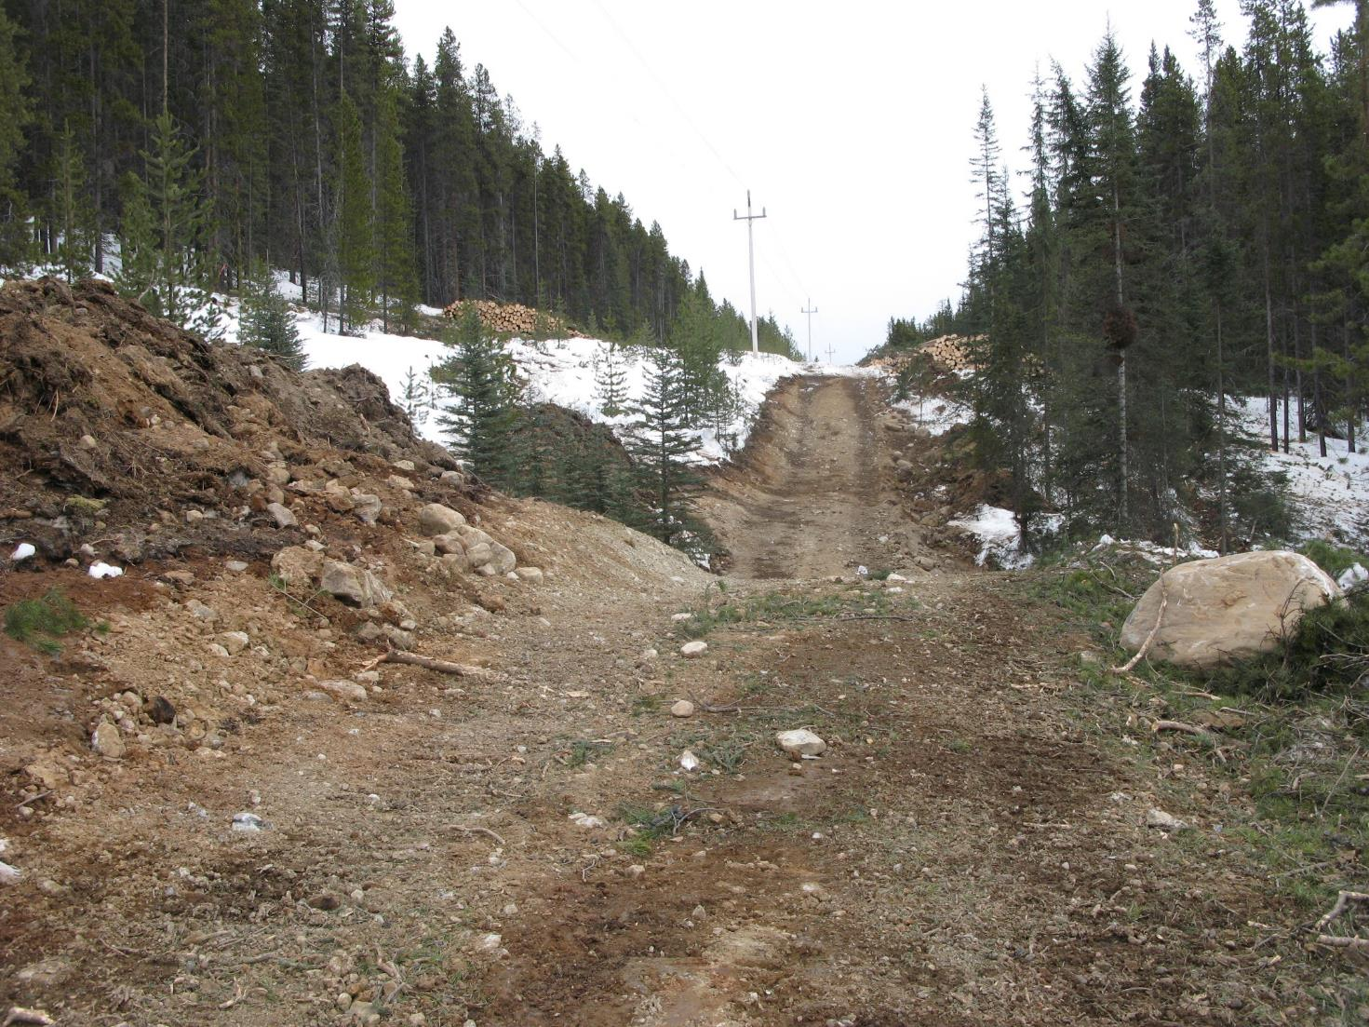
Notes:
The first phase of the project in each section was building access for machinery to travel along the row. This involved a lot of cut and fills on steep sections of the ROW.

Slide 6
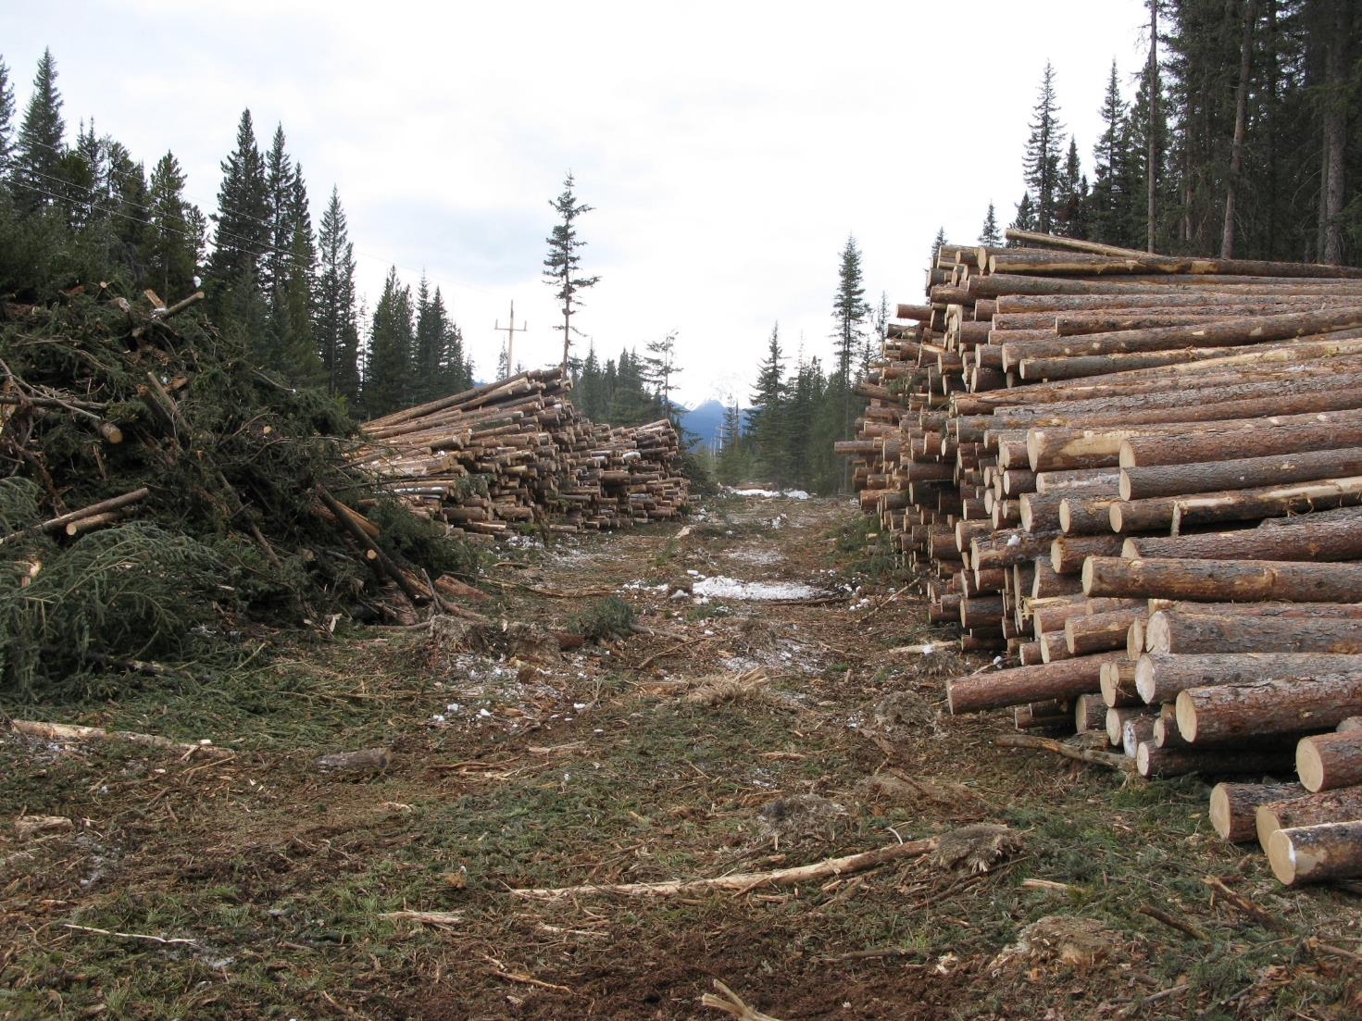
Notes:
Danger tree removal resulted in a lot of tree removal in some areas, hundreds of loads of logs were removed the right-of-way.

Slide 7
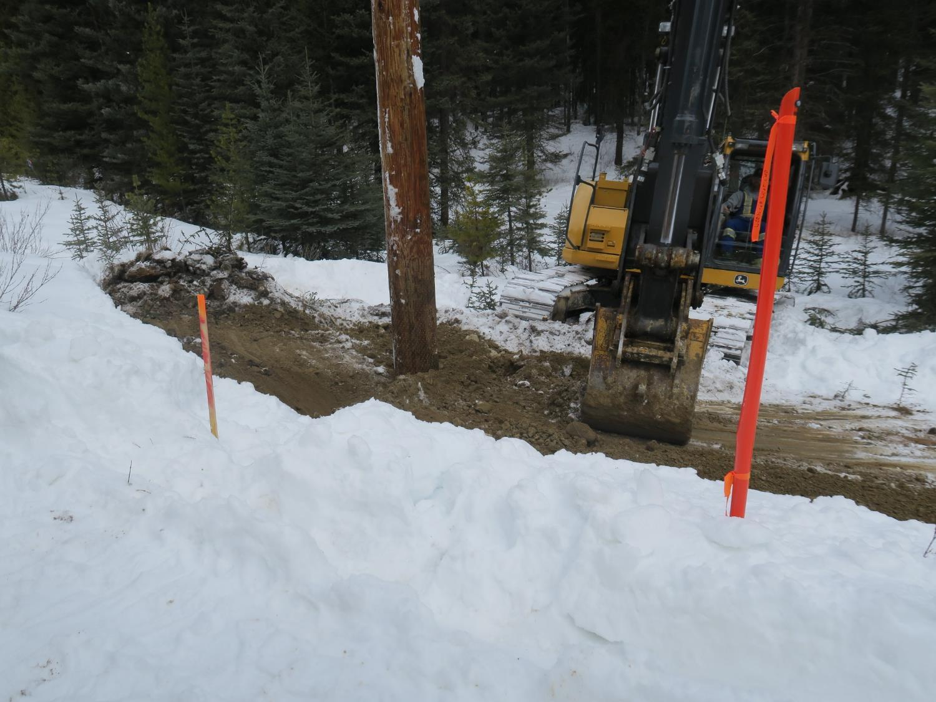
Notes:
Most str and by-pass str were installed in the ground using an excavator that dug a 3-4m deep hole and then backfilled it. A few strs were installed with a spider hoe in sensitive areas.

Slide 8
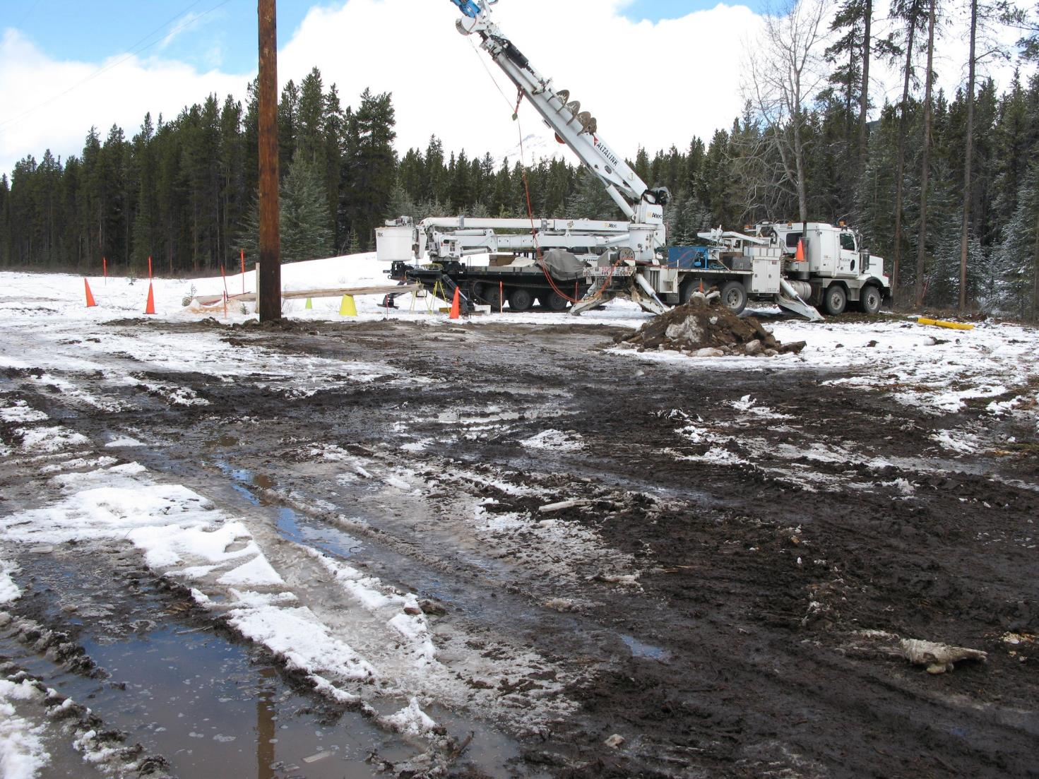
Notes:
Then they replaced the structures and the conductor in each section . And then salvaged the bypass line. Again Hundreds of machine trips down the ROW.

Slide 9
Reclamation Objectives
Stabilize the soil
Restore hydrology of the site
Restore native plant community that provides same ecosystem services as undisturbed reference sites on the ROW
Control weeds and prevent spread to new locations
Notes:
No erosion, restore hydrology meaning restoring groundwater flow regimes by recontouring slopes to original , restore native plant community, control weeds

Slide 10
Reclamation challenges
Large scope: more than 15 ha to reclaim over 57km
Multi-year project requiring steady supply of native plants
Many different ecosites on ROW from dry south slopes to wetlands
Travel along ROW during summer is mostly on foot
Accesses needed to be reclaimed
Pre-existing weeds
Notes:
This project came with a lot of challenges. First of all the shear scope of the project. There was more than 150,000 M2 ha of disturbed area that had to be reclaimed. It was also a multi-year project and we needed to have a steady supply of native plants and seed over 5 years. Then there were the many different ecosites on the row that we had to reclaim. In addition there is almost no machine access on the ROW during the summer due to uncrossable streams and wetlands. So almost all of the reclamation was done on foot. In some limited cases plants were brought in by helicopter or by UTV. And as in every project there were weeds to contend with.

Slide 11
Pre-planning
Recorded all vegetation communities along 57 km of right-of-way
Collected seed of dominants in each community
Started growing plants in greenhouse 1-2 years prior to construction in each section
Notes:
In the planning phase of this project I recorded all vegetation communities and dominants along the entire 57 km ROW. Then we collected seed on the ROW in the year before construction started so that Grumpy’s could grow an initial set of the plants. And then seed collection continued every year after that to ensure a steady supply of plants. Not surprisingly commercial seed from a local source is just not that available for the mountain parks. We also needed seed collected from the park to ensure good success in such a harsh environment.

Slide 12
Mitigation during construction vital to reclamation success
Used smaller machines in sensitive terrain
Reduced average disturbance size at structures by 50% from year 1 to year 3
Winter construction and hard snow roads
Notes:
One thing we learned in the first year of the project was that with a lighter touch on the landscape (i.e. using smaller machines in sensitive terrain) and reducing the avg size of disturbance areas for each structure saved a lot of time, effort and money in the reclamation phase.

Slide 13
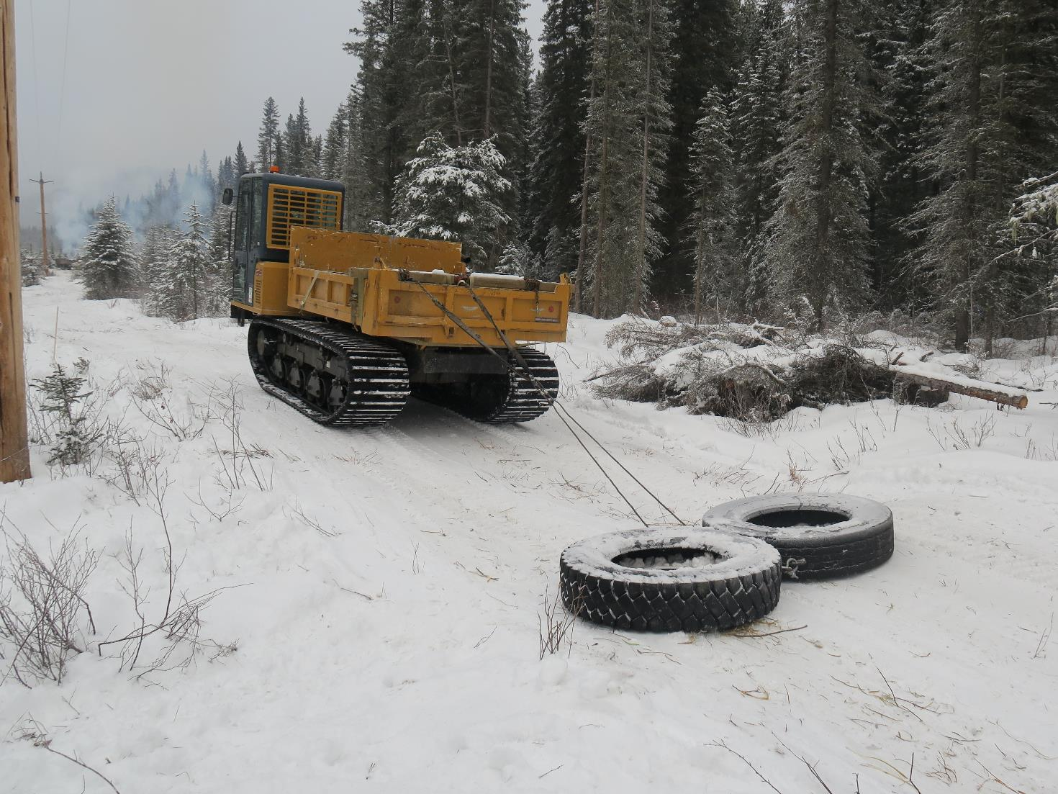
Notes:
Winter construction was key to reducing ground disturbance between structures. Before any larger machines accessed the ROW they packed hard snow roads to drive the frost in deeper with smaller machines. Even in wetlands there was no disturbance from hundreds of machine trips.

Slide 14
Topsoil handling
Success in restoring native plant communities is largely determined by the soil
Proper soil handling can reduce reclamation effort drastically
Machine operators are a vital part of the reclamation team
Notes:
So over the years on this project and others I came to the conclusion that if topsoil was stripped correctly, handled minimally and put back on a disturbed area you could get a native plant community re-established even if you did nothing else. So hence the idea that 80% of reclamation success comes from how soil is stripped and handled during construction. So given this it is important that machine operators are aware of the importance of good topsoil handling and have the skills to do it properly. In other words successful reclamation starts as soon as soil is disturbed.

Slide 15
Notes:
In this photo you can see the stored topsoil on the side of the cut and fill. Note that soil is not stored in a huge pile but in a long windrow beside the trail. Small pile size (width and height) is critical to maintaining high oxygen levels in the topsoil. This keeps the bacteria, fungi, and invertebrates alive that do all the nutrient cycling in the soil. We never covered topsoil on this project either for the same reason. Covering the topsoil causes the pile to go anaerobic and you rapidly lose productivity of the soil. Also topsoil has generally low erodibility in the course soils of the mountains as it has lots of “roughness” associated with rocks, roots, plants etc. and therefore there is no need to cover it.

Slide 16
Notes:
At structure sites the topsoil was replaced frozen on the disturbed area before machines left the site at the end of March. It resulted in lots of large sods sitting on the surface. These sods and chunks were then broken down and/or keyed into the soil by the reclamation crew to provide a good bed for seeding and planting.

Slide 17
Planting and seeding
Reclaimed >150,000 m2
Planted >350,000 forbs, grasses, and shrubs
Planted in May-June or September-October (seeding mostly in fall)
Notes:
The scale of this project required a lot of coordination between myself as the reclamation specialist, Grumpy’s greenhouse and the Vitae reclamation crews to make sure we had the right plants for each area and each shift for the reclamation crew.

Slide 18
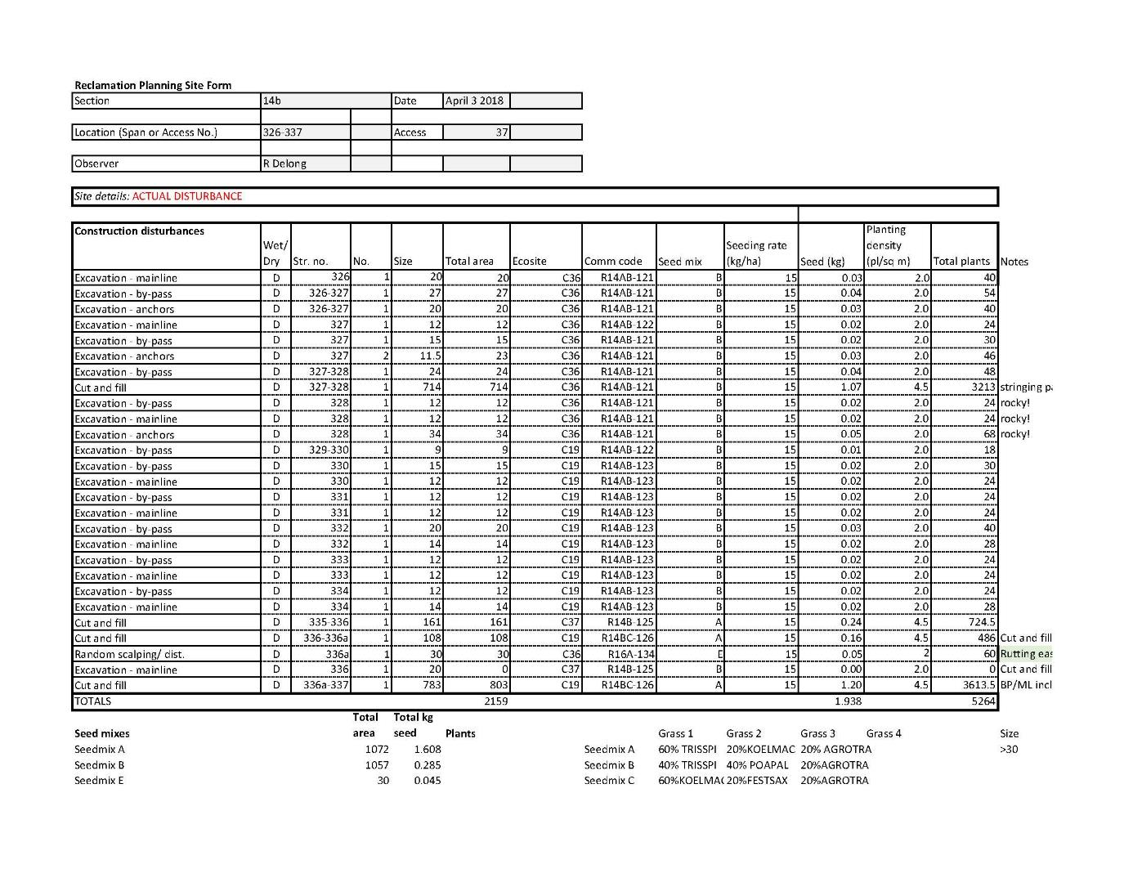
Planning for planting/seeding
Notes:
We used a spreadsheet with details of what was to be planted and seeded at each specific site. For each disturbance there was a code that referred back to the plant community database so the growers (Grumpy's greenhouse) could send up the plants required for each section to be reclaimed. For seed mixes we ordered bulk seed of each species so we could make custom mixes according to the ecosite we were in. We made 7 mixes with 6 species over the course of the project but every seed mix had wheatgrass.

Slide 19
Notes:
Vitae set up a temporary nursery each season in the AltaLink yard in Mannix pit in the park just off the TransCanada. This was hooked up to an automatic watering system and plants were brought up all season from the grower’s nursery.

Slide 20
“dirtwork” required prior to planting each site
Notes:
The topsoil chunks sods at the structures were buried and broken down in the spring to prepare the site for seeding and planting. If you walked away from the site at this stage you would get a native plant community within 5 years. The sods had all of the seeds/rhizomes and plants present in the original vegetation community because it was stripped in the winter, and then replaced. Handled only once.

Slide 21
Notes:
This picture shows the crew laying out Plants prior to installation..

Slide 22
Reclamation monitoring
Reclaimed areas were monitored for a minimum of 3 years post-reclamation
Assessed against established criteria:
Minimum 60% of plant cover compared to reference site on ROW
Minimum 15% of litter cover compared to reference site
Soil/ site is stable
No weeds
Notes:
These criteria were adapted from provincial reclamation criteria (percent cover was upped from 50% to 60% for this project). After using these criteria for the last 4 years they have proved to be robust. That is when a site meets these criteria it generally has a native plant community re-established that is resistant to weed invasion (unless they were pre-existing on the site). Also they match what any layperson that walk up to a site would consider reclaimed (i.e. they are green, lots of plant species, no weeds, no erosion evident).

Slide 23
outcomes
Every site monitored and tracked in spreadsheet until it made criteria
Almost all sites made criteria in 2-3 years following reclamation
Sites not making criteria
Strategies adjusted
SOLUTIONS

Slide 24
Lessons learned about seeding
Seeded grasses provide fastest cover but many species are only “placeholders” for later successional species
In BNP seed mixes had 3-4 species only
Quick establishing species (bunchgrasses) die off after 5 years and other species occupy that ground over time
Notes:
All of our grasses had 3 or 4 species only. People ask me why my seed mixes have few species. Its because the dominant late successional grasses hairy wild rye and pine grass will eventually occupy the sites but cannot be seeded (seed generally not commercially available). These species will not grow from seed. So we seeded a mix that would establish quickly and then added plugs of these late successional grasses that would eventually take over.

Slide 25
Example “placeholder” species
Poa palustris (fowl bluegrass) has become a highly used species
Bunchgrass that establishes quickly
Relatively cheap, easy to find
Dies off over ~ 5 years but provides excellent litter
Notes:
All of our grasses had 3 or 4 species only. People ask why my seed mixes have few species. Its because the dominant late successional grasses hairy wild rye and pine grass will eventually occupy the sites but cannot be seeded. So we seeded a mix that would establish quickly and then added plugs of late successional grasses that would eventually take over. Also generally many seed mixes with lots of species in them will only have 1-3 species establishing readily from seed in the mountain ecosystems. This results in lots of expensive native seed going to waste as it does not germinate or become established. Our seed mixes had the species that come readily from seed in these ecosystems. It is important to remember that what gets seeded is not what will be in the seeded areas at 5 years, 10 years, 20 years post-reclamation. The role of seeding post-reclamation is to get native species that can establish quickly to occupy ground to aid in soil stabilization and keeping weedy species out. Seeded native grasses also help to rapidly re-establish the topsoil rhizosphere and soil biology which in turn seems to re-establish the natural resistance that native undisturbed soil has to invasion by weeds.

Slide 26
Notes:
Site 2 years after planting/ seeding showing high cover of seeded grasses including the Poa palustris. It should be noted that no fertilizer was used at all on this project. The only thing that was used was a small handful of worm castings in the planting hole of each plug.

Slide 27
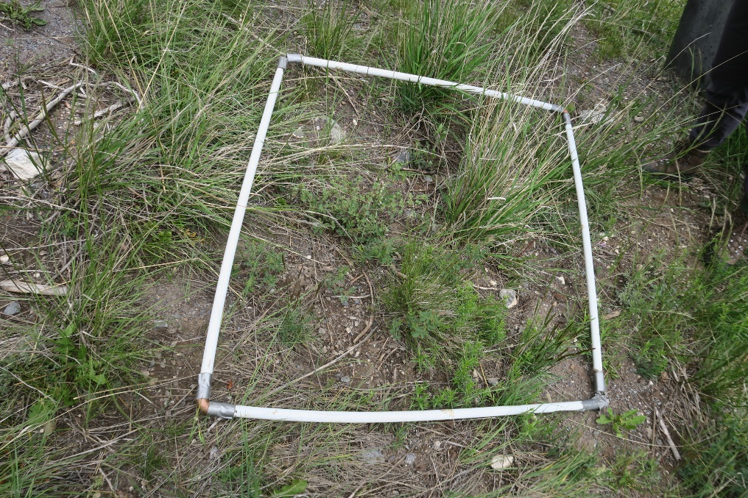
Dry sites with no topsoil: Poor Growth
SOLUTION:
Planting/seeding in early spring
Working in dry hydromulch
Planting groups of plants
Notes:
Dry rocky sites that had <2cm topsoil before construction were challenging. We had to replant many of them. Solution was to reclaim in early spring instead of fall, work in dry hydromulch (Proganics) by hand to add organic matter, plant plugs in groups to create better microsites or islands of vegetation – 3-4 plants per hole, reseed grass but don’t rely on that for plant cover

Slide 28
areaS THAT needed to be accessed twice
Methods used:
Restrip topsoil and replace 2nd time
Drive on trail with topsoil replaced in frozen conditions
Leave topsoil off for several seasons and replace once
Notes:
So as you know projects don’t always proceed from A to B smoothly. On the 551 project a few times early on topsoil was replaced on cut and fills before construction was complete. This led to restriping the topsoil or machines driving on the areas with topsoil replaced in frozen conditions. This resulted in reduced reclamation success. In the latter half of the project we left the topsoil off for 2-3 growing seasons and replaced it once. The difference was dramatic.

Slide 29
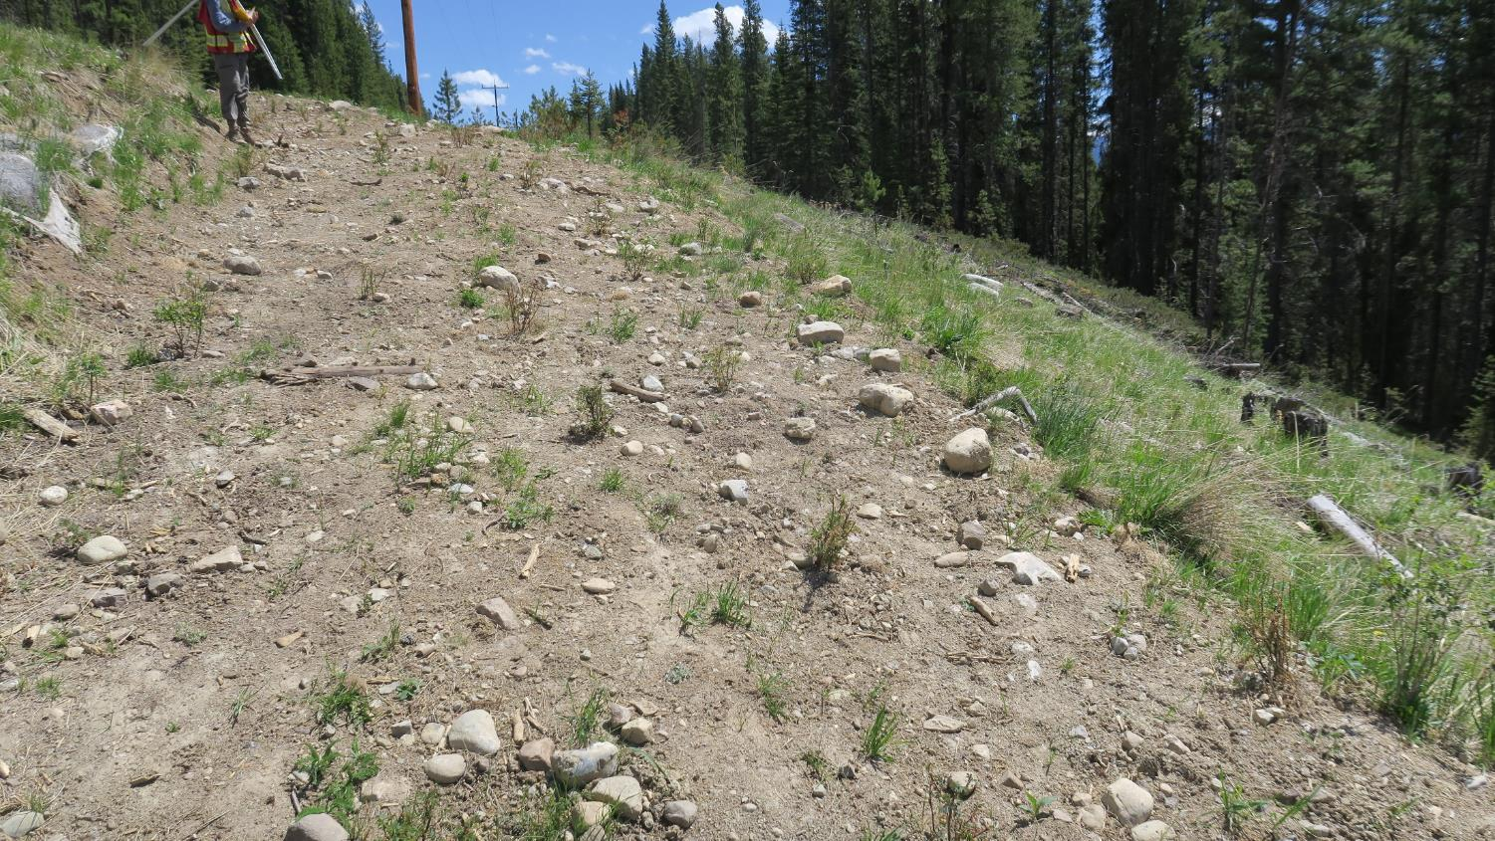
Topsoil replaced and reclaimed 2016, driven on winter 2018-19 with no stripping, devegetated
Notes:
This site required a lot of remedial work to reclaim it again. The reclamation crew worked hydromulch in by hand on this site to bring up the organic matter and allow for seeded grass to germinate.

Slide 30
May 2017 – topsoil off
Notes:
By far the best results came from leaving the topsoil off thru multiple growing seasons and replacing it once all the work was done. No compaction and no loss of topsoil productivity and amount due to double stripping. This is a large cut and fill may 2017. Topsoil was stored on edge of cut on the downhill side. It was not covered but it was seeded with wheatgrass to maintain soil biology.

Slide 31
June 2019 – topsoil replaced, planting and seeding
Notes:
This photo is taken 2 years later. Topsoil replaced in March 2019. Then planting and seeding happened 3 months later.

Slide 32
June 2021 – reclaimed trail meets reclamation criteria
Notes:
So after storing the topsoil for 2 years in a rocky site with little topsoil, handling it only once, replacing it over 2 years later we met the reclamation criteria in only 2 years. Again to my point about topsoil handling being key to reclamation success.

Slide 33
wetlands
54 Wetlands mapped and delineated on the ROW
Some wetlands had structures in them
Wet fens with thick peat >40 cm left to recover naturally
Notes:
From work on prairie wetlands I was fairly confident that we could leave fens with deep peat to recover naturally following disturbance. Most wetlands were spanned in the rebuild but when a structure had to be placed in a wetland they minimized disturbance areas and we left them to recover naturally.

Slide 34
Notes:
First year natural recovery sites sort of sat there with minimal infill of plants.

Slide 35
Conclusion: Natural Recovery is very effective strategy to restore wetlands
Notes:
By 3 years after disturbance wetland sites had completely filled in.

Slide 36
Weeds
Dozens of pre-existing weed patches on the ROW prior to construction
Significant weed spread when driven over with no snow cover
Solution: avoid weeds on the ROW with machinery during construction
Annual treatments at disturbed sites including hand-pulling and herbicide treatment
Notes:
Lots of time was spent each fall marking weed patches for construction crews to avoid with their machinery during the winter. We also discouraged plowing to ground in the winter to use the snow cover as another barrier to weed spread by machinery. Avoidance was very effective in avoiding weed spread from existing weed patches. The main weed spread observed was from a few weedy areas that were driven on without any mitigation (no avoidance, no snow cover). Machines dragged the weeds for several hundred meters down the ROW and even up to 800 m to the nearest disturbed cut and fill. The thought at the time was to deal with the weed spread after the fact. But those by far were the worst areas, once weeds are established they are incredibly hard to eliminate completely. We have successfully eliminated almost all new weed patches on disturbed sites.

Slide 37
Notes:
Weeds were marked for avoidance during construction. Also hard packed snow on snow roads prevented weed spread as well. Was an effective strategy to prevent spread.

Slide 38
Accesses
Reclaiming accesses has been challenging
Very compacted soils resulting in failure of seed germination
Notes:
We had some almost complete failures the first time some accesses were seeded with no decompaction of soils. That is there was less than one percent cover of seeded grass even though they were seeded heavily. So we knew we had to decompact the soil to get successful grass germination.

Slide 39
Notes:
To get all the logs and allow for machine access filter cloth and thick gravel was laid down on accesses. This gravel was down for 2 – 4 years before being removed and accesses reclaimed.

Slide 40
Notes:
Initially we tried roughing up the soil with rakes at the time of planting and seeding but it was not enough and we got almost no grass germination.

Slide 41
Notes:
After gravel was removed a machine with a ripper attachment was used to rip the compacted soil on the accesses.

Slide 42
Notes:
This is post ripping (generally 15-20 cm deep rip seems to be sufficient to decompact soils and allow for plant establishment)

Slide 43
Notes:
This is a different site but shows hydromulching. All ripped sites were hydroseeded with 25 kg/ha of seed.

Slide 44
Notes:
This is an access two years after ripping and hydroseeding

Slide 45
Notes:
Thought I would finish by showing a series of pictures of reclamation progress on a major cut and fill

Slide 46
Notes:
This cut and fill needed to be hydromulched as the soil was fine textured silty clay with no course fragments (no rock at all). We brought in a portable hydromulching unit just before the frost came out of the ground at the end of march

Slide 47
Notes:
One year post reclamation

Slide 48
QUESTIONS?
Notes:
4 years post-reclamation with a restored native plant community

