Slide 1
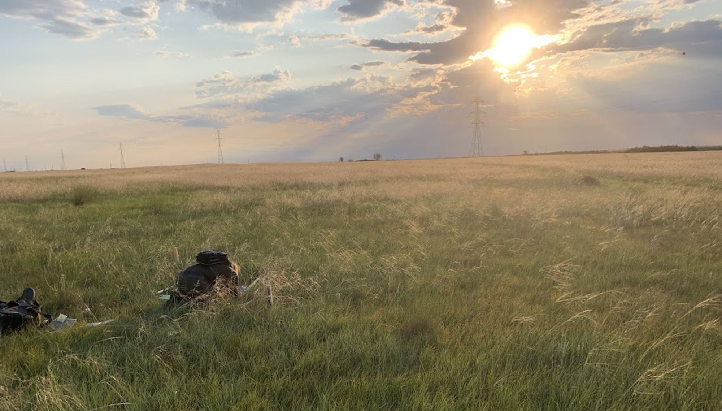
Grassland research forum: eDNA in the grasslands
Porter, Emilie¹ and Harrison, Jori²
¹University of Alberta
²InnoTech Alberta
Notes:
Looking into different questions focused on the detection and repeatability of these DNA based methods to determine how robust and sensitive DNA metabarcoding methodology can be in Alberta ecosystems.

Slide 2







Thank you
Extend grateful acknowledgement to Alberta Innovates, Innotech Alberta, University of Alberta, Mitacs Accelerate grants.
We would also like to thank Diane Haughland, Scott Nielsen, Brian Eaton, Sue Koziel for support and supervision
Notes:
ANYONE I AM MISSING?

Slide 3
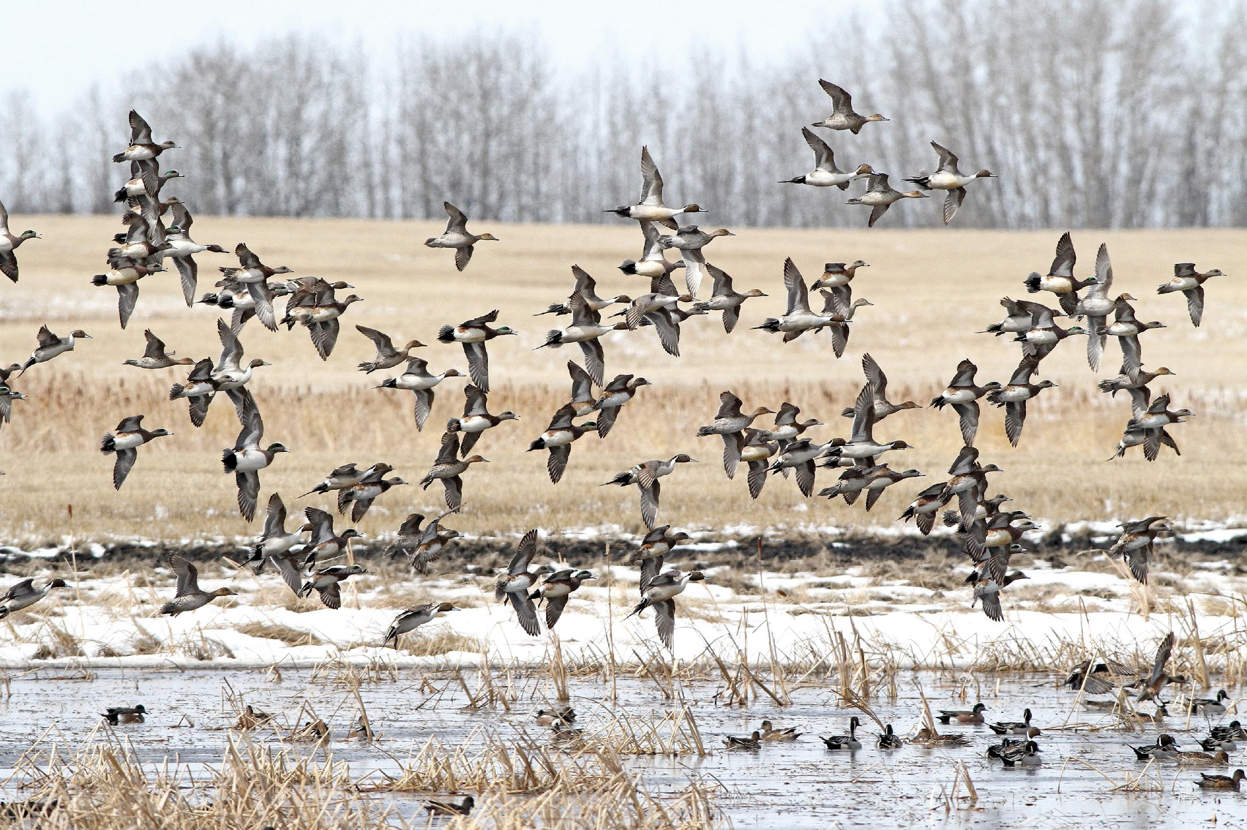
Notes:
The Prairies contains millions of small depressional wetlands, often called potholes, that are biodiversity hotspots that provide extensive ecosystem services. This ecosystem is characterized by a drought and deluge water cycle creating productive wetlands, which represent the most productive waterfowl breeding habitat on the continent.

Slide 4
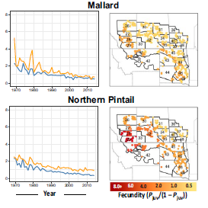
Prairie duck productivity is declining
Specht and Arnold 2018
Notes:
While these efforts have had a myriad of benefits, we know that Prairie dabbling duck productivity is declining overall. We will focus on Mallard and Pintail today, where we can see a reduction in fecundity over time, and specifically in the northern portion of the breeding range. The authors of this study hypothesized that the observed declines in the northern breeding range as opposed to the south may be related to stronger wetland policy and incentives to conserve grassland in the US.

Slide 5
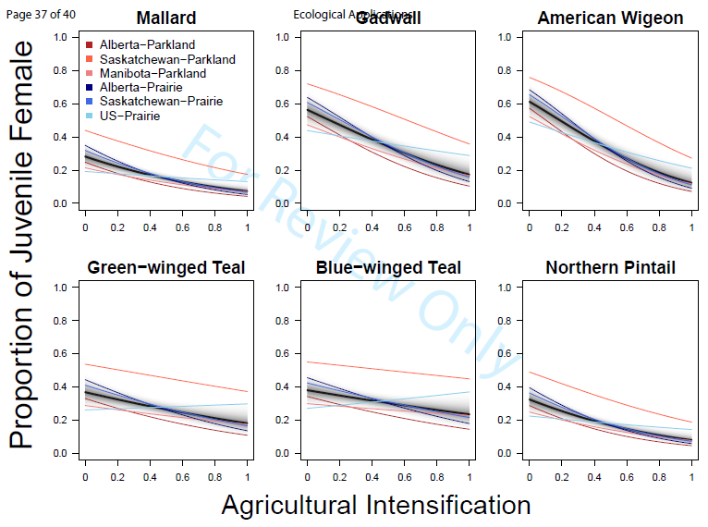
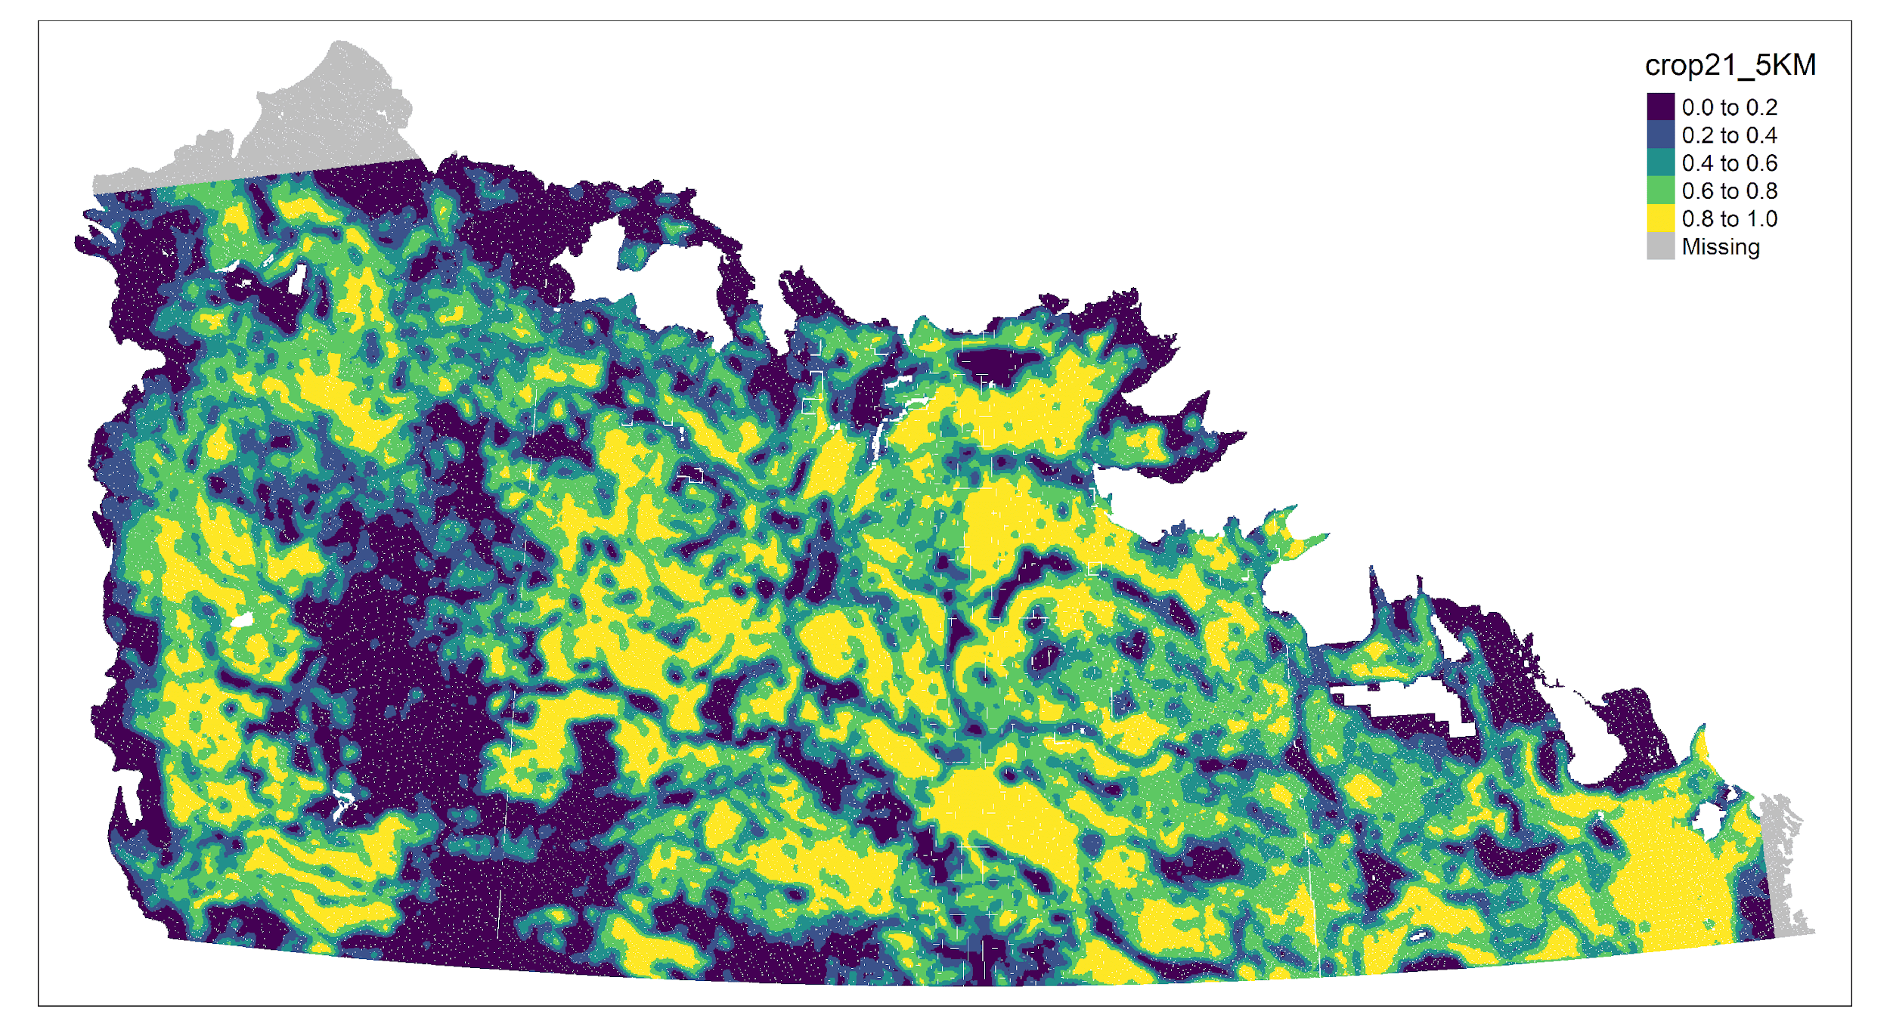
Declines are associated with increased cropland
Intensity
Weegman et al. Ecological Applications
Notes:
Current evidence suggests that these declines are associated with the proportion of cropland cover on the landscape.
One proposed mechanisms for these declines is that prey availability, primarily aquatic macro invertebrates, is changing in prairie wetlands, which could be limiting productivity of ducks.

Slide 6
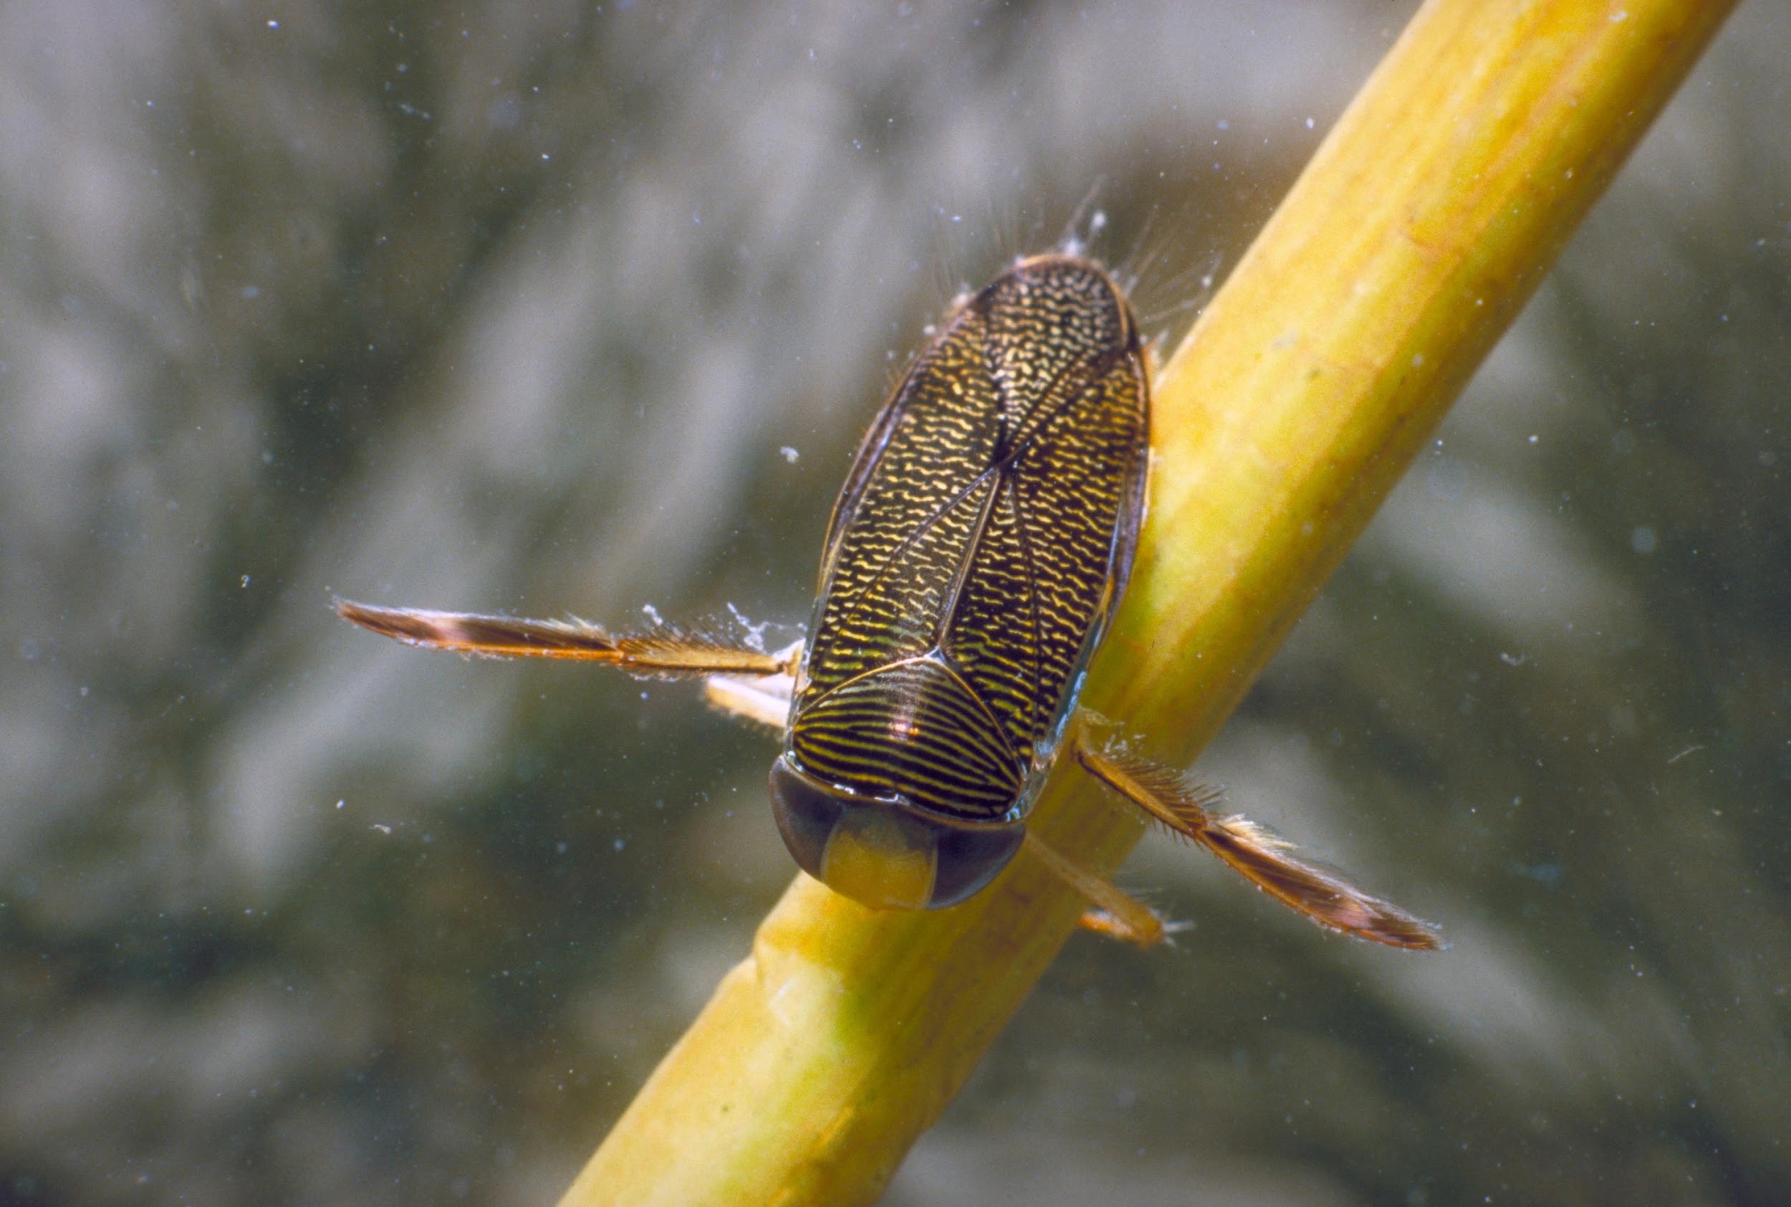
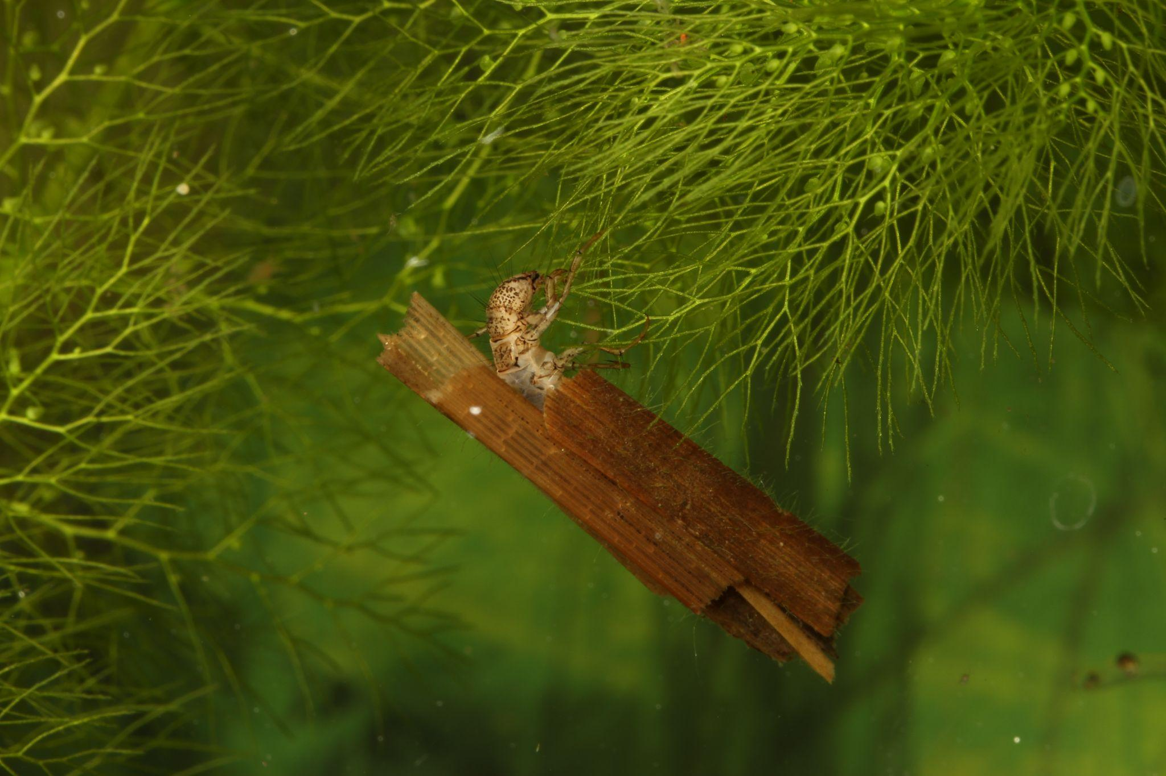
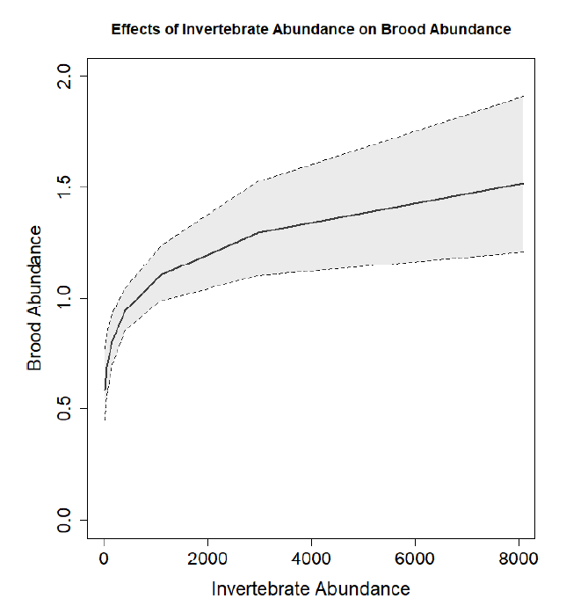
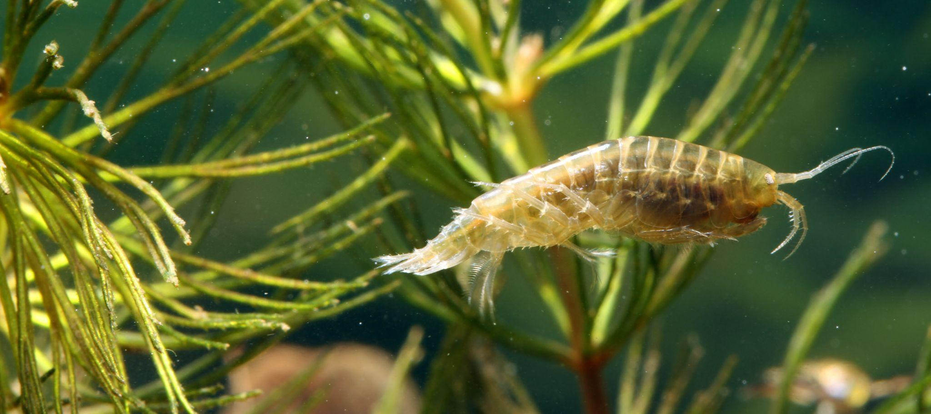
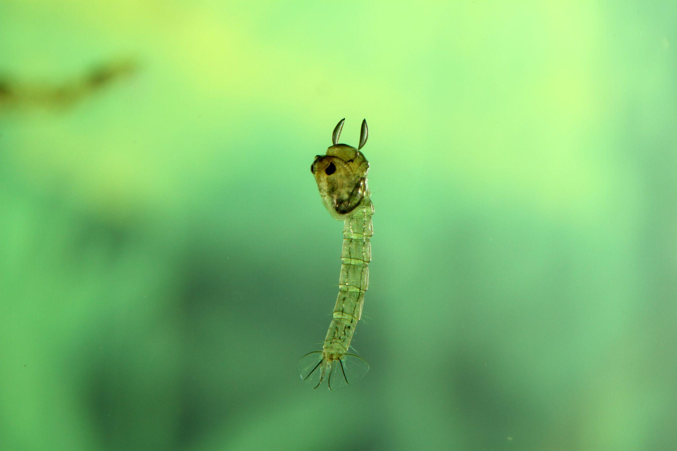
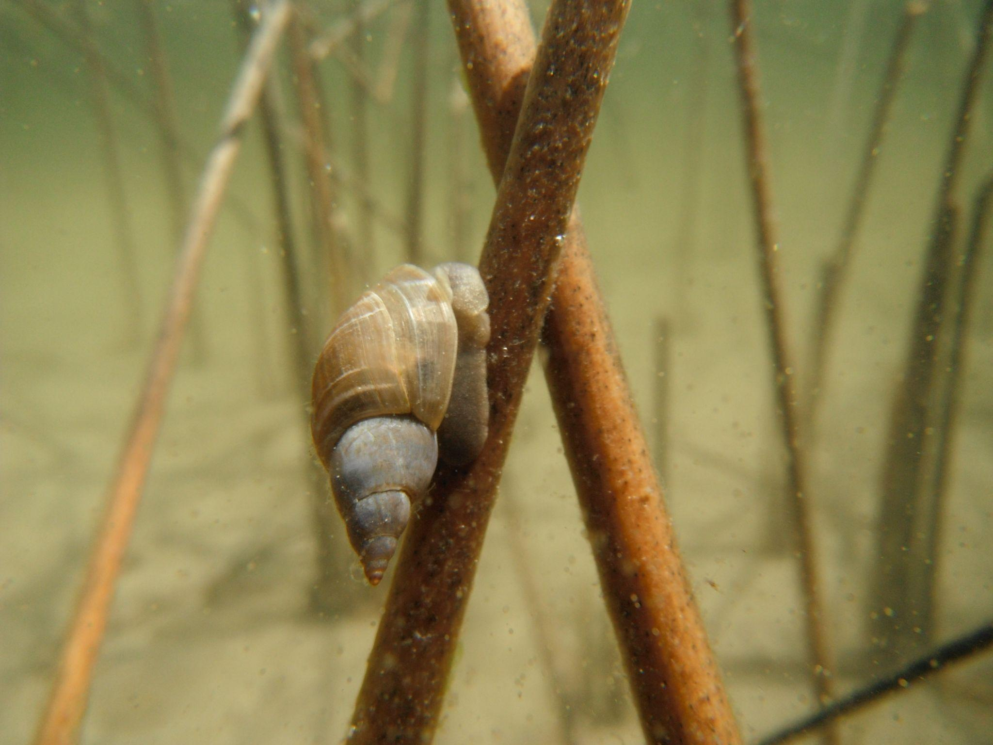
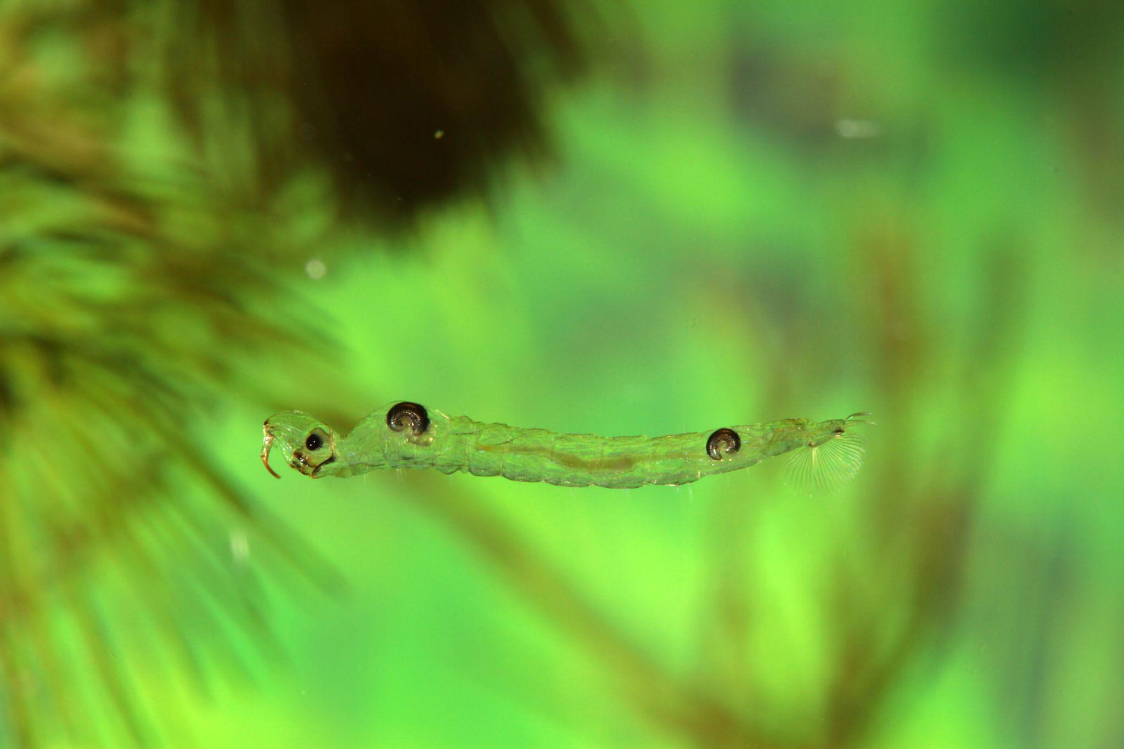
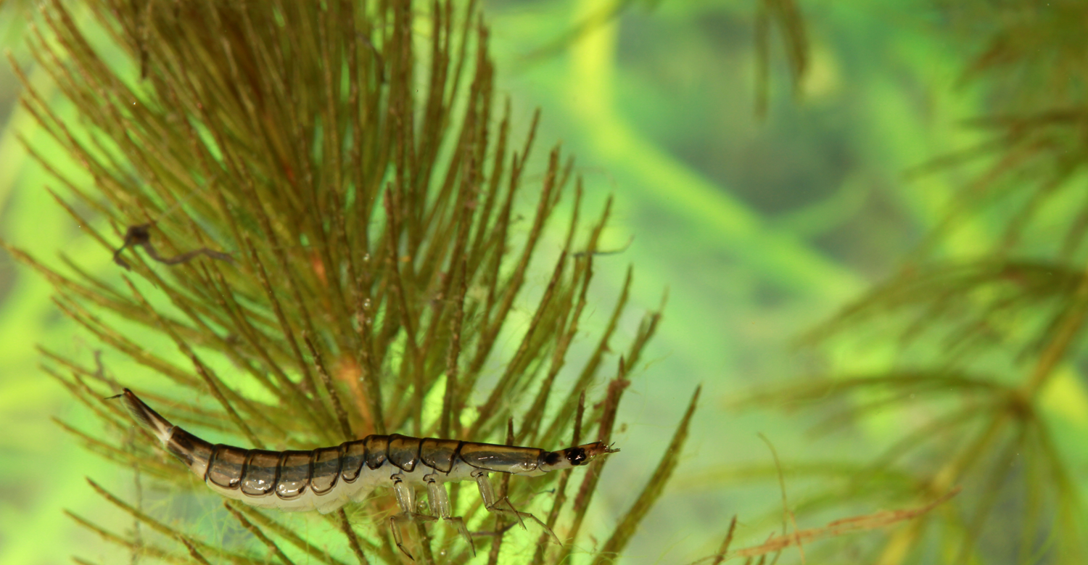
More bugs = more ducks
Terry, 2021
Notes:
Invertebrates are critical elements of food web dynamics of all wetlands, and can be useful indicators of wetland ecological health. This group plays a key role in linking primary productivity (plants) to higher trophic levels (e.g., water birds), and therefore also represents a significant linkage between aquatic and terrestrial habitats. Many aquatic macroinvertebrate species are sensitive to stresses associated with climate change and land use activity, such that environmental changes can be detected by monitoring relative abundance or overall community composition of this group.
Ducks require adequate food resources to hatch and fledge young. Invertebrates serve as the primary food source for most dabbling duck species and are critical during egg production, incubation, and duckling rearing.

Slide 7
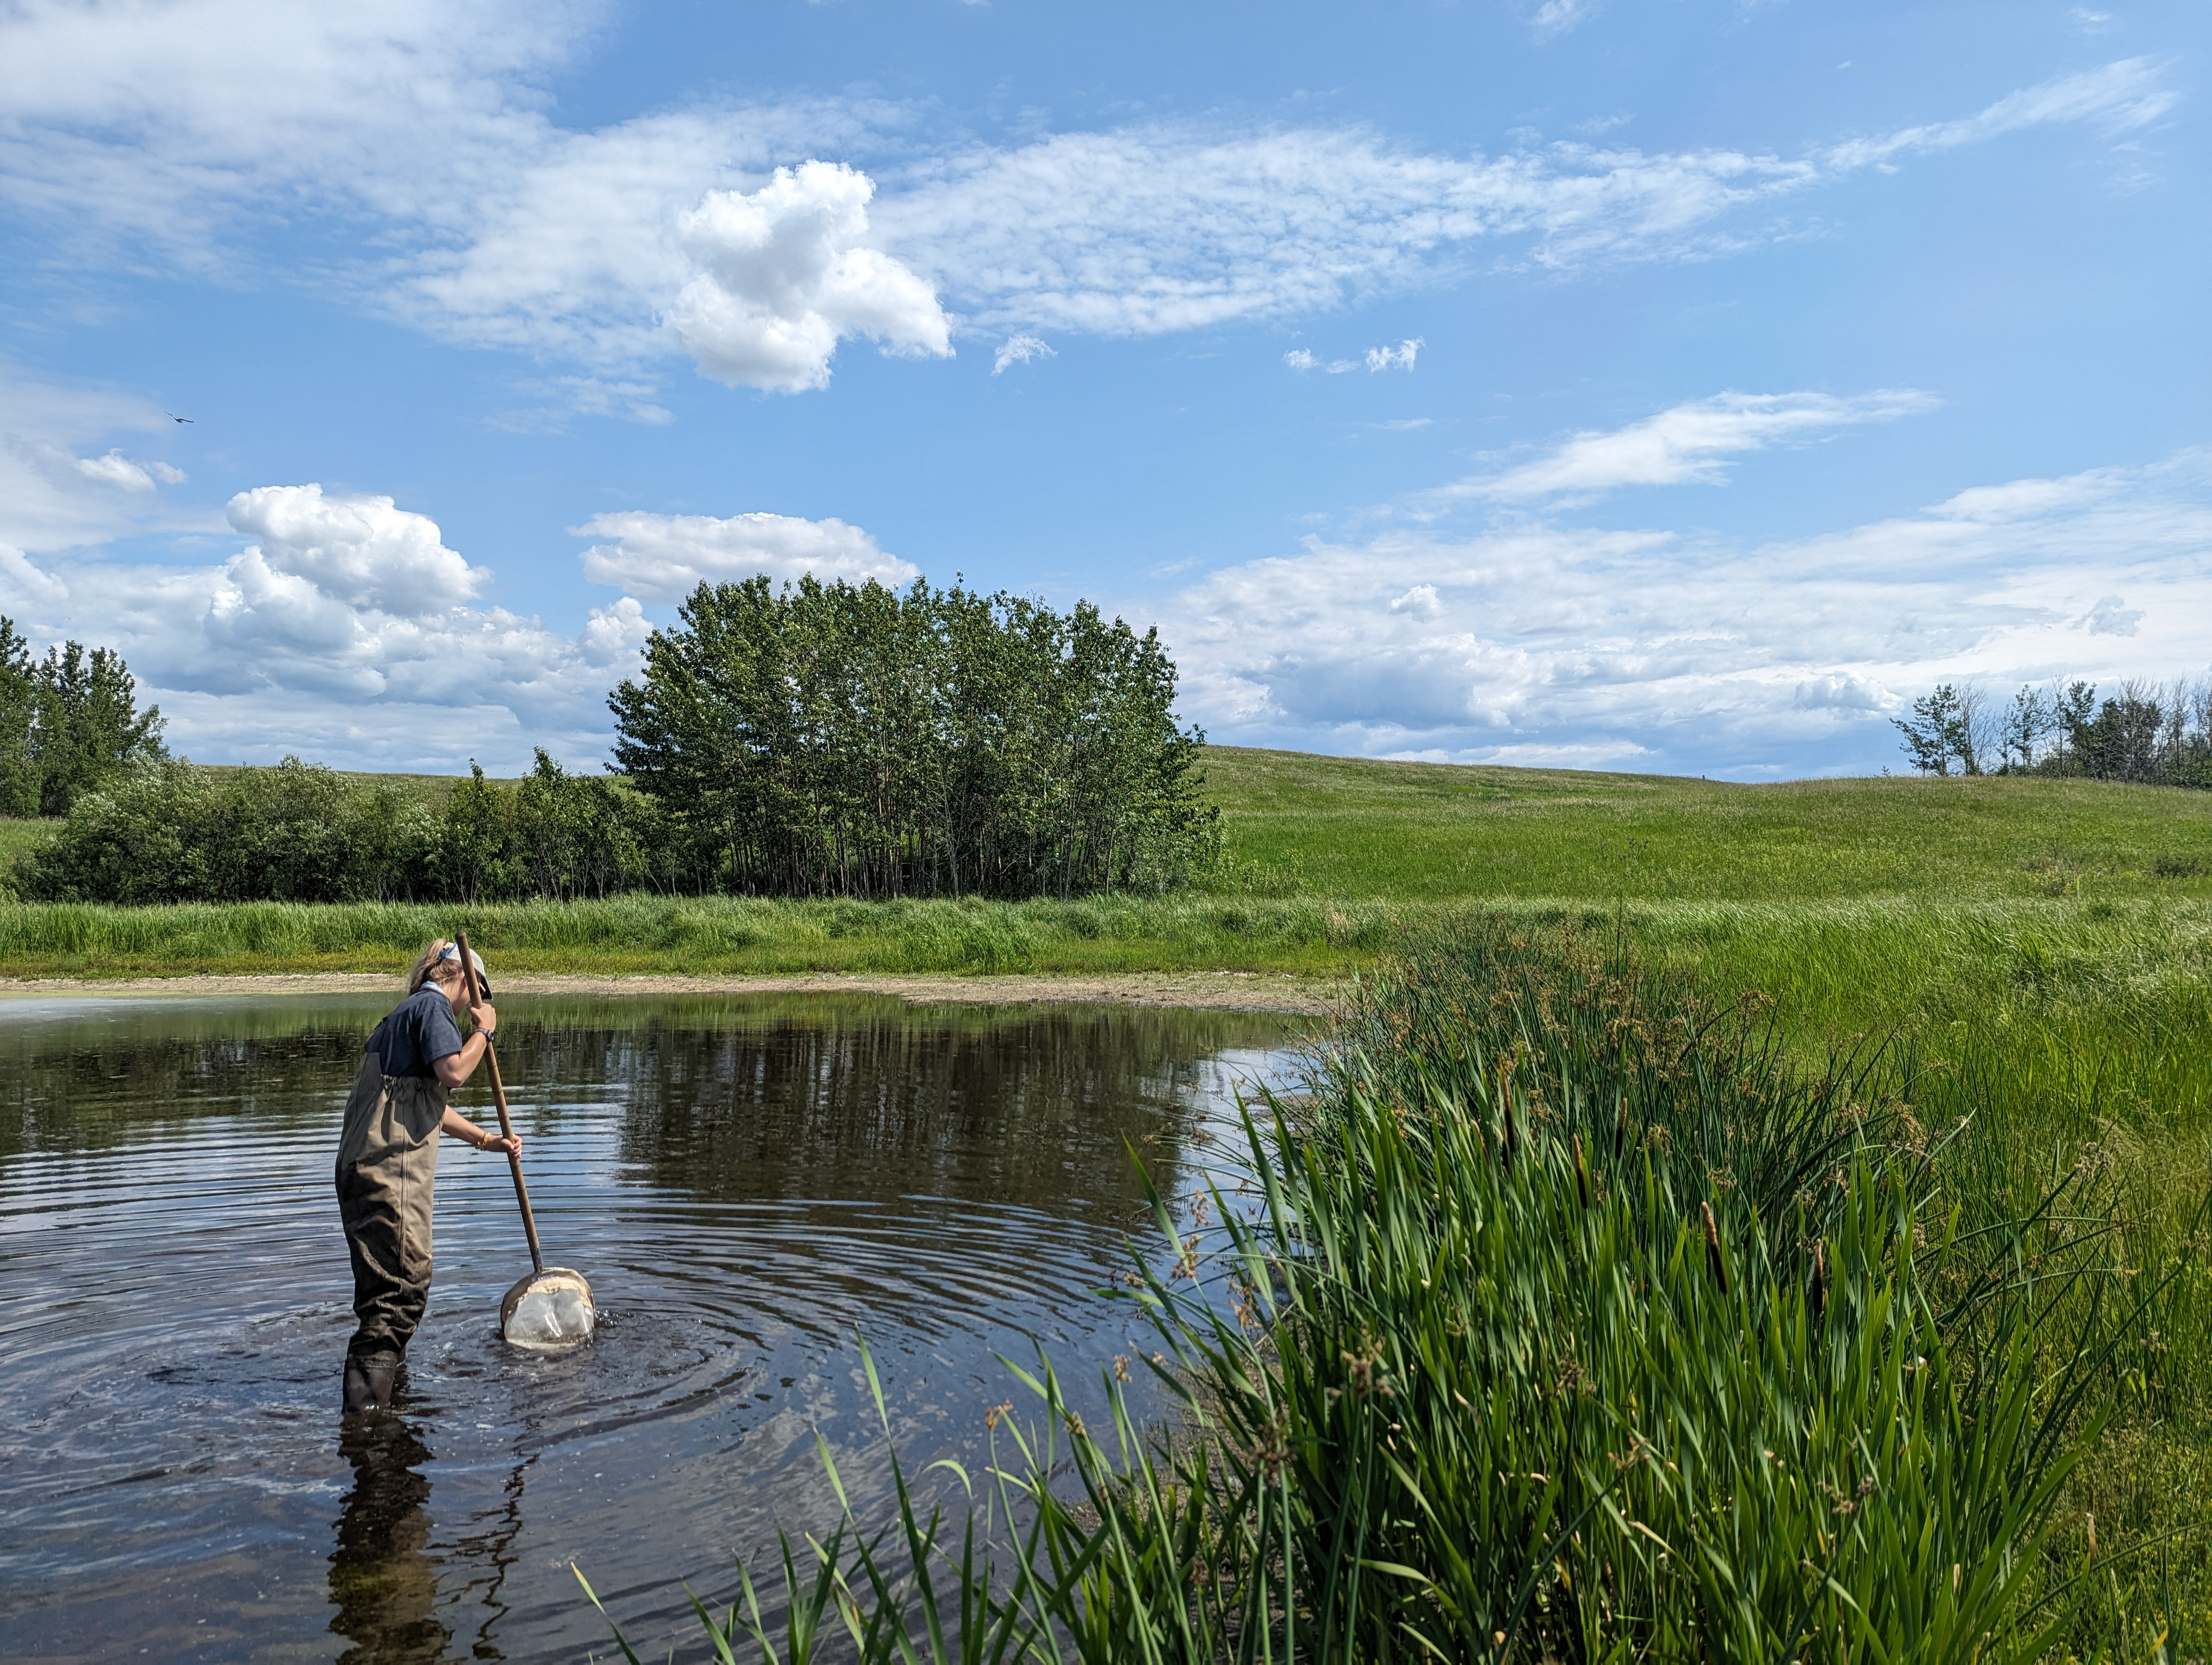
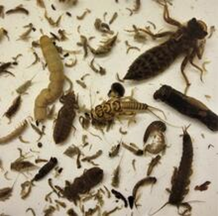
Macroinvertebrates are indicators of water quality
Intensity

Slide 8
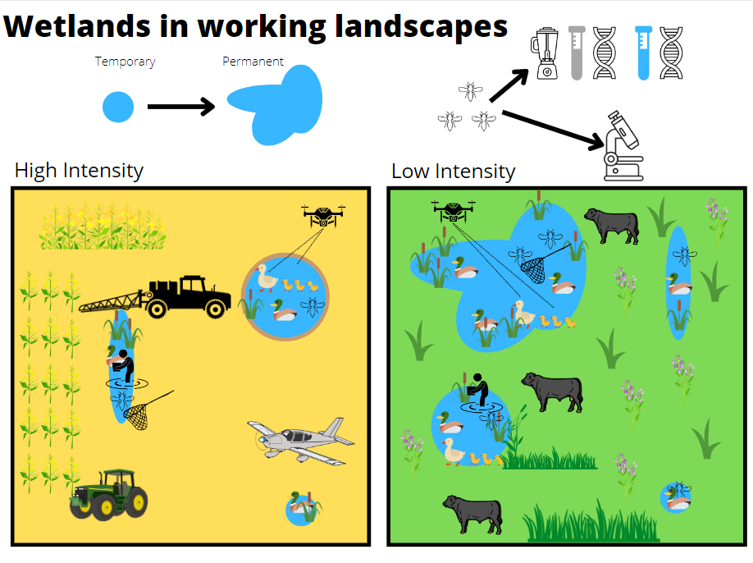
2023: 20 Wetlands
2024: 50 Wetlands
Future Goal: 300+ wetlands

Slide 9
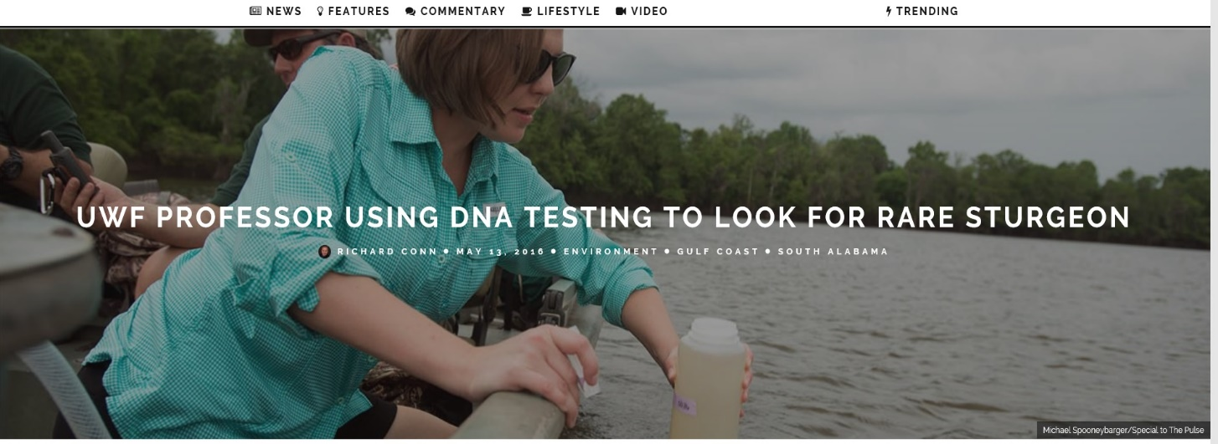
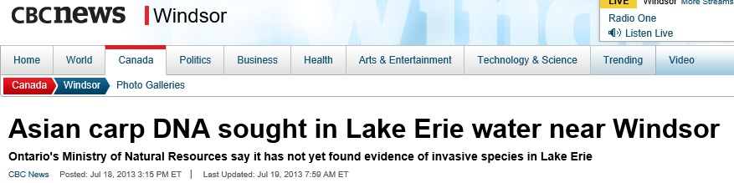
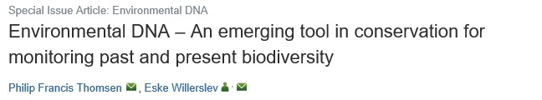
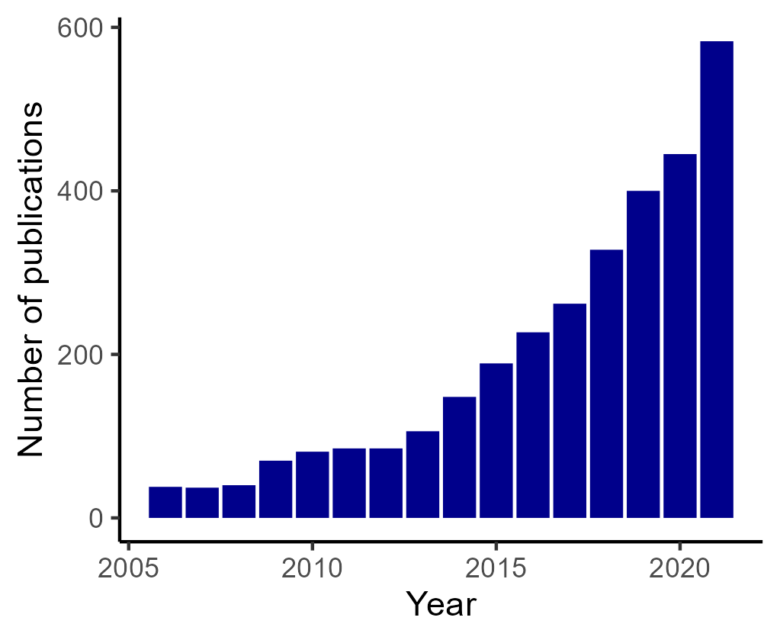
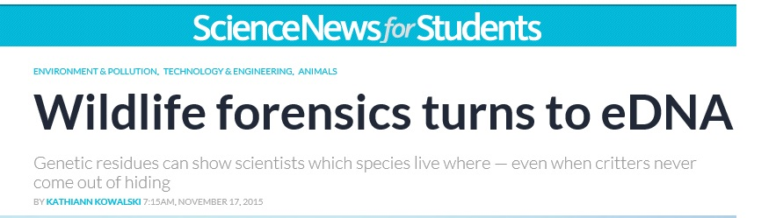
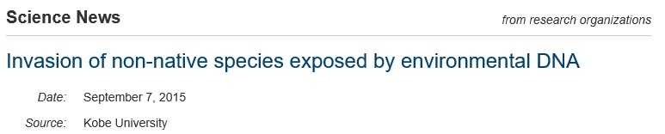
Area of increased study
A New Approach

Slide 10
What organisms can you detect?
Theoretically, anything with DNA.
Practically, detection is limited by habitat preference, tissue biology, and investment in Assay (primer) development
Notes:
Theoretically, anything with DNA
- Been used for fish

Slide 11



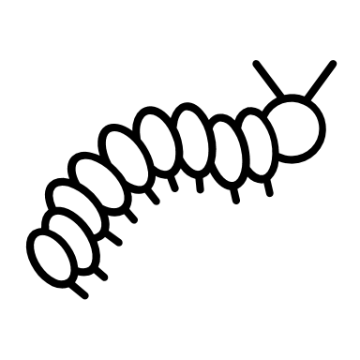

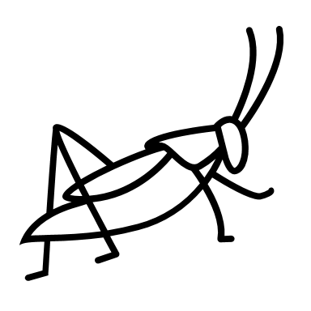





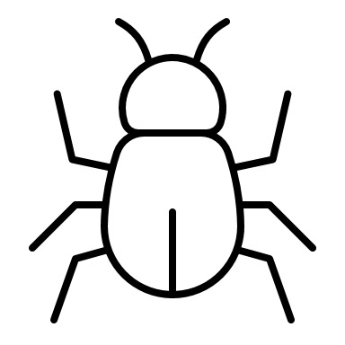



What is environmental DNA (eDNA)?
Environmental Processes & Collection
Detection & Identification
DNA shedding
DNA isolation

Slide 12
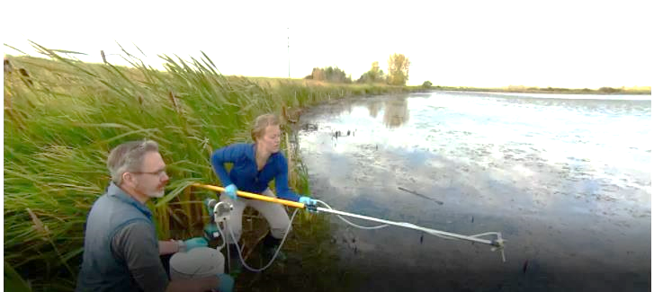
What environments can you collect DNA from?
Water
Soil
Air
Notes:
Theoretically, anything with DNA
- Been used for fish

Slide 13


What is community (bulk) DNA?
What is community (bulk) DNA?
Collection of Bulk Tissue
Bulk
DNA isolation
Detection & Identification
Homogenize

Slide 14

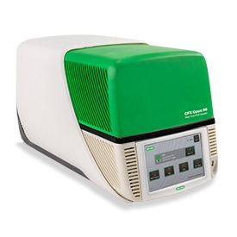


“Single-Species”/qPCR Analysis
Assay
(Primers)

Slide 15
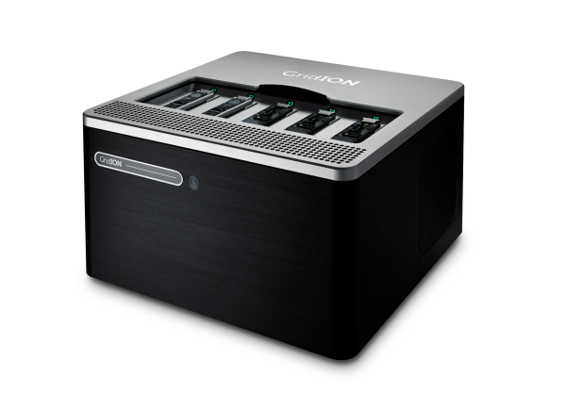

“Multi-Species”/Metabarcoding Analysis
Assay
( )
Primers
Primers
Primers
Primers
Database

Slide 16
So, does eDNA work?

Slide 17

What is a successful eDNA study?
Can you detect the organism you’re looking for?
  Generally, yes! But...
  It depends on the taxa, environment, and assay design.

Slide 18


What is a successful eDNA study?
Can you distinguish between closely related taxa?
  Often yes. But…
  Taxonomy isn’t perfect, and DNA fragments aren’t an entire organism
  Organisms vary genetically over geographic distance
  Management decisions are made either on taxonomic units (species, genera, DUs) or specific metrics (species richness, evenness)
  It depends on the taxa, assay design, and reference databases.

Slide 19
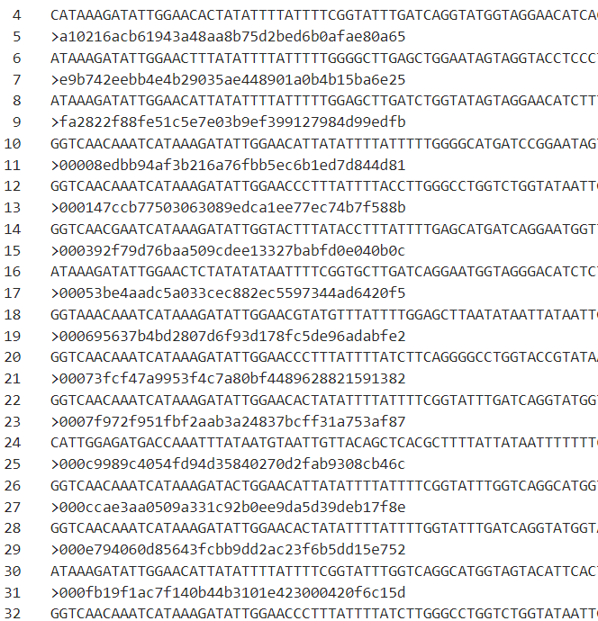
What is a successful eDNA study?
For successful projects, users need to:
Develop appropriate and useable bioinformatic and statistical methods for data analysis
Create/curate databases of verified reference sequences appropriate for western Canadian samples
Evaluate databases and data results on biologically relevant scales
We’d love your help collecting local tissue samples! Insects, Fish, Amphibians, Plants, etc.
Jori.Harrison@InnoTechAlberta.ca

Slide 20

What is a successful eDNA study?
Can you identify if an organism isn’t there?
  No.

Slide 21
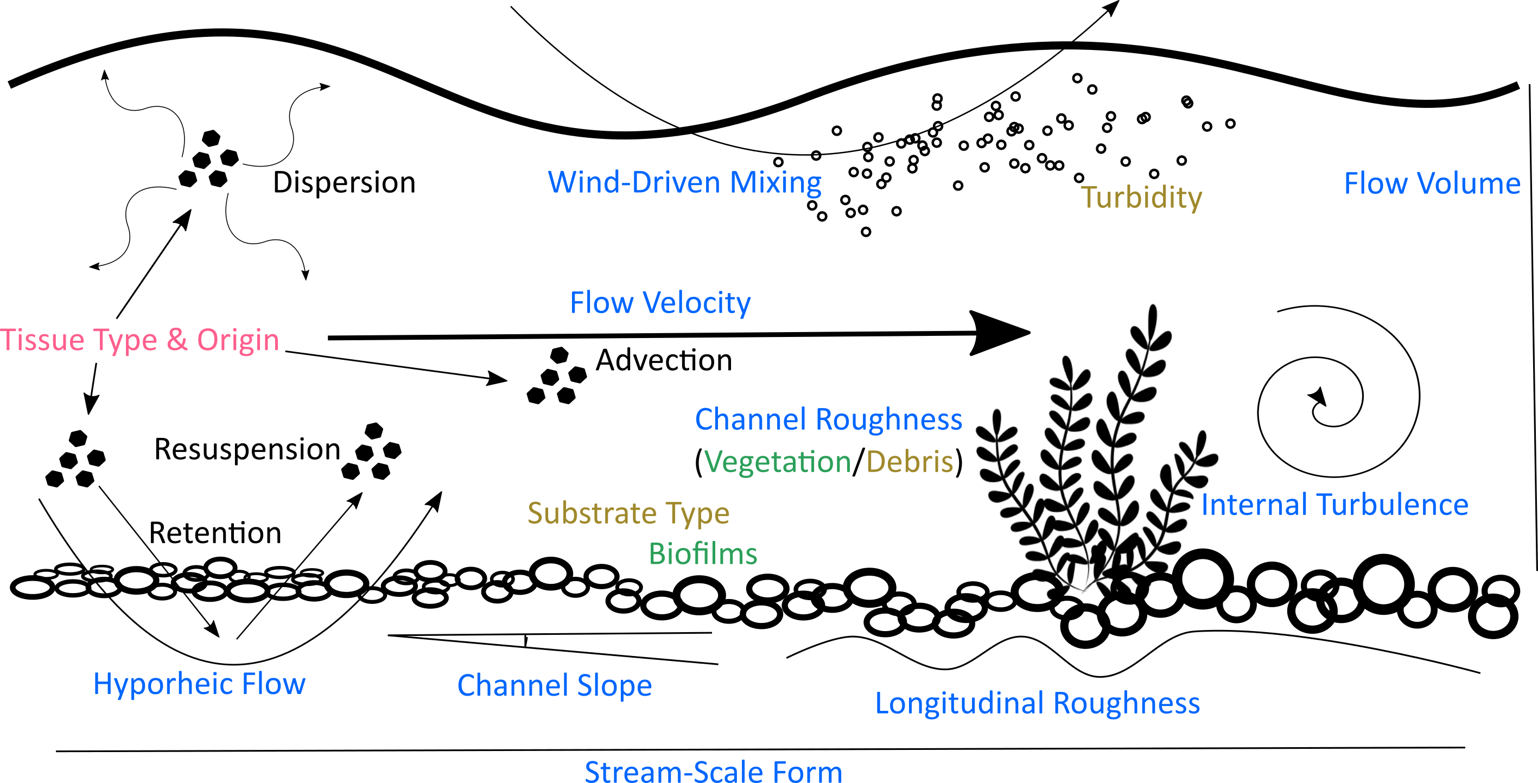
What is a successful eDNA study?
Can you tell where the organism was/when it was there?
  We’re getting there
  It depends heavily on the environment
  *For bulk DNA samples, this is not an issue.
Harrison et al 2019

Slide 22
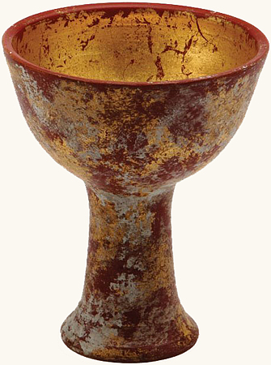
What is a successful eDNA study?
Can you quantify how many organisms are there?
  We are very good at quantifying how much DNA is in a sample, BUT
  Relating the amount of DNA in a sample to the organism abundance is much more challenging.
  This is much more likely to be successful with bulk DNA than eDNA.

Slide 23
So, does eDNA work?
eDNA studies can give very useful information, but need environment and taxa specific validation and appropriate constraints on interpretation

Slide 24
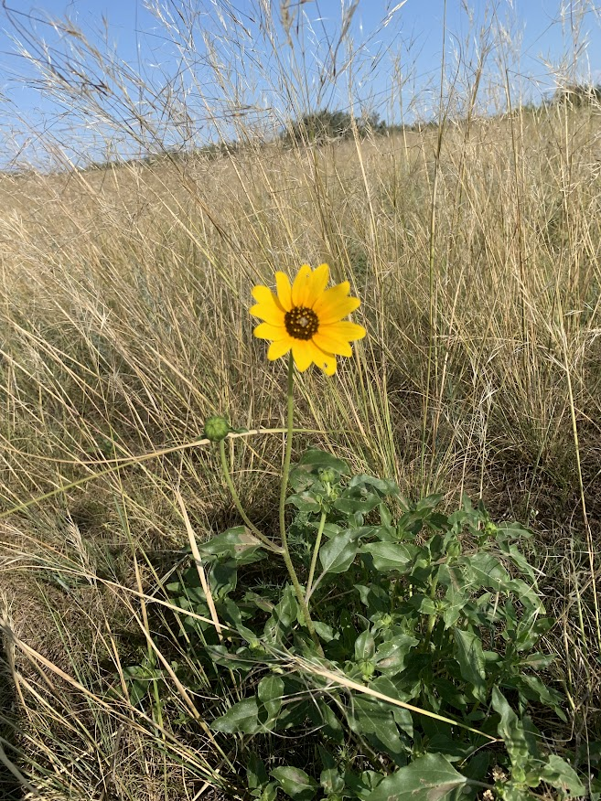
Monitoring Grassland Biodiversity
Exclusive habitat for many lifeforms (birds, reptiles, vascular plants, lichens)
Cryptic species not well understood
Losing space (and diversity) at a rapid rate
Track shifts in communities
Notes:
INTRO TO eDNA MONITORING IN THE GRASSLANDS
Monitoring Grassland diversity is critical to its protection, as there are many species that are endemic to the grassland ecosystem.
Speaking from a cryptogamic perspective it is thought that around 9% of cryptogamic species have not been fully described in some of our most intensively studied grassland ecoregions globally.
As of 2010, only 1.14 Milion hectares remain of the original 61.5 Million hectares of native grassland in the prairie provinces in Canada. (Bailey et al. 2010). There is extensive conversion of native prairie for agriculture and urban development which puts a vital ecosystem at risk. Once these sites are degraded, the consequences can include loss of vegetation, soil erosion and reduction of soil fertility reducing the ecosystem services they can provide (Finger-Higgens et al. 2022).
Seeing as the grasslands provide critical resources for the globe it is important to protect, conserve and monitor range health that is reliable and cost effective. Many climate change predictions for regions that are grasslands include more extreme weather patterns and temperatures. This may reduce water availability and increase plant stress. We will continually need to monitor the changes in our habitats and eDNA metabarcoding could be an efficient and appropriate measure of the general shifts occurring in the ecosystem.

Slide 25
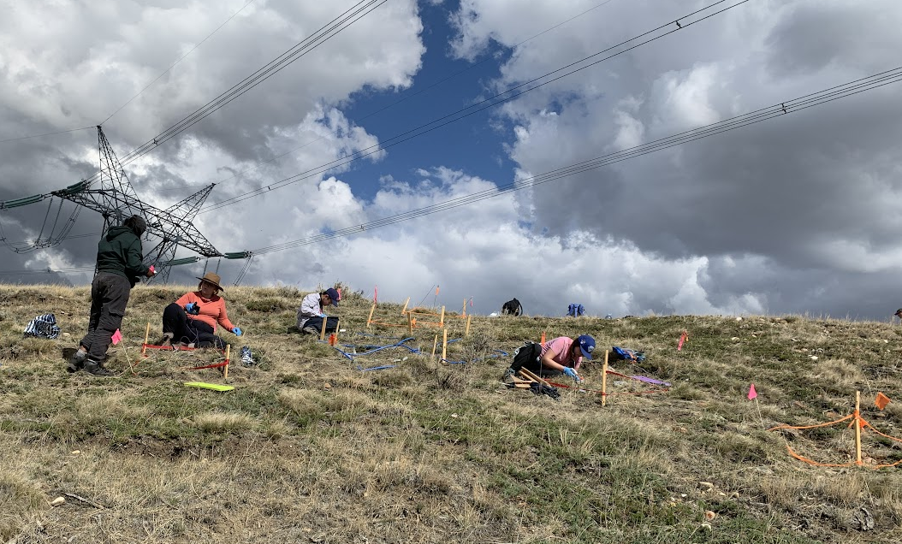
Conventional Surveys
Army of taxonomists required to identify biodiversity
Plant blindness
Reliance on vouchers and dichotomous keys
Novel technologies act as a tool to add to the tool kit of monitoring methodology
Notes:
Few taxonomists can critically identify more than 0.01% of the millions of species on the planet and therefore a huge task force of taxonomists are required to identify all these different types of life forms
Conventional vegetation monitoring methods require expert taxonomists with years of experience in their specific field for the correct and efficient identification of detectable species. taxonomists only capture a snapshot of the diversity, as it is nearly impossible to morphologically identify species missing diagnostic characteristics or species that are ephemeral, cryptic, juvenile or dormant.
Destructive sampling for vouchering is a regular practice and collections are even more necessary when dealing with cryptogamic species that will need lab identification.
Furthermore, knowledge surrounding local flora has receded amongst the public, limiting the number of people interested in plant identification. Conventional morphological methods of vegetation monitoring rely on the detection of specific morphological characteristics being observed either in field, or under a microscope. With a reliance on morphological determination, taxonomists only capture a snapshot of the diversity.
Individual observer biases and variations in morphological surveys can affect precision, practicality, accuracy, cost-effectiveness and the ability to share datasets across studies and landscapes. Furthermore, targeting smaller, less abundant, inconspicuous, poorly detectable species requires higher surveying effort over smaller areas, limiting the efficiency of conventional surveys.
Therefore, to complement morphological studies, there are novel methods of detecting diversity that can increase the confidence and completeness of diversity within a sample space. in our case we are looking at using DNA to answer similar questions.

Slide 26
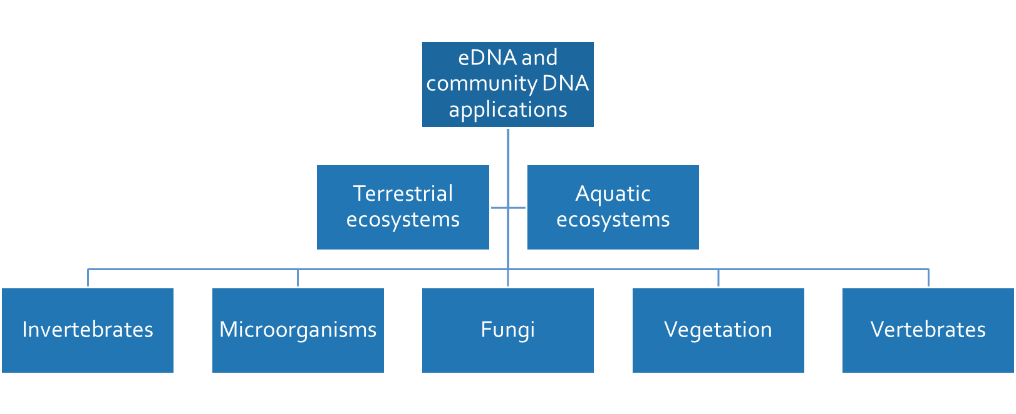
eDNA concepts
Simultaneously identify multiple species from the collection of an environmental sample.
Notes:
GENERAL EDNA CONCEPTS, WHEN AND HOW IT CAN BE USED –As a reminder there are different ways to use eDNA and community DNA to monitor the biodiversity and ecological applications using eDNA –Most common in aquatic ecosystems however there are also uses in terrestrial systems. As an example we can look for Invasives in both systems, cryptic vs rare species,
In all landscapes both aquatic and terrestrial, there are different primers that can amplify certain gene regions or “barcodes” of different species.
Can be found within trace elements (gametes, tissues, Spores) Extracellular DNA (DNA sloughed off within the enviro)
Relic or Ancient DNA ( dead or degraded organisms)
Cellular ( Cells or tissues in nature)
DNA from non target (ex: plant DNA in cow dung)
This is so fun but maybe a little bit complicated – Why are we even looking for new ways to monitor our biodiversity?

Slide 27
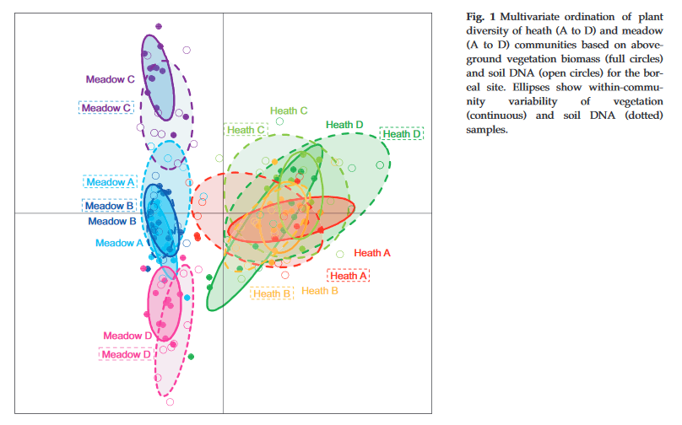
Goals of eDNA
Develop community DNA and eDNA tools for biodiversity surveys.
Determine if it can be an appropriate test for monitoring in our grasslands
Multivariate analyses
Notes:
Identifying and developing evidence-based, Alberta relevant genomics tools to support ecosystem monitoring.
As an example, Yoccoz in 2012 looked at the comparison between soil eDNA aND aboveground biomass to determine the commonalities and contrasts between the two different methodologies.

Slide 28
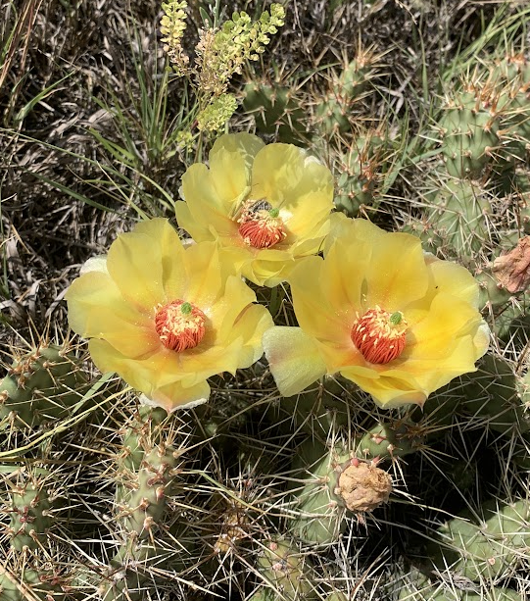
Vegetation monitoring
Community tissue metabarcoding
Soil eDNA
Notes:
There are several applications for eDNA and metabarcoding technologies within the grassland ecosystems. Bulk tissue samples can help in identifying cryptic species that we would regularly lump with another species. This is a common issue in the grasslands when identifying biocrusts and lichen forming fungi.

Slide 29
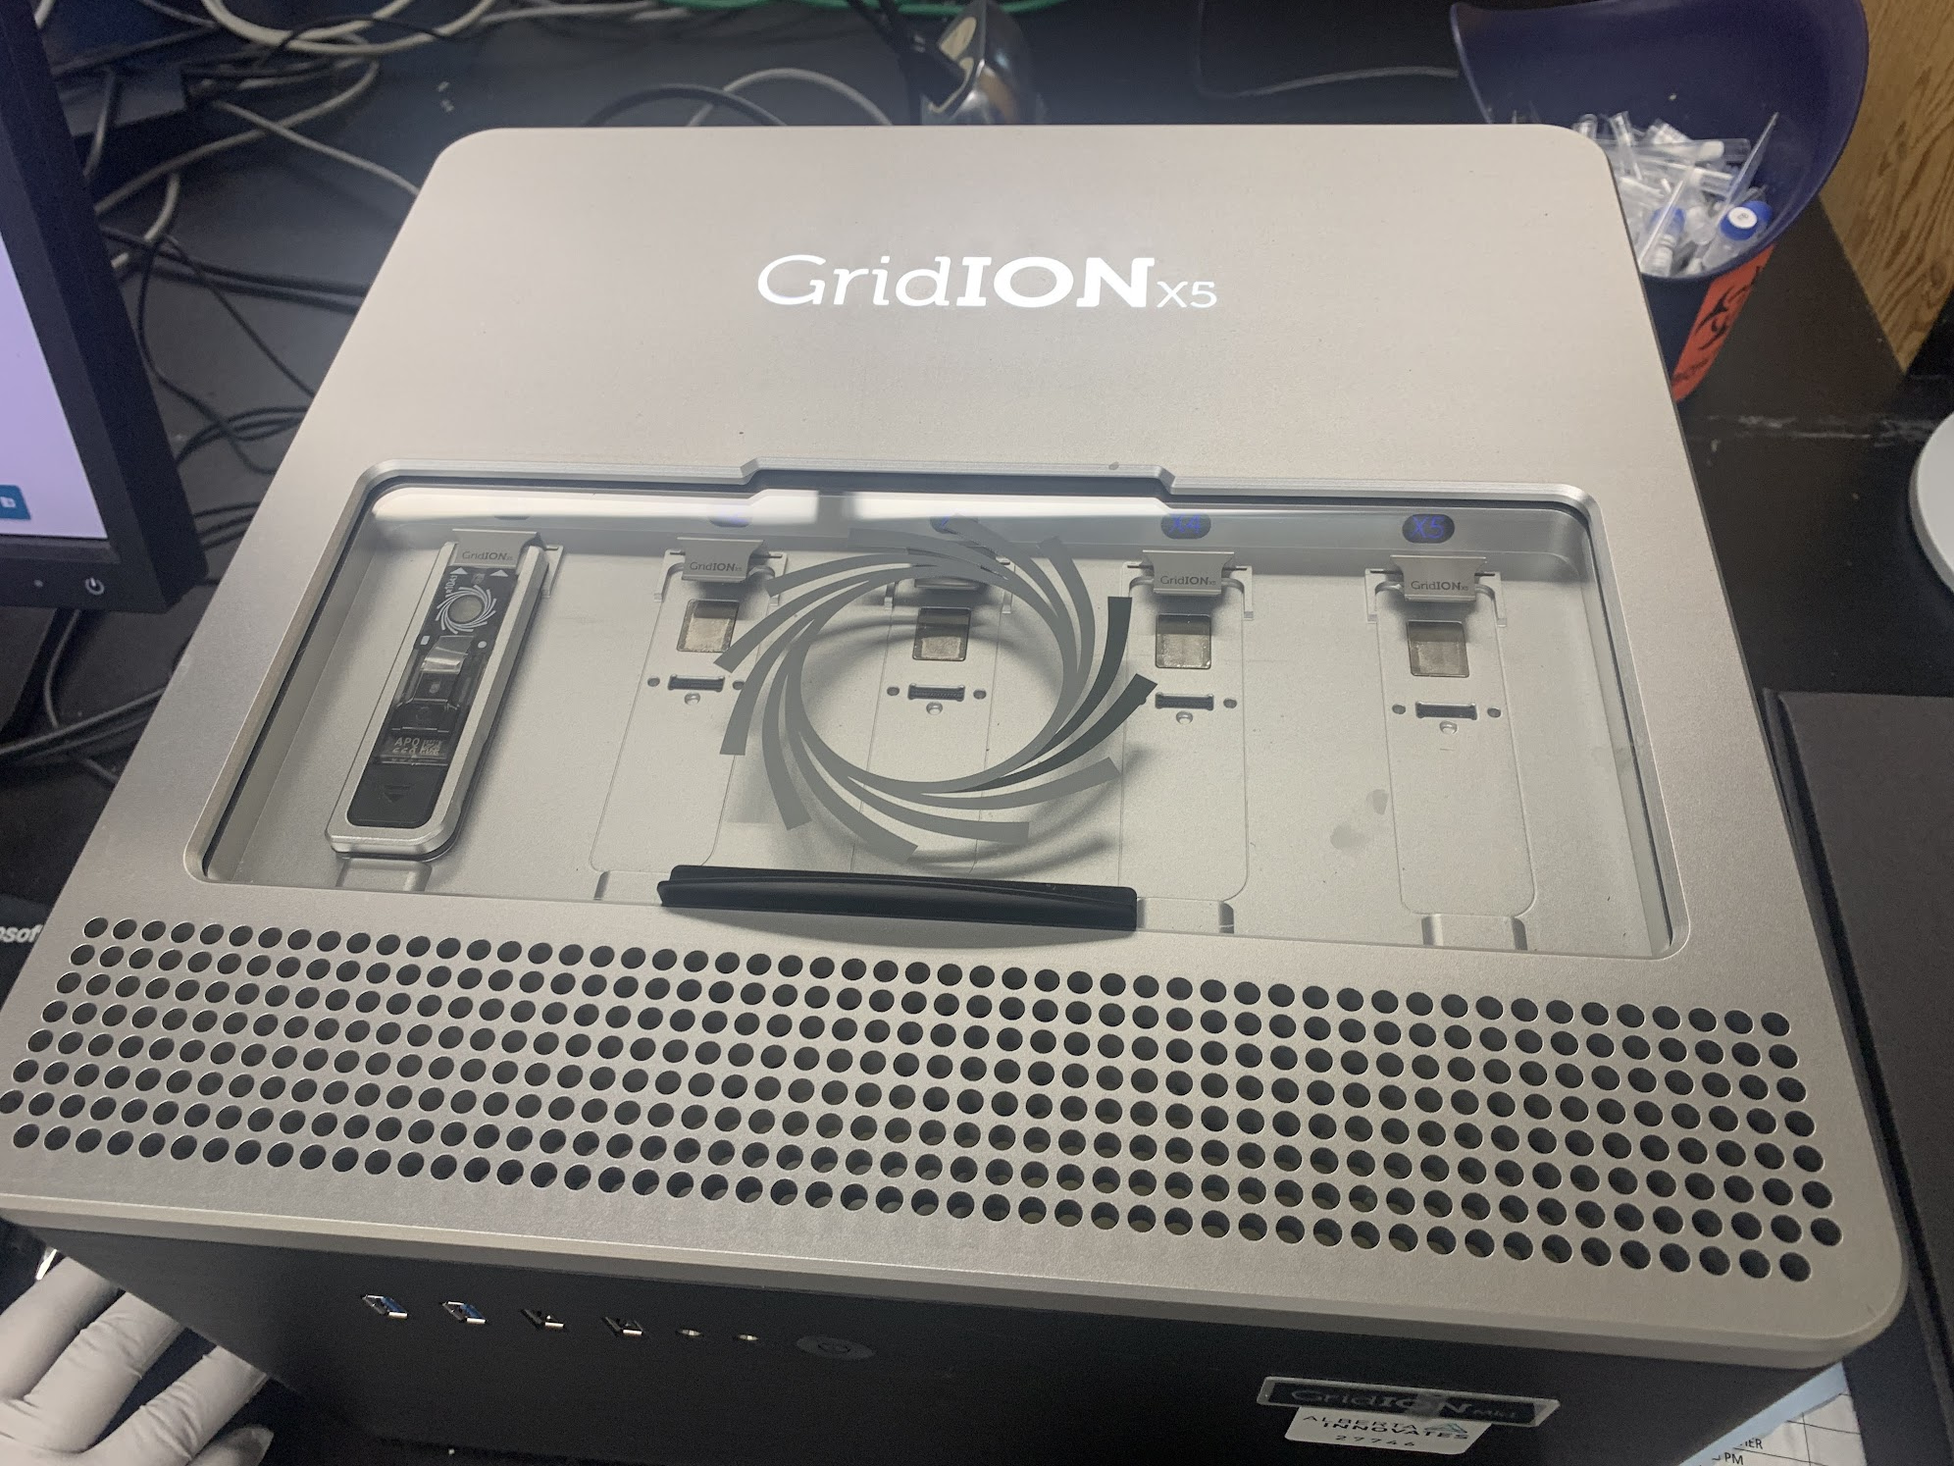
Community DNA
Uses:
Uncover greater diversity
Detect species at low abundance
Distinguish between species that are morphologically similar
Notes:
DNA metabarcoding approaches hold promise for monitoring diversity and ecological health in the grassland ecosystems. The generation of these sequences from community samples identify all organisms within the sample. This could allow non-specialists to identify cost efficient monitoring.
Could uncover greater diversity, detect species with low abundance, identifying different species that morphologically similar. We are currently exploring how we can use eDNA to monitor vegetation and it’s best uses and practices

Slide 30
Community DNA
Potential Issues:
Imperfect sampling and false detections
Difficulties in quantifying abundance/ biomass
Taxonomic Identification assignment biases
Incomplete reference databases
Notes:
Some potential issues that come up with community DNA include Imperfect sampling or false detection either due to the limited persistence of DNA, or the inhibition of DNA amplification or sample contamination. To solve this we can do different lab techniques like replicates and positive and negative controls.
There is also issues in quantifying abundance or biomass while using community DNA
And finally taxID biases caused either by an amplification bias or incomplete reference databases which can be solved eventually by increasing the number of species that have been barcoded and made available publicly.

Slide 31
Vegetation monitoring
Community tissue metabarcoding
Soil eDNA
Notes:
There are several applications for eDNA and metabarcoding technologies within the grassland ecosystems. This includes DNA from soil or water or any extracellular sampling not directly from the taxa of interest.
Soil Sampling commonly can help to monitor bacterial and archaea samples that would otherwise be much more difficult to tease out. Also relic DNA can be abundant in soil and give an estimate of species that were once at the site.

Slide 32
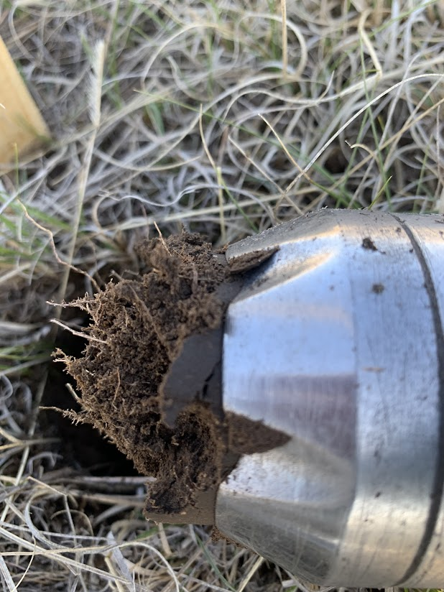
Soil eDNA
Uses:
Collect multiple taxa simultaneously
Non-invasive, non-destructive alternatives
Assessment of above and belowground signals
Notes:
Within soil eDNA some benefits and uses include the possibility of collecting multiple taxa simultaneously without destroying the ecosystem and being less invasive then conventional voucher collections. It also allows us to assess above and belowground signals like pollen debris and roots to get a cohesive picture of the habitat. Commonly, soil DNA is used for microbial and fungal analyses but now we are trying to use these samples for vegetation analyses.

Slide 33
Soil eDNA
Potential Issues:
Imperfect sampling and heterogeneity
Limited understanding of the ecology of eDNA
Inconsistencies in the methodology
Lack of ecological information
Notes:
Some potential issues common in soil eDNA work includes heterogeneity of the soil and imperfect sampling due to degraded DNA.
Also when collecting eDNA, we have a limited understanding of the ecology of the sample including the origin and state of the DNA in the sample unless metadata has been properly recorded.
There is also a potential issue of lacking ecological information since the organisms that we could be targeting aren't sighted within the sample.

Slide 34
Research Objectives
Objective
Filling in gaps in the local DNA barcode reference library
Developing a community DNA methodology for biodiversity surveys
Testing soil eDNA metabarcoding to temporal and spatial variability
Comparing between community DNA and morpho-group surveys for biological soil crust communities
Notes:
I would like to focus my DNA metabarcoding project on overcoming and understanding certain costs and benefits to using this novel genetic tool. SO the objectives that I would like to complete for this project is to explore the development and practice of DNA metabarcoding in Alberta.
I would like to continue adding barcode information to a locally curated barcode library distinct to species found in Alberta to fill some of the gaps in missing barcode information and data and create a standard for parkland and grassland ecoregions.
I would like to compare the detection rates and repeatability of community DNA sampling to a classic morphological survey and then comparing these detection rates and repeatability to different environments. This advance will give us a new way to look at potential monitoring standards and learn about the potential for DNA community analyses.
For my third chapter I want to quantify the number of soil samples necessary to get as close to a true estimate of the habitats diversity. And then compare the detection rates and repeatability of eDNA over temporal and spatial variation in a variety of environments.
Finally, I would like to test the use of community DNA in biocrust communities to determine if it is a feasible way to track a largely ignored part of grassland communities.
Advance
Building a baseline gold standard of a local library
Determine reliable ways to detect indicator species, determine fitness of process comparing to a conventional morphological surveys.
Broadening survey window in time and space
Determine the feasibility of tracking biocrust community functions in the ecosystem using community DNA.

Slide 35
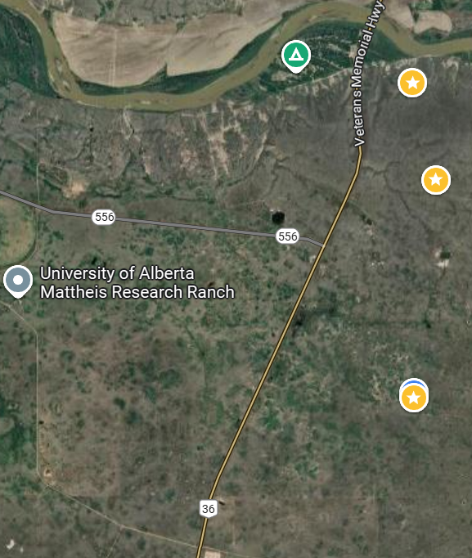
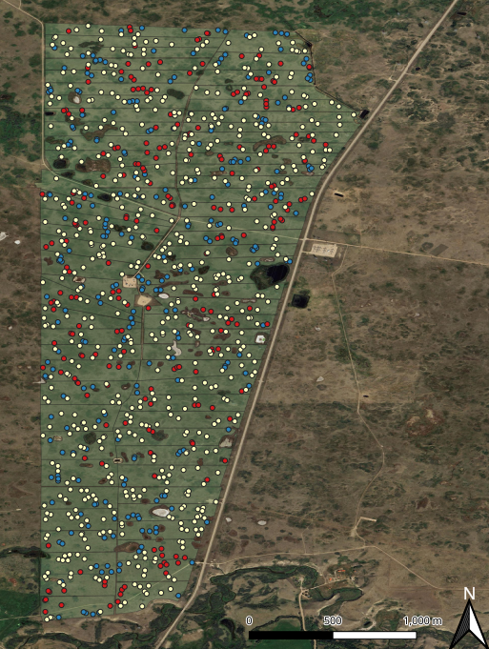
Field collection methodology
2023
Soil samples = 135
Community vegetation samples = 27
Conventional surveys = 27
2024
Morphogroup surveys = 180
Community BSC samples = 180
Notes:
My field work was conducted at Mattheis research ranch and Royberg Kinsella research ranch in 2023 and 2024. I collected community samples and soil samples as well as a conventional or morphogroup survey to compare and contrast, developing DNA methodology and comparing the fitness for purpose for biodiversity surveys. I collected soil (n=135) and vegetation community samples at the same sites (n=27 quadrats). This will be so that I can compare and contrast between the different methodology and sites.
Then this year I collected morphogroup and community collections of BSCs at 180 sites across Mattheis and Kinsella.
Using eDNA and community analyses we have to take into consideration certain contamination and degredation issues when in the field. To circumvent this in the field , we would bleach and rinse between sites and would bring a cooler into the field to freeze the samples immediately.

Slide 36
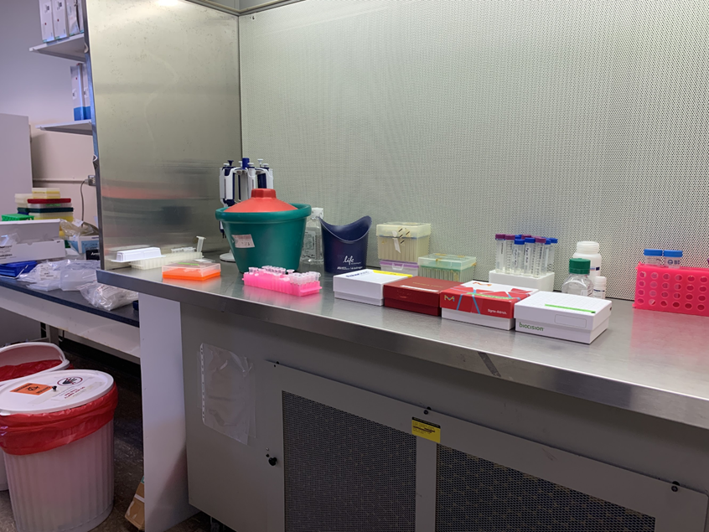
Lab methodology
Extractions specific to grasslands
PCR amplifications
Sequencing using Oxford Nanopore
Bioinformatics
Notes:
This is the general sample to sequence flow from field work to getting a species ID in the lab.
SPECIFIC TO THE GRASSLANDS: Sand vs. humic soils
Various secondary metabolites and phenolic compounds in grassland species and the extraction process
PCR amplification and “universal” primers
Sequencing>>>>>

Slide 37
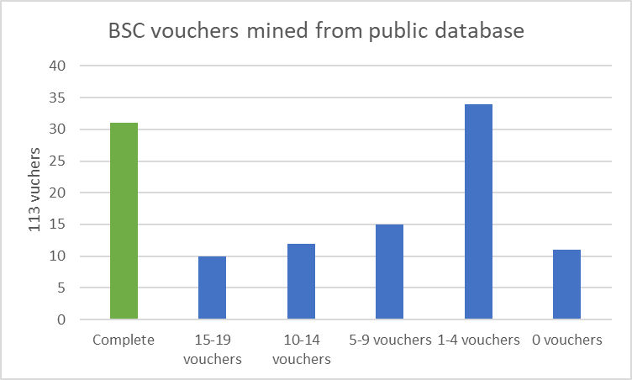
Barcode Library
Closing the gaps for correct and complete barcodes for species specific identification
Goal is to build a baseline for local flora
Universal Amplicons
113 common Albertan biocrust species collected using NCBI and personal voucher collections sequenced
310 common vascular plants collected using NCBI and personal voucher collections to be sequenced.
Notes:
For DNA-based methods, establishing a trusted local barcode reference library is required for species-specific identification. Local representative samples can be important in increasing the precision and accuracy of species assignment and making a trusted reliable database.
Molecular challenges that need to be overcome in barcoding includes difficulties in distinguishing between closely related species and amplifying species over a broad spectrum with universal barcodes. Closely related species are very difficult to gain species level identification while using short barcodes. Examples include Salix and Carex species being very difficult to cluster based on the assays chosen. There are also difficulties amplifying certain species with choice in barcodes. As an example, using universal primers, I have not been able to amplify dandelion. In talking with other ecology geneticists they have found that a different assay works well for amplifying and sequencing Taraxacum however with other plants it can only resolve to family level identification grouping large swaths of species together due to it being a smaller barcode commonly used for degraded samples.
So far I have collected vouchers for all vegetation collected from samples and pressed and dried them to preserve them. I have begun to process vouchers for plant samples at Innotech labs and then begun processing lichen samples at Spribille labs on U of A campus. I have mined through NCBI for common plants found at my sites to determine where these gaps are for my studies and used a mix of private ABMI data and NCBI databank to do the same with the lichen vouchers and determine which barcodes are the most important to add.
The goal of these barcoded sequences would be to eventually have them in a public database for the successful identification of species in the future.
This summer I was able to work with a highschool intern to determine where some of these gaps were in the lichen database and she determined that nearly 15% of the species we were looking for did not have a barcoded voucher. We then started in lab to sequence some of these species that can one day be accessed publicly with downstream applications in my community and eDNA analyses.

Slide 38
Plant Community Mixes
Comparing ecological signal between tissue DNA metabarcoding and conventional methodology of vegetation monitoring
What overlaps between surveys and samples?
What can only be found in conventional surveys?
What can only be found in community samples?
Why?
Conventional survey IDs
DNA species hypotheses
Notes:
One of the downstream applications for that library is looking at completing this community tissue study determining if targeted community DNA metabarcoding provides an efficient objective and reliable approach to characterize the diversity of vegetation in biomonitoring research. To do this we are comparing the ecological signal between DNA found in plant tissues collected and a conventional survey completed at the same site and then contrasting the species documented by the surveyor and the species hypotheses. This could allow us to answer whether we could capture additional diversity not captured due to morphological similarities, juvenile or missing diagnostic characteristics to allow scientists to sample a wider range of substrates and habitats without having to voucher or collect whole specimens.
We can also tease apart what we can find easily in both survey methods, what can only be found in conventional surveys ( things like equisetum and salix are notoriously difficult to find in community samples as the universal primers used for plant ID commonly miss or do not amplify these genuses appropriately). And then what was only recoverable in eDNA samples either due to cryptic species or environmental contamination.
Once morphological surveys were completed at my grassland sites, vascular plant community samples were collected at each quadrat by collecting a 0.5 x 0.5 cm fragment of each species found on the survey into a sterile packet and frozen immediately.
I have completed the lab work and sequencing for this work and am in the initial stages of analyses for this work. I would like to create an ordination to model these communities and look at whether these are complementary methods of conventional monitoring within our grassland ecosystems.

Slide 39
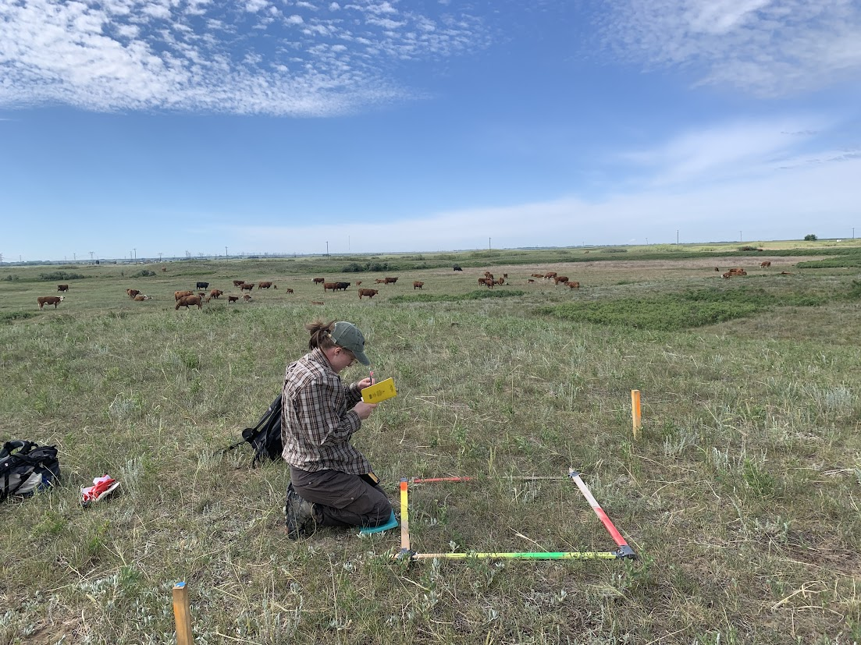
Biocrusts
- What are biocrusts
- Function within the landscape
- Why they are difficult to monitor in conventional ways
- How might DNA metabarcoding be used in biocrust research
-collection and comparison
Notes:
Biological Soil crusts (BSCs) are a complex mixture of cyanobacteria, algae, microfungi, bacteria, lichens and mosses and are a key component of these grassland ecosystems. Within their habitat, BSC’s contribute to ecosystem function and resilience, providing critical functional processes including soil stabilization, water infiltration, microtopography, vascular plant composition, carbon and nitrogen cycling and are included in microbial activities.
BSC control several functions and support ecosystem capacity and provide multiple regulating services – PROVIDE ECOSYSTEM SERVICES!!
Surveying biocrusts is a challenge, biocrust communities are often diverse, species tend to be small and difficult to identify efficiently in the field, much of the taxonomy for these species is unresolved which is impractical for visual assessments using BSC as an environmental indicator.
eDNA could be an effective tool to monitoring our BSCs. There is a study out of Colorado that is looking at using metabarcoding to delineate the LFF in biocrust communities but to my knowledge, this has yet to be completed in our more northernly grassland ecoregions and these approaches could allow non-specialists to collect this cost efficient biocrust monitoring data.
I have completed morphogroup surveys at 180 sites and collected tissue samples at all the 1 x 1 m quadrats. We are amplifying with universal fungal primers. Once we have sequence ID's we will compare back to the morphogroup surveys and look at the relationship between the diversity of BSC's and other functional metrics we collected like vegetation and soil moisture, N and C content.

Slide 40
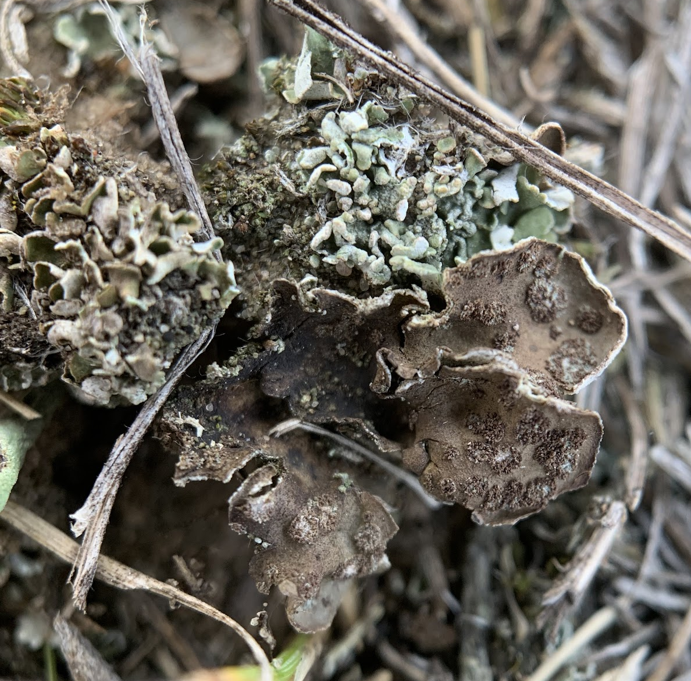
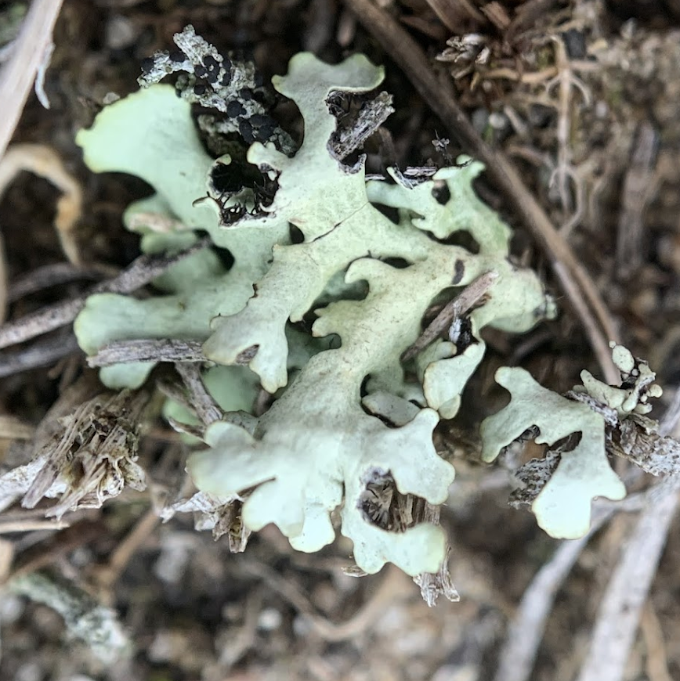
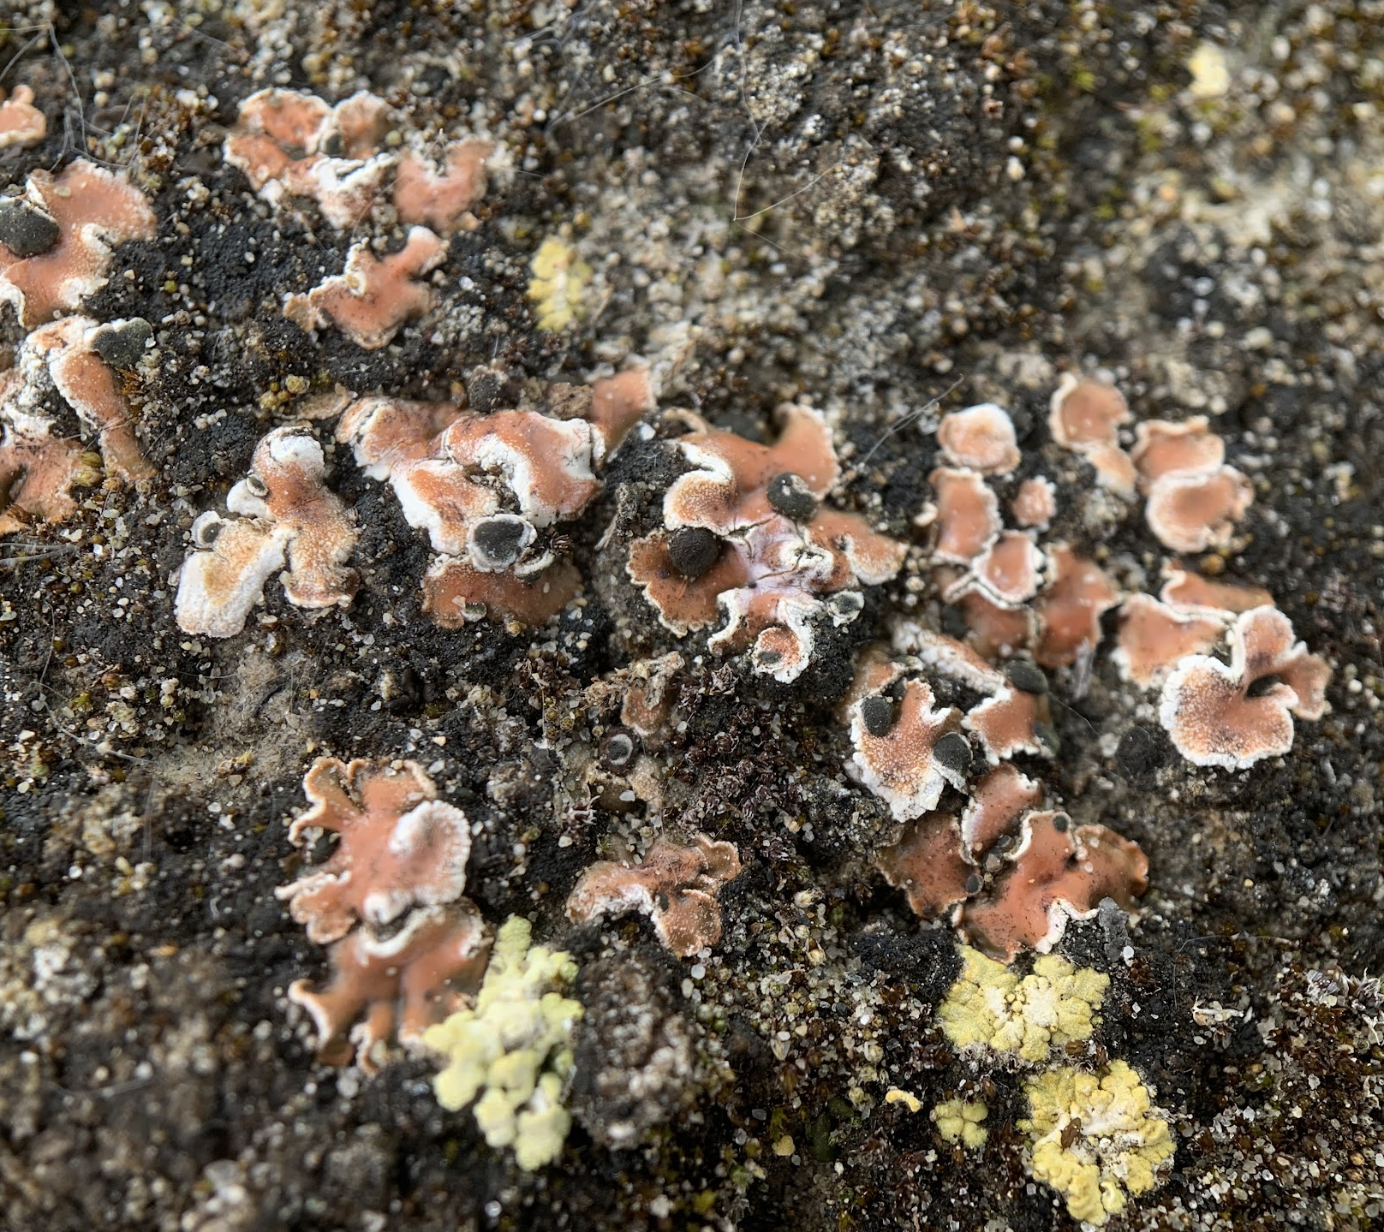
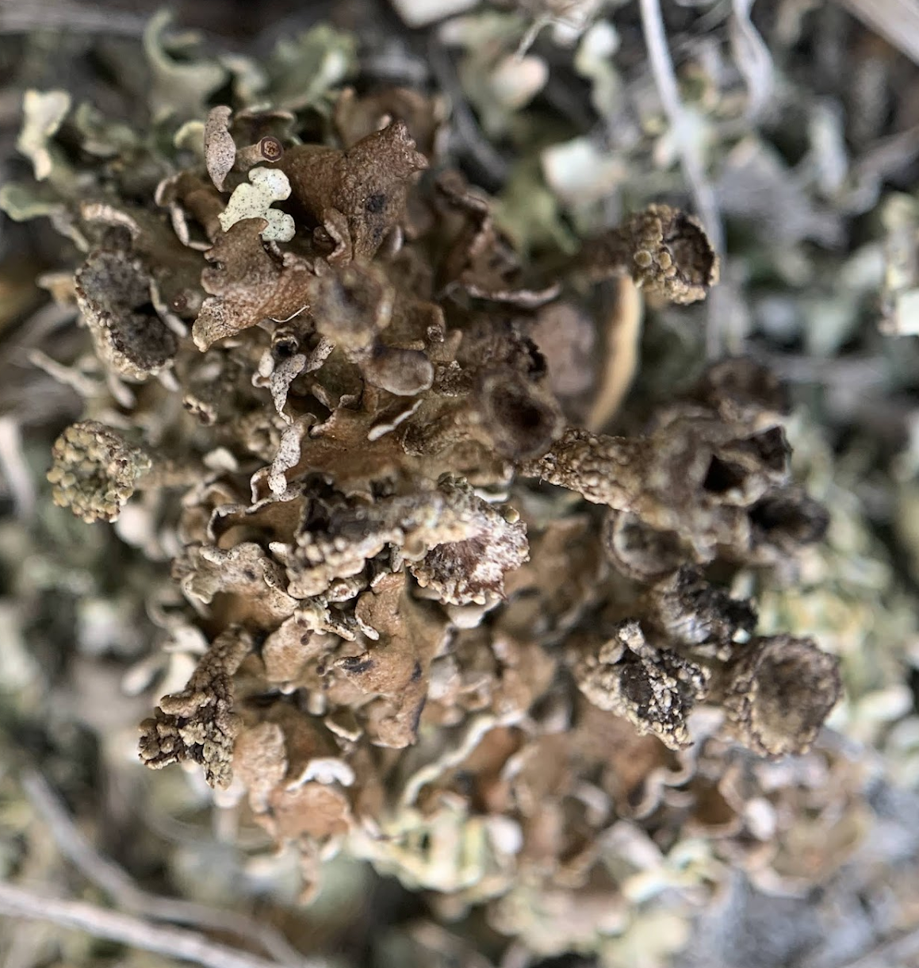
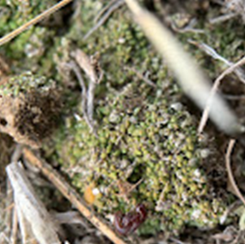
Mock communities and analyses
Set up samples of known LFF, bryophytes and lycophytes.
Able to compare different lab methodology
Possible sequencing biases
Sense of variation that can occur during the lab process
Notes:
Within my biocrust metabarcoding studies I have also created some mock communities for which I know all of the species that make it into the sample, I cleaned off any dirt and dust particles before setting up 3 communities of just LFF, Bryophytes and Sel. densa and then a third community of all specimens together.
These samples are a bit more difficult then the vegetation samples because they aren't quite plants, not quite soil/microbes in the soil, so it is best to compare and trial different lab methods and see what will in the lab and through to getting a species hypothesis. Some things we will be looking for in the sequencing is whether we see similar results in all of the mock communities or if there is variation between the samples since I know exactly what went into each extraction.
I have been able to extract and amplify these specimens and will hopefully sequence them by the end of the year to determine the gaps in community DNA metabarcoding within the BSC communities of the northern grasslands.

Slide 41
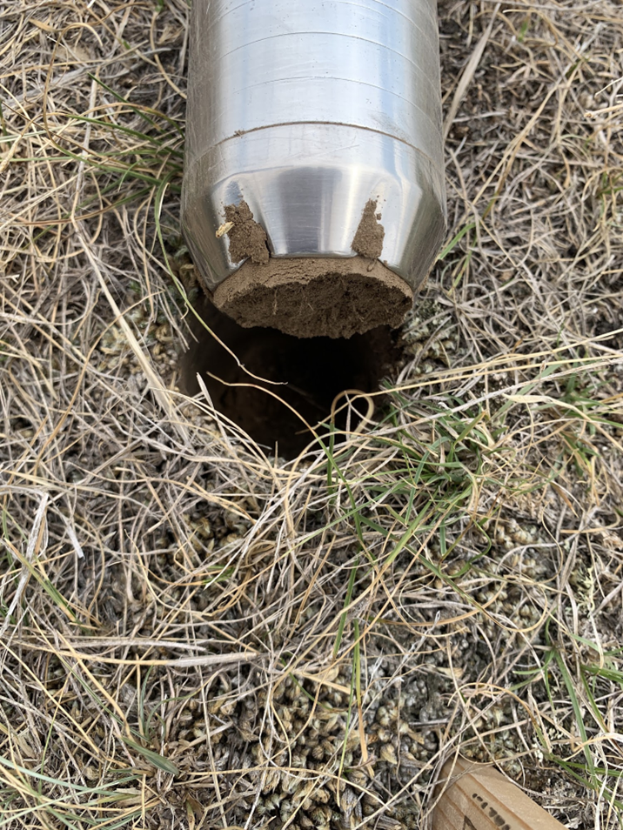
eDNA in soils
Considerations for:
Less heterogeneity in a sample
Mixing
Inhibitors
Longer retention times
Problems we are trying to solve
Notes:
Switching gears in soils, we collected soil eDNA using these soil corers and placed in sample bags. I homogenized and pooled the soil by quadrat before collecting .5g for extraction. One of the key concerns for using soil to monitor vegetation is the heterogeneity of the landscape and the inability of a single soil sample to capture the breadth of diversity we are trying to capture. By mixing the soil and capturing enough from various places at the site of interest we hope that this will overcome some of the challenges of eDNA in soils.
Another key concern we think about when collecting environmental DNA from the soil is the inhibitors found in soil samples. Organic compounds like humic acid can affect the purity and isolation of genomic DNA. The percentage of clay and silt as well as the pH of soil will also affect the DNA we receive from a sample.

Slide 42
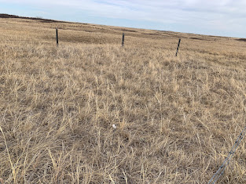
Soils in the grassland
Plants
Fungi
Consideration about plants in lab
Congruence to conventional surveys
Notes:
To determine if eDNA sampling methods are robust to differences in environments with abiotic and biotic variables I collected soil samples in the spring summer and fall and then I homogenized and pooled all of the samples by quadrat before extracting the DNA.
To date, I have extracted DNA from all samples either using a lysis solution specific for humic or sandy soils and have finalized PCR protocols designed for degraded environmental samples difficult to amplify. efficiently amplify low-copy targets and degraded targets. We are now in the process of sequencing our samples and starting to get to species IDs. Once we understand some of the taxIDs of eDNA we can look at the congruence between conventional surveys and soil surveys and to what resolution we can look at for species hypotheses and spatial and temporal variability.
.

Slide 43

Future of eDNA in grassland research
Soil samples for vegetation
Quantifying species richness
Standardize sampling and workflow from various ecosystems
Detect cryptic taxa or life stages with sensitivity
Notes:
Deiner, Kristy, Holly M. Bik, Elvira Mächler, Mathew Seymour, Anaïs Lacoursière-Roussel, Florian Altermatt, Simon Creer, et al. “Environmental DNA Metabarcoding: Transforming How We Survey Animal and Plant Communities.” Molecular Ecology 26, no. 21 (2017): 5872–95.
eDNA metabarcoding makes it possible to detect the presence of many species simultaneously, including species not previously suspected of being present. This broader untargeted approach is called “passive” surveillance in management applications. looking to the future, there are emerging applications of eDNA metabarcoding in ecology, , biomonitoring, and potentials for eDNA metabarcoding can be used in citizen science and biodiversity education.

Slide 44

Questions?
Jori Harrison, Ph.D., P.Biol.
Experienced Researcher - Environmental Impacts
jori.harrison@InnoTechAlberta.ca
Emilie Porter
Ph.D. Student
eaporter@ualberta.ca
https://www.stateofthebay.ca/edna-learning-from-the-molecule-thats-always-left-behind/

