Slide 1
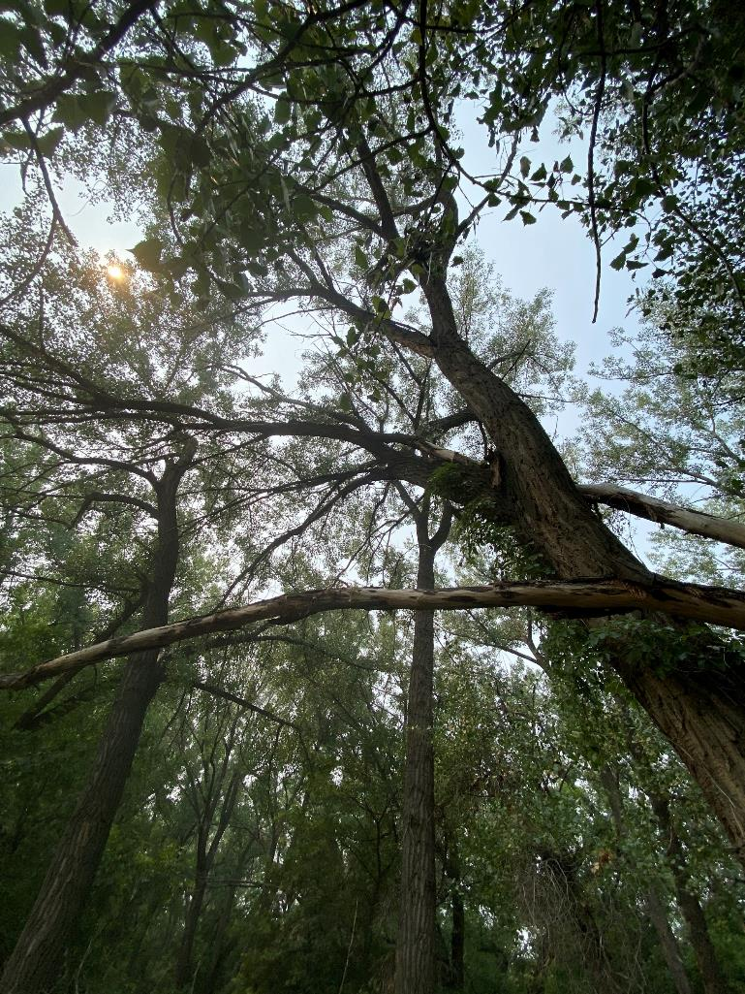
Ecological Mapping & Urban Trees Project (for Ecological Restoration)
GRF PRESENTATION
BRENT SMITH, Medicine hat college
15 NOVember 2024

Slide 2
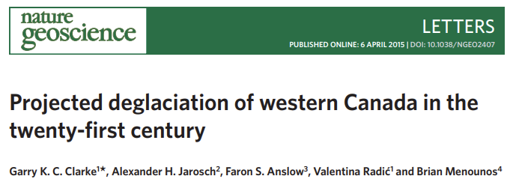
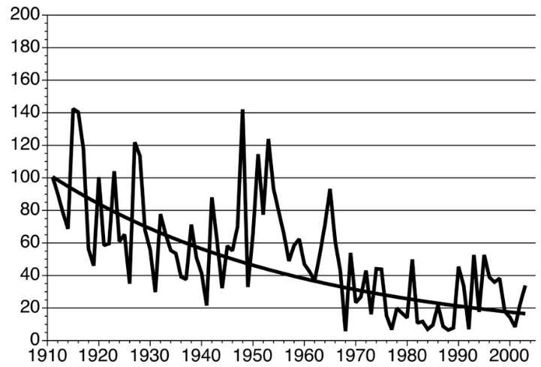
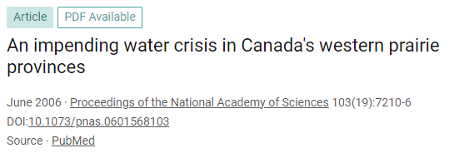
Climate & Climate Change
South Saskatchewan River Flows at Saskatoon, SK

Slide 3
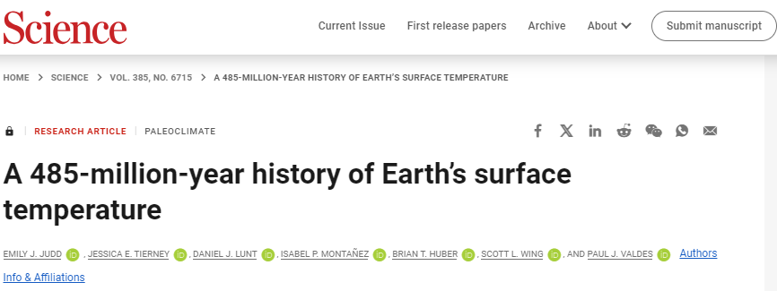
Climate & Climate Change
The GMST-CO₂ relationship indicates a notably constant “apparent” Earth system sensitivity (i.e., the temperature response to a doubling of CO₂, including fast and slow feedbacks) of ∼8°C, with no detectable dependence on whether the climate is warm or cold.
“EPFL climate scientists find that roughly a third of the models are not doing a good job at reproducing existing sea surface temperature data, a third of them are robust and are not particularly sensitive to carbon emissions, and the other third are also robust but predict a particularly hot future for the planet due to high sensitivity to carbon emissions.”

Slide 4
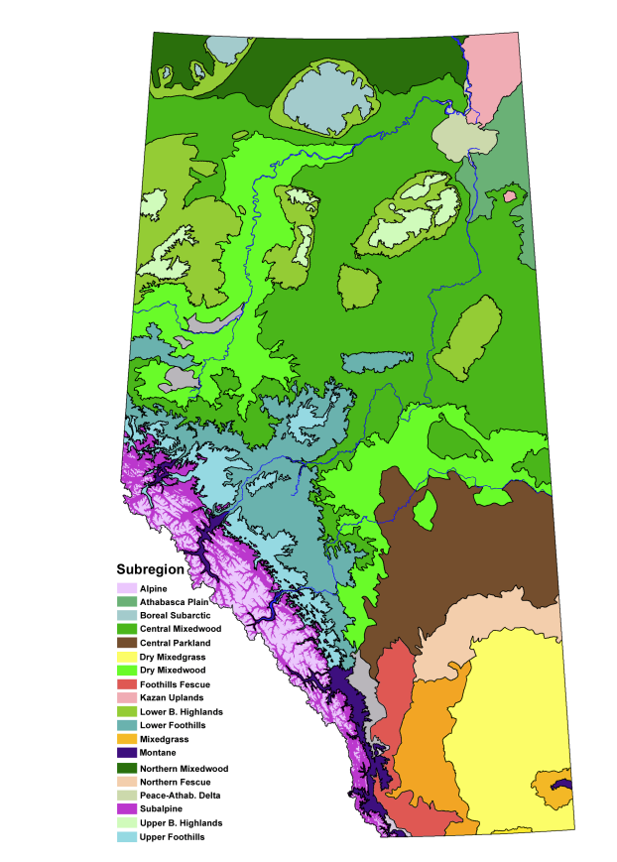
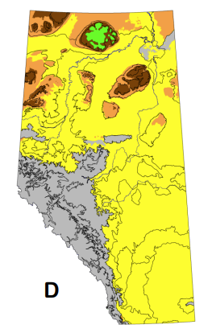
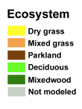
Climate & Climate Change
Subregions of Alberta 2080
Subregions of Alberta 2013
HOT MODEL
Source: Schneider. 2013. Alberta’s Natural Subregions under
a Change Climate: Past, Present and Future. Alberta Biodiversity Monitoring Institute

Slide 5
Research Questions
What is the distribution of tree cover in Medicine Hat?
How will urban and natural forests change into the future?
How can Medicine Hat become more resilient to climate change?

Slide 6
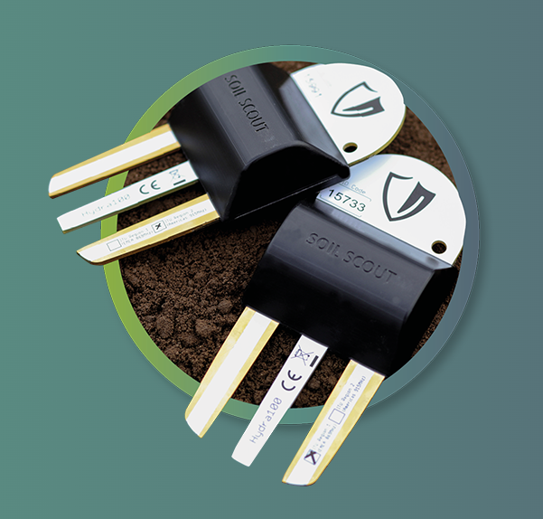
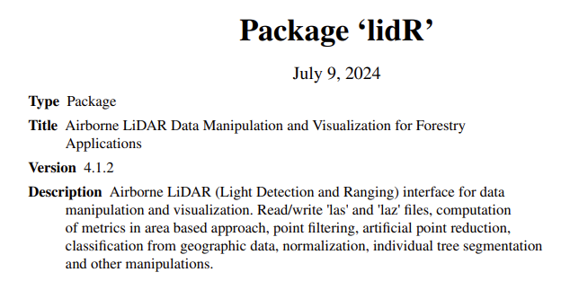
Data Sources & Software

Slide 7
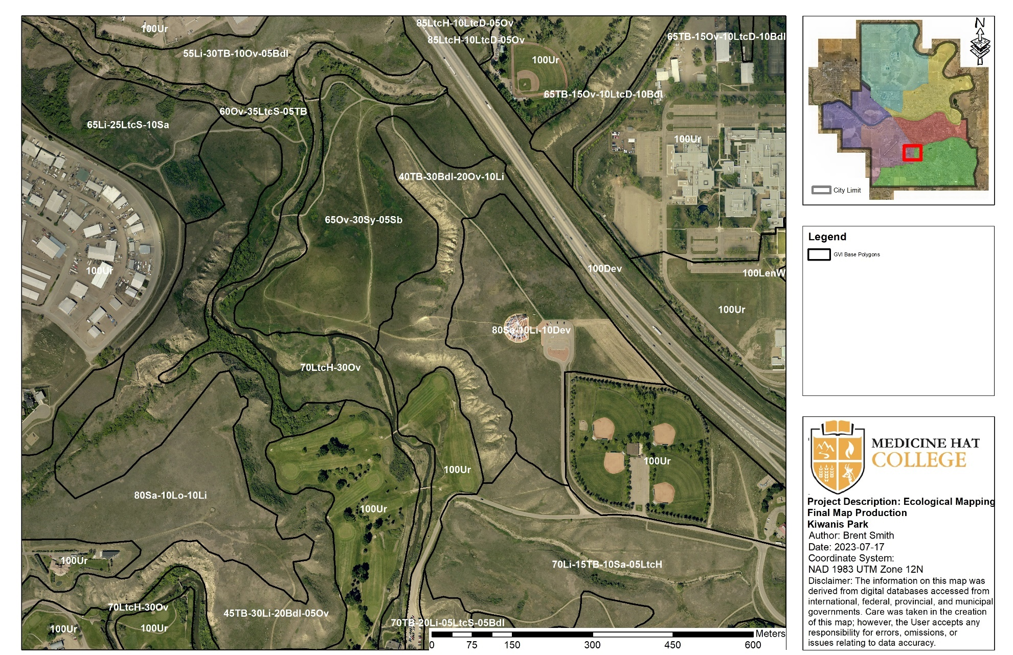

Slide 8
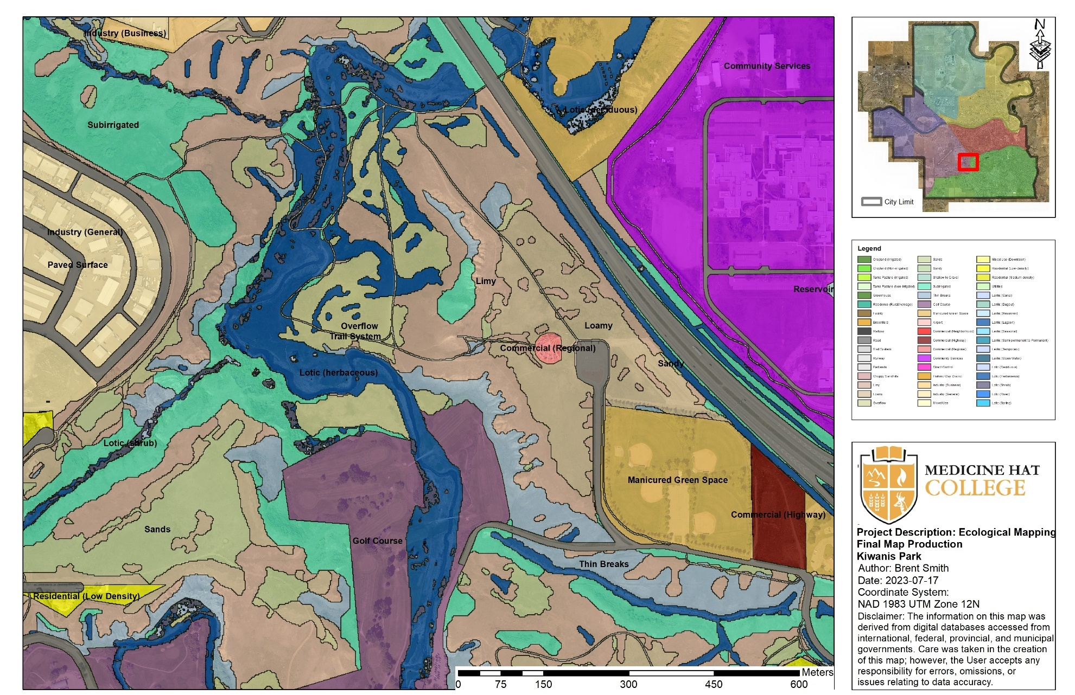

Slide 9
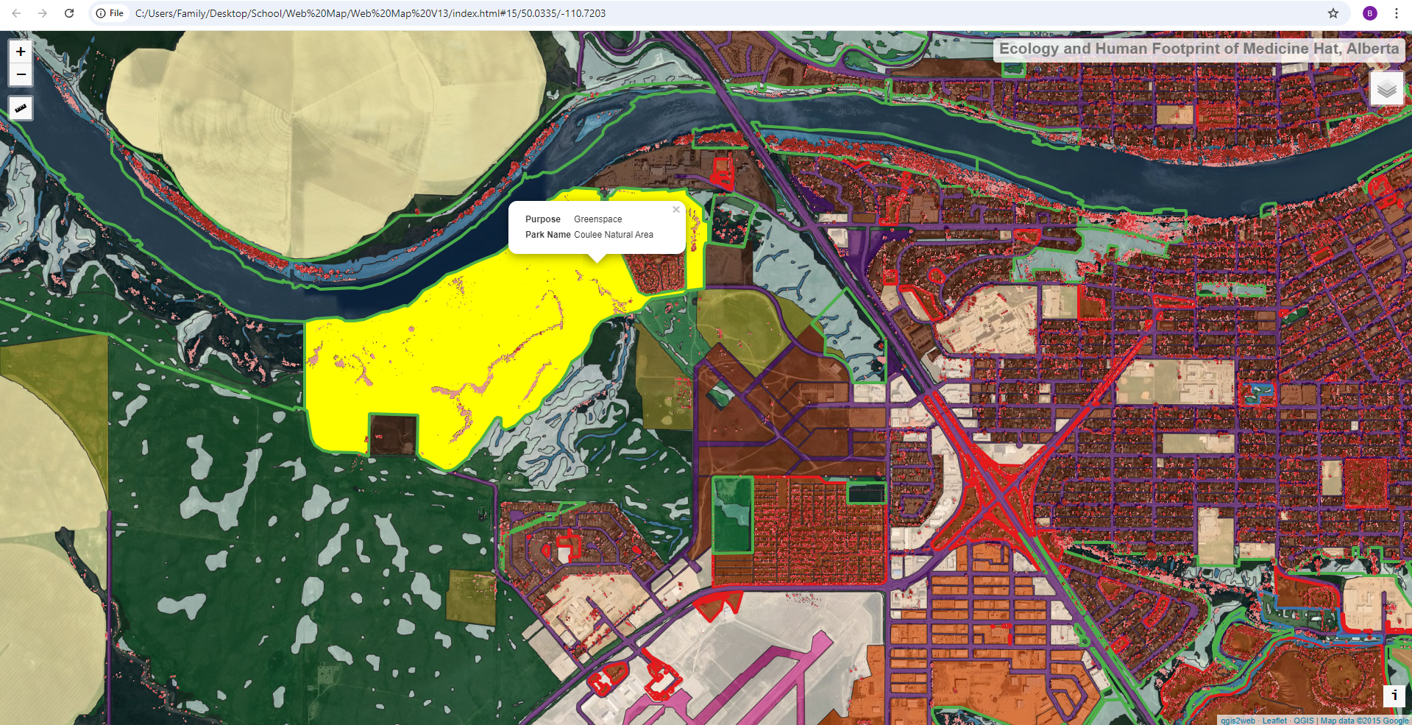
Ecological and Human Footprint Map
-To answer these questions, I built a 1:2000 map containing complete datasets for Medicine Hat:
-upland ecology (uncultivated land)
-riparian ecology (lotic/lentic)
-urban system (landuse zones)
-agricultural system (tame pasture/cropland)
-industrial (gravel pits, industrial plants)
-transportation system (roads, rail, trails)
-native prairie distribution

Slide 10
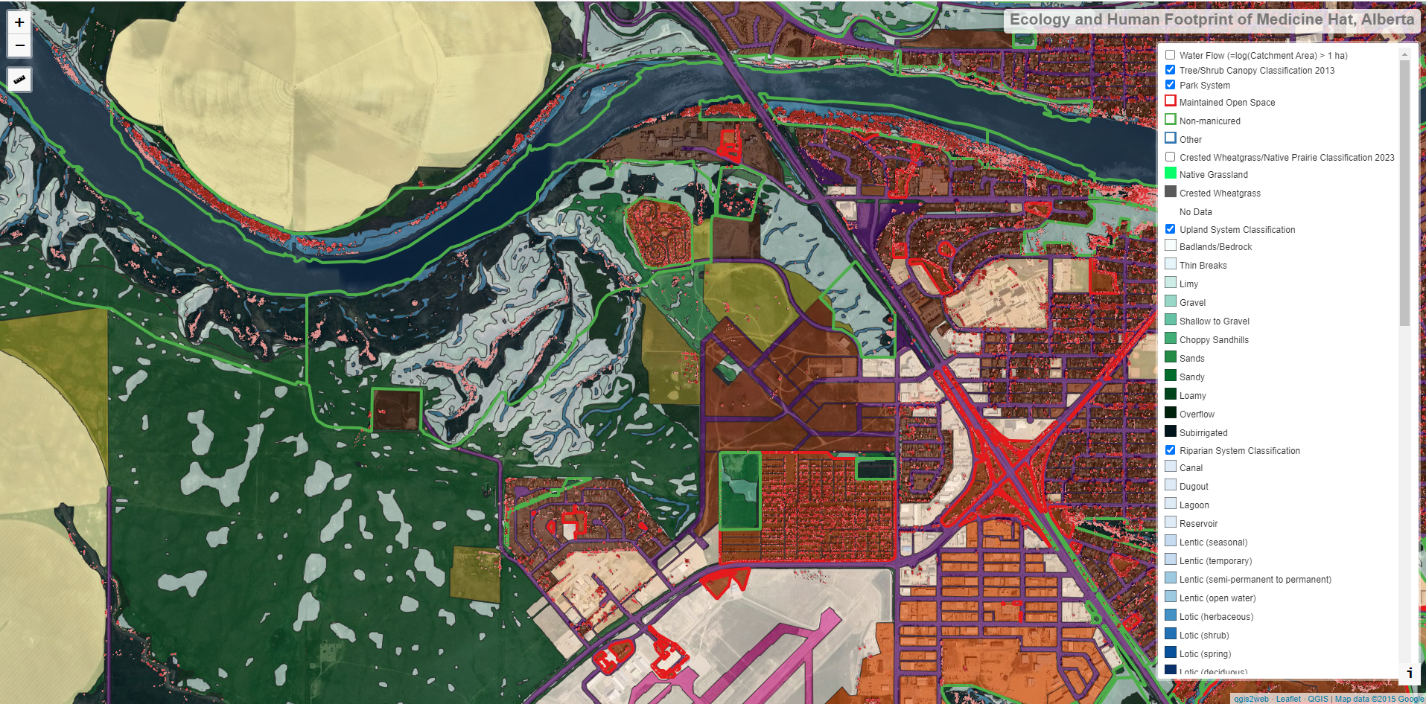

Slide 11
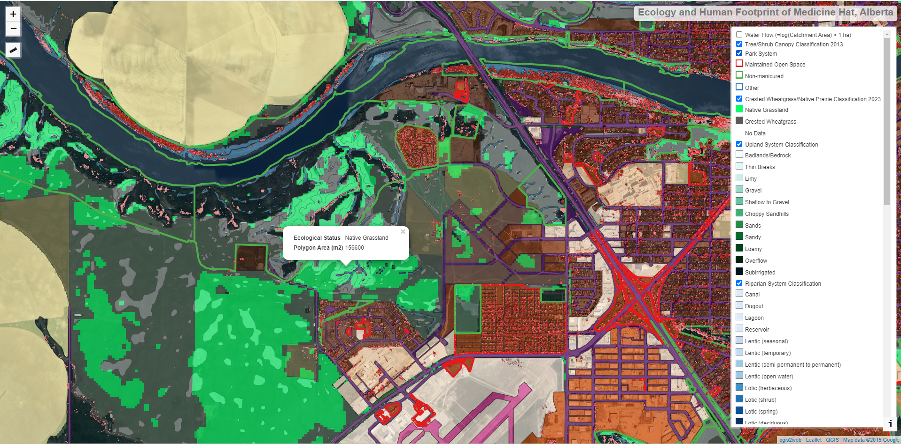

Slide 13
Tree Distribution (2013)

Slide 14
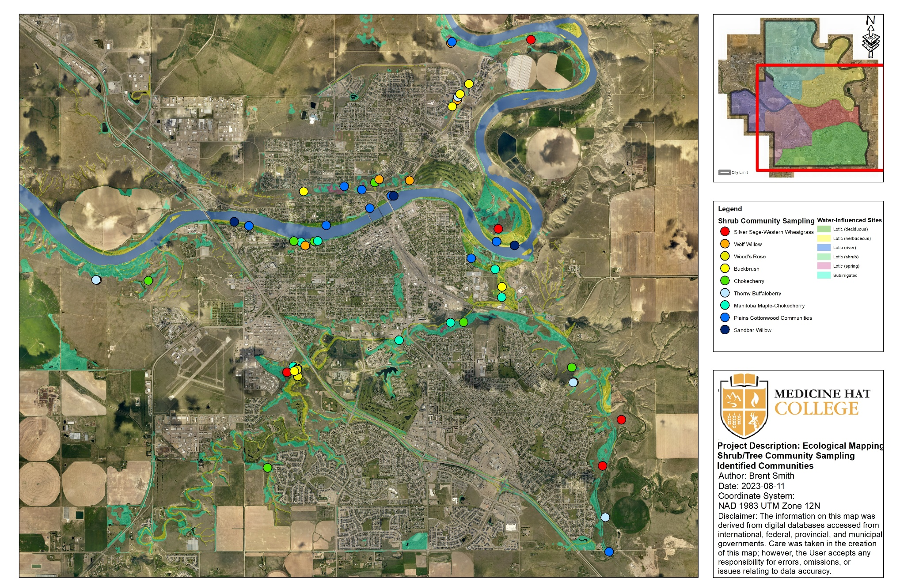

Slide 15
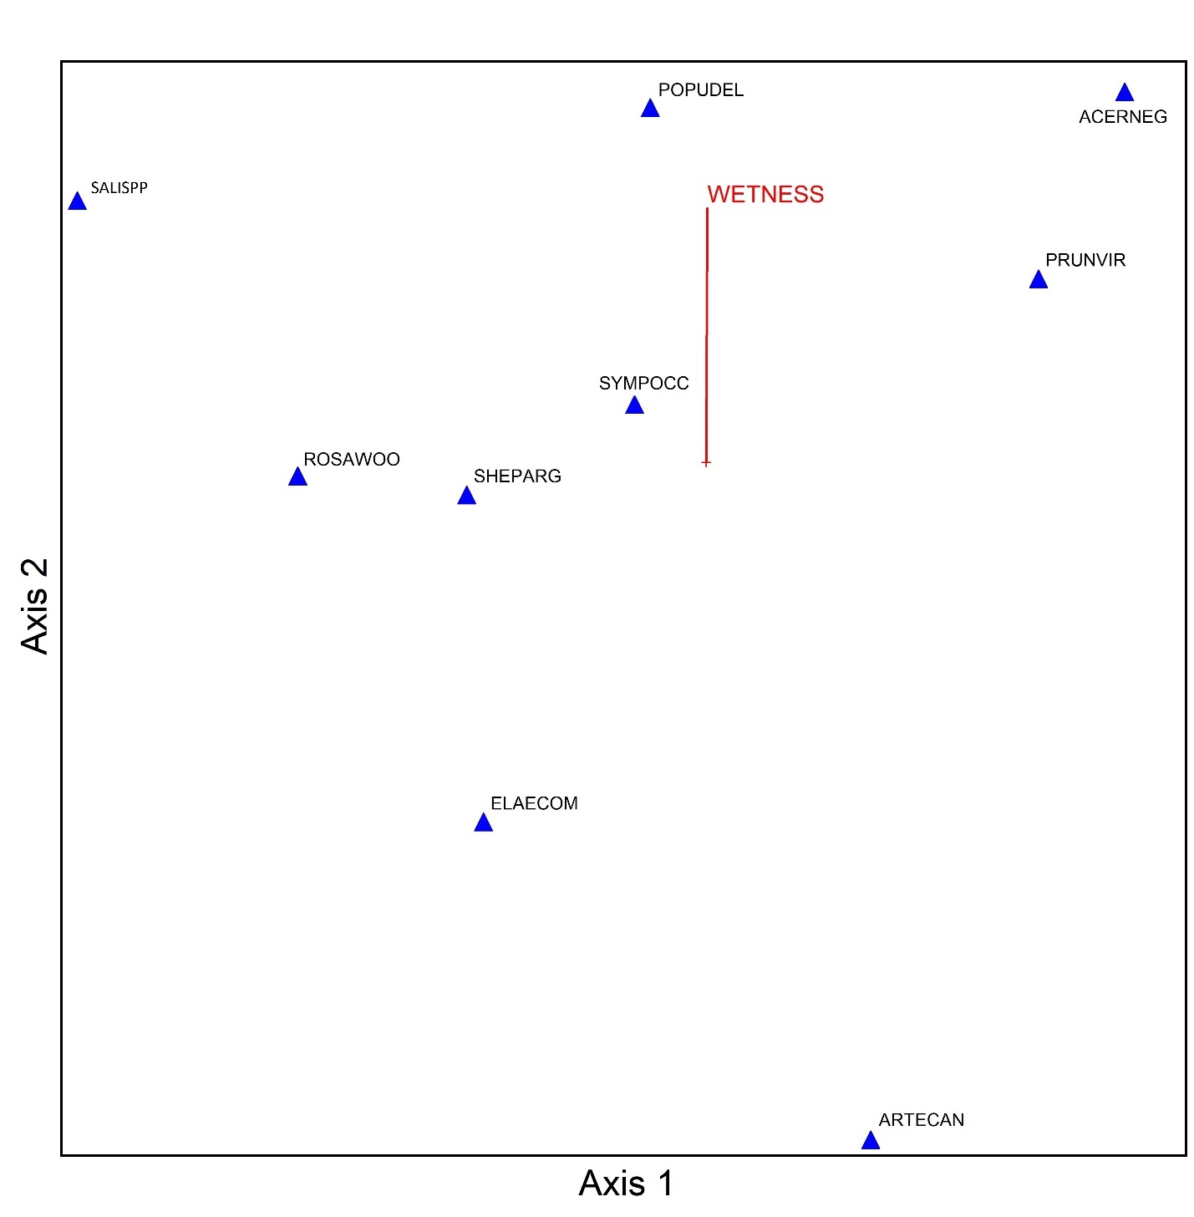
Community-level Ordination
Axis 1 = Succession
Succession = seral stage (early to late)
Axis 2 = Wetness
Wetness = Landsat-derived soil moisture (dry to wet)
SUCCESSION

Slide 16
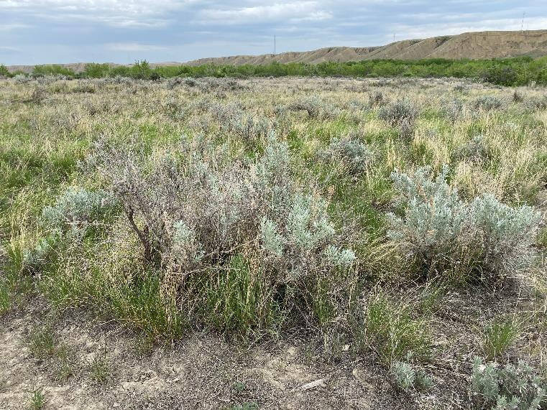
Findings: Riparian Ecology
Silver sage (Artemisia cana)
Height: < 1 m
Habitat: Overflow sites adjacent to Ross Creek, Seven Persons Creek, South Saskatchewan River
LATE SUCCESSIONAL SPECIES
DRY
WET
VERY WET

Slide 17
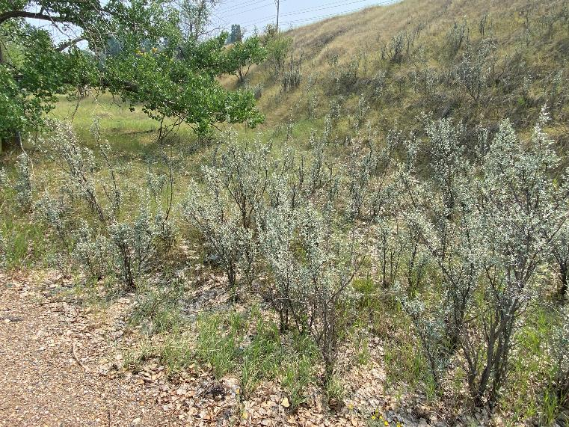
Findings: Riparian Ecology
Wolf willow (Elaeagnus commutata)
Height: 1-2 m
Habitat: North-facing slopes in V-shaped coulees that are not subirrigated or lotic. Drier areas upslope to subirrigated sites within Ross Creek, Seven Persons Creek, South Saskatchewan River
LATE SUCCESSIONAL SPECIES
DRY
WET
VERY WET

Slide 18
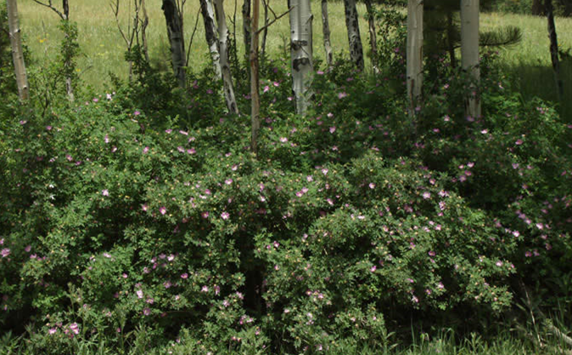
Findings: Riparian Ecology
Woods rose (Rosa woodsii)
Height: < 1 m
Habitat: Subirrigated sites within Ross Creek, Seven Persons Creek, South Saskatchewan River
EARLY SUCCESSIONAL SPECIES AND/OR BROWSING RESISTANT SPECIES
DRY
WET
VERY WET

Slide 19
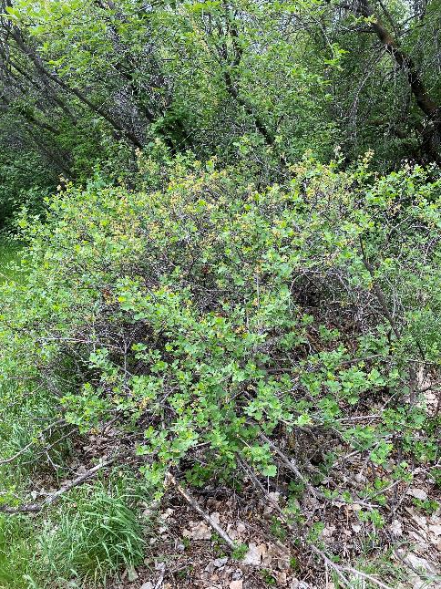
Findings: Riparian Ecology
Golden currant (Ribes aureum)
Height: 1-2 m
Habitat: Subirrigated and lotic sites within riparian areas, and V-shaped coulees, including springs
LATE SUCCESSIONAL SPECIES
DRY
WET
VERY WET

Slide 20
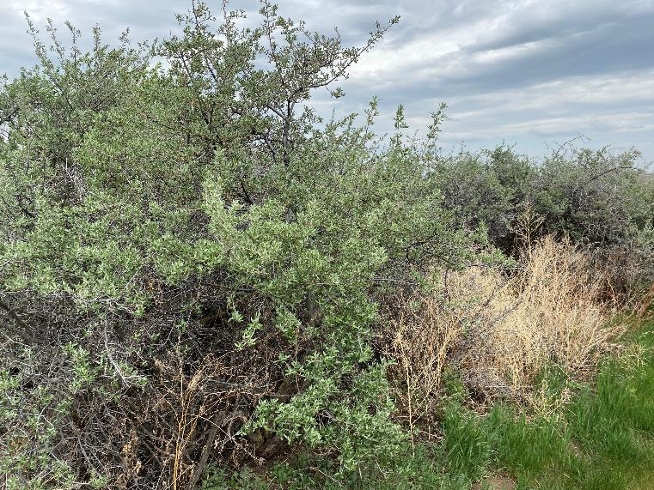
Findings: Riparian Ecology
Thorny Buffaloberry (Shepherdia argentea)
Height: 2-3 m
Habitat: subirrigated and lotic sites of Ross Creek, Seven Persons Creek, South Saskatchewan River, subirrigated sites in sandy soils
LATE SUCCESSIONAL SPECIES AND/OR BROWSING RESISTANT SPECIES
DRY
WET
VERY WET

Slide 21
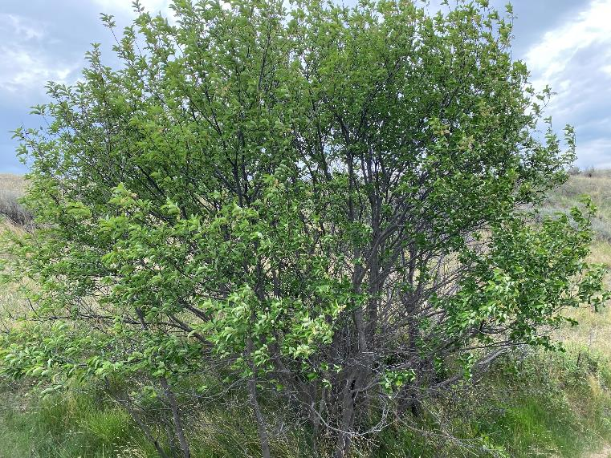
Findings: Riparian Ecology
Chokecherry (Prunus virginiana)
Height: 2-5 m
Habitat: Subirrigated and lotic sites within riparian areas, and V-shaped coulees, including springs
LATE SUCCESSIONAL SPECIES
DRY
WET
VERY WET

Slide 22
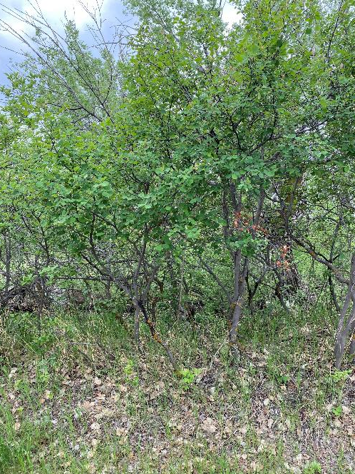
Findings: Riparian Ecology
Saskatoon (Amelanchier alnifolia)
Height: 1-5 m
Habitat: Subirrigated and lotic sites within riparian areas, and V-shaped coulees, including springs
LATE SUCCESSIONAL SPECIES
DRY
WET
VERY WET

Slide 23
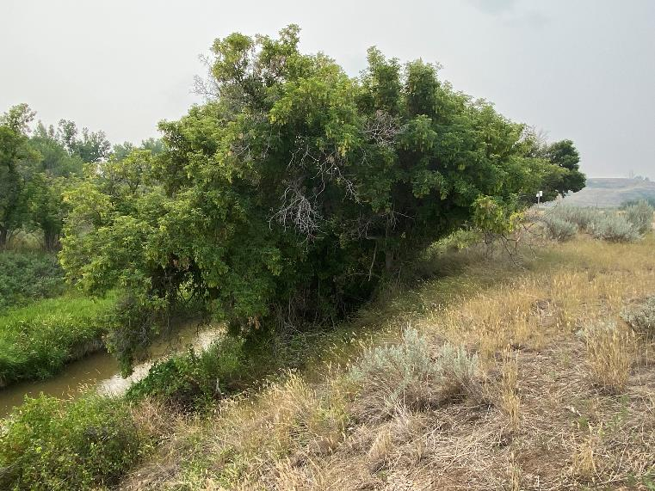
Findings: Riparian Ecology
Manitoba Maple (Acer negundo)
Height: 3-6 m
Habitat: Lotic and subirrigated within Ross Creek, Seven Persons Creek, South Saskatchewan River, including springs
LATE SUCCESSIONAL SPECIES
DRY
WET
VERY WET

Slide 24
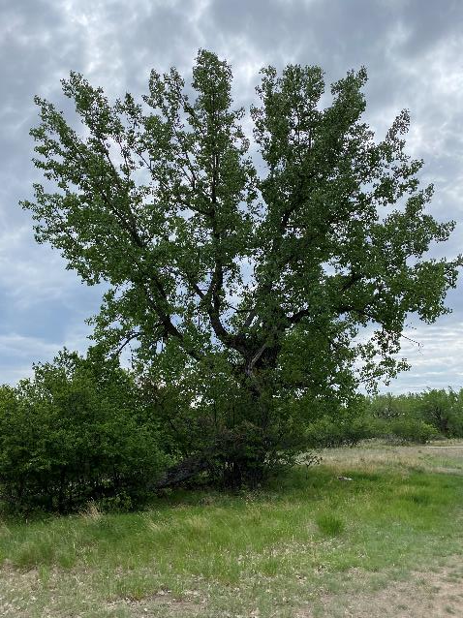
Findings: Riparian Ecology
Plains Cottonwood
Height: 5-10 m
Habitat: Lotic sites within South Saskatchewan River, including springs
Requires flooding and fresh sediment for establishment
EARLY SUCCESSIONAL SPECIES
DRY
WET
VERY WET

Slide 25
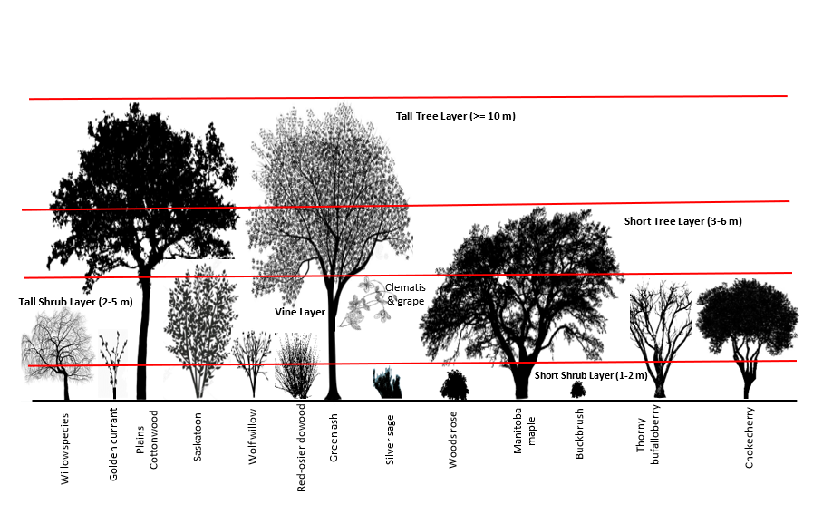
Findings: Riparian Ecology
-There are 12 native trees/shrub species in Medicine Hat
-Diverse forests contain up to 5 structural layers
-within city limits:
-25 % of tree/shrub cover occurs in natural systems
-75 % of tree/shrub cover (urban) is irrigated
TALL TREE LAYER
SHORT TREE LAYER
TALL SHRUB LAYER
SHORT SHRUB LAYER

Slide 26
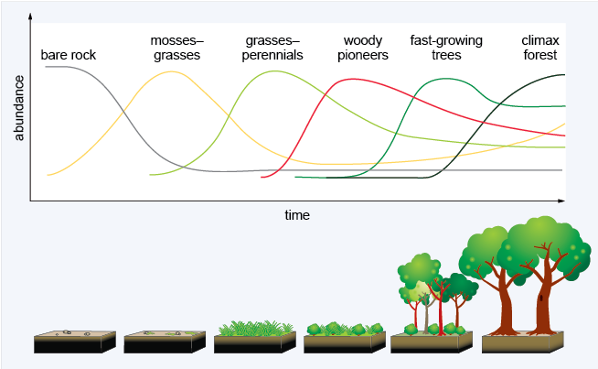
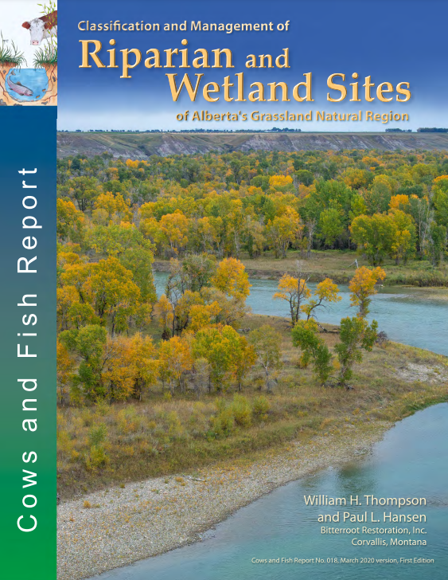
Riparian Ecology
Ecological Succession

Slide 27
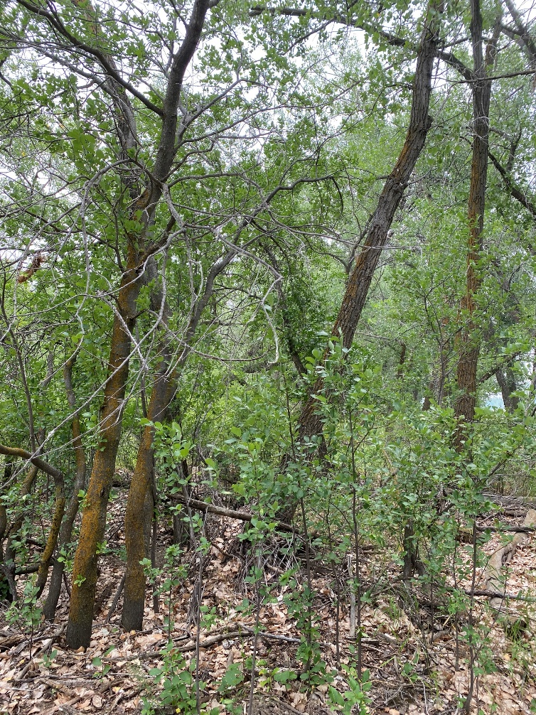
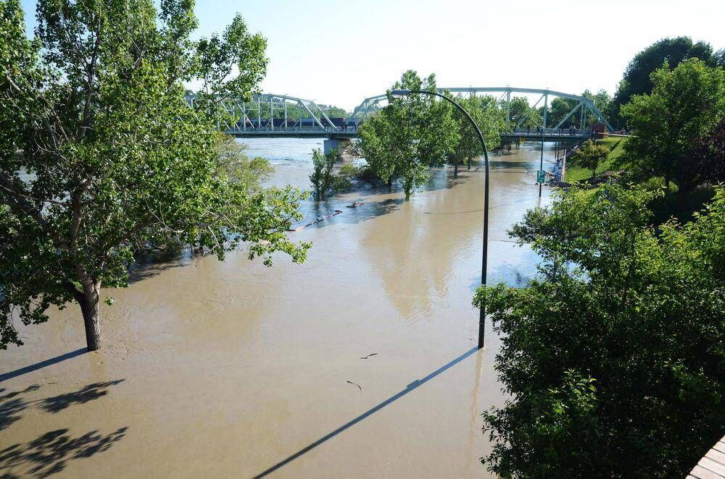
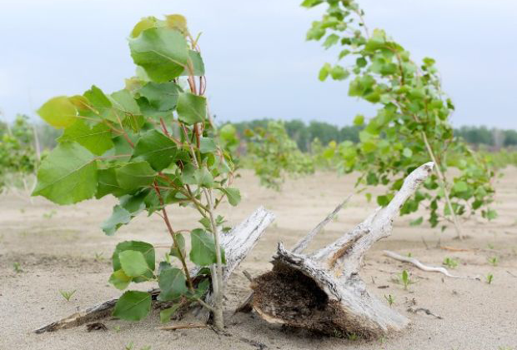
Riparian Ecology
Year 20-100 ???
Year 0
Year 1
Large flood event
Cottonwood regeneration
Cottonwood mixed shrub understory

Slide 28
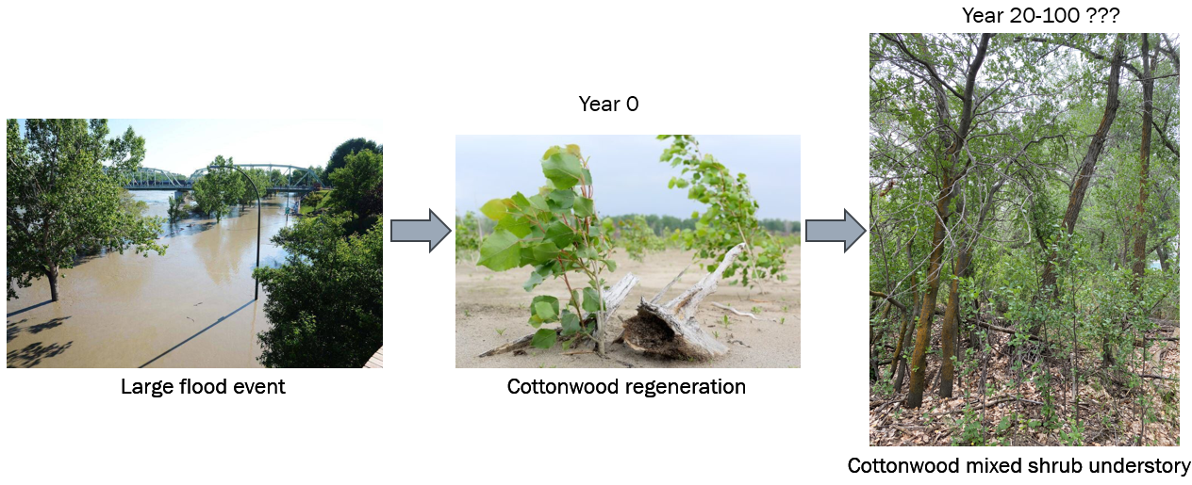
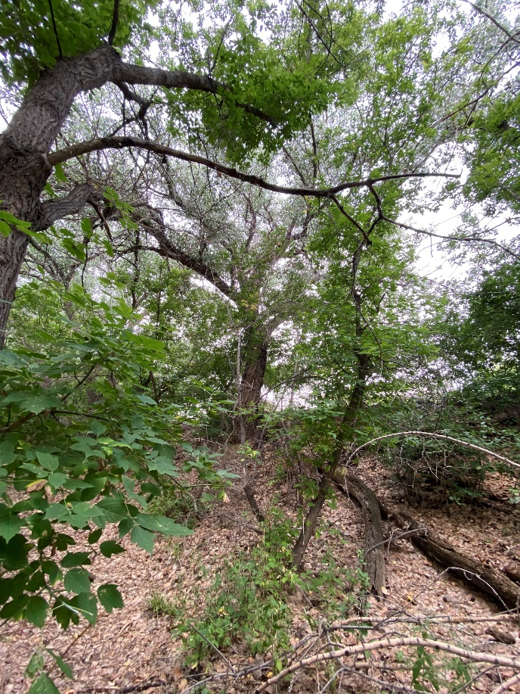
Riparian Ecology
Climax Community
Early Succession
Cottonwoods die out
Manitoba Maple mixed shrub understory

Slide 29
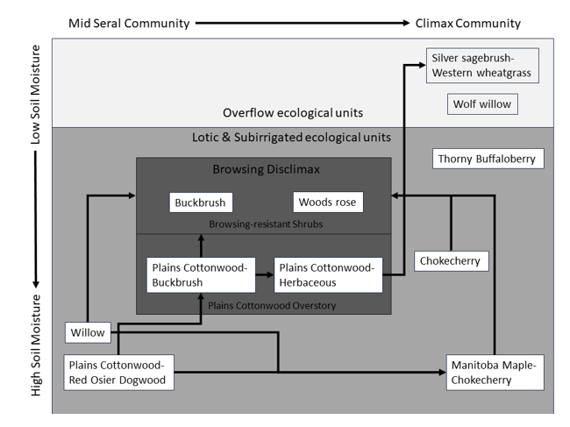
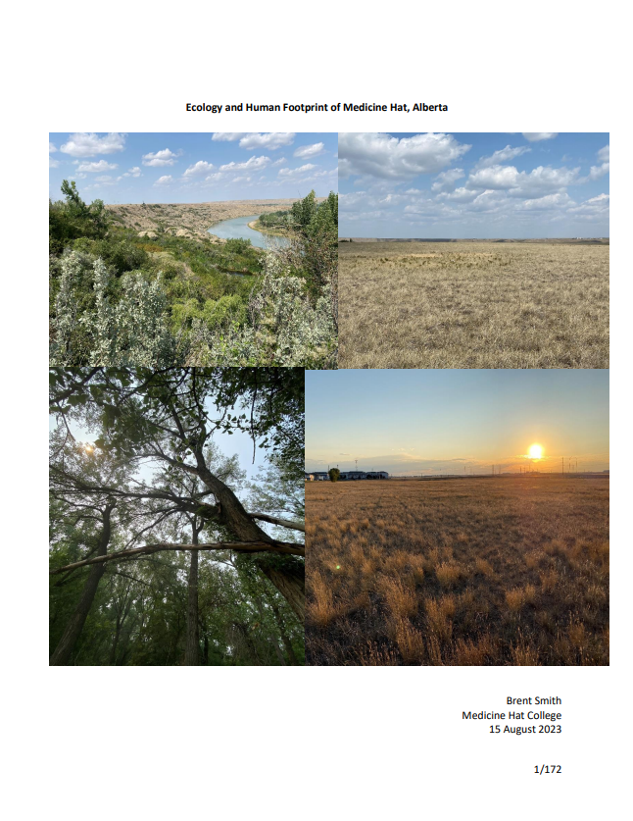
Ecological Modelling

Slide 30
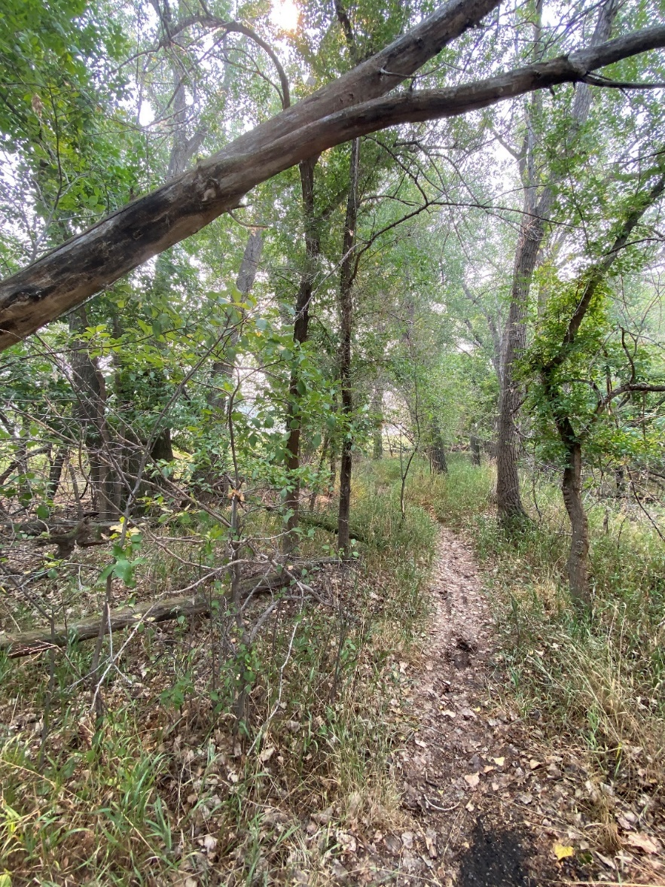
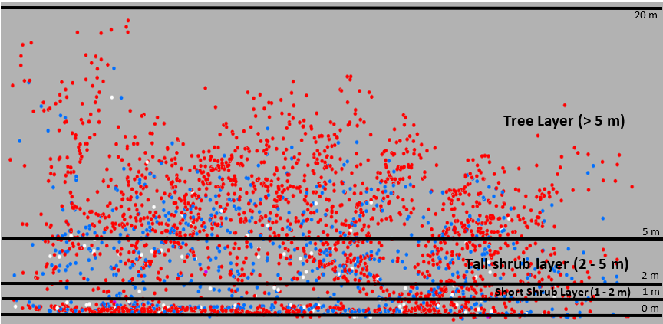
Ecological Modelling
LiDAR Cross-section of diverse cottonwood understory

Slide 31
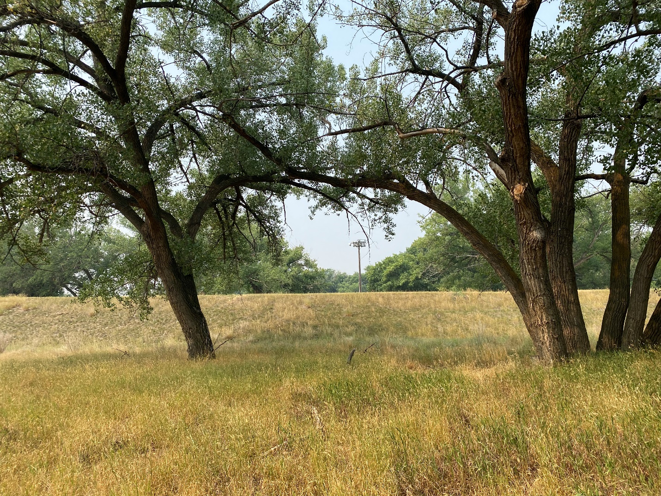
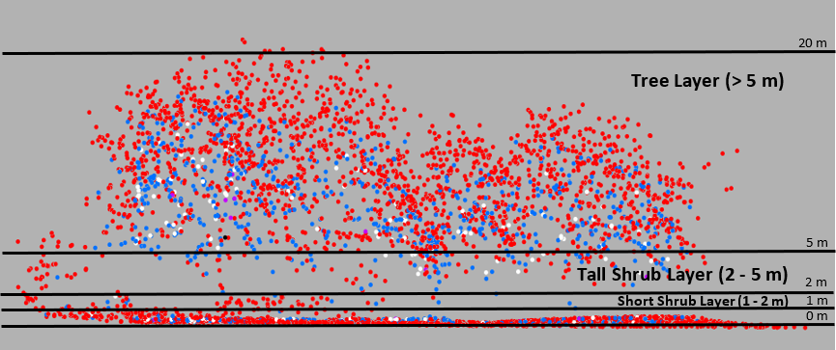
Ecological Modelling
LiDAR Cross-section of non-diverse cottonwood understory

Slide 32
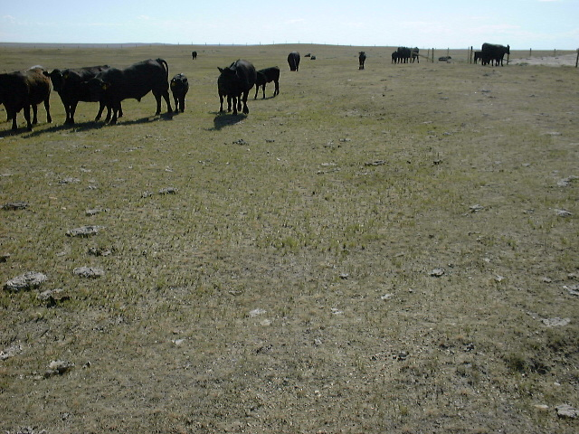
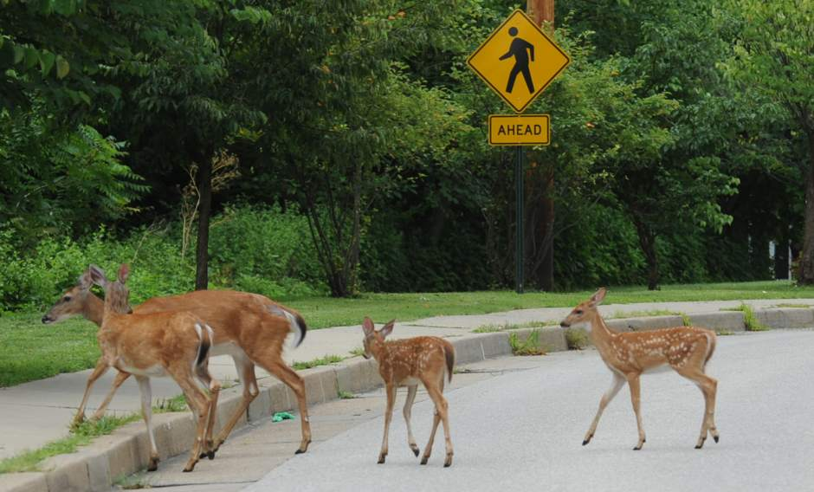
Ecological Modelling

Slide 33
Findings: Riparian Ecology

Slide 34
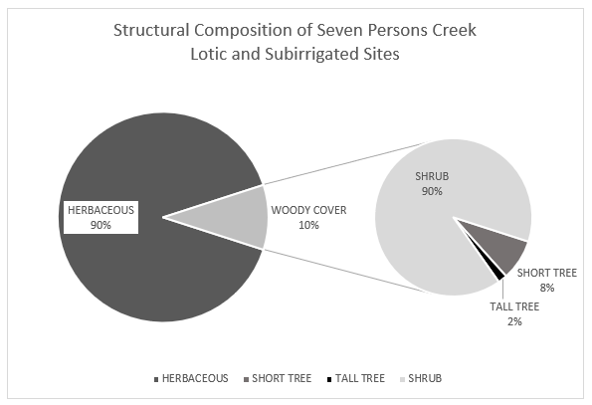
Findings: Riparian Ecology

Slide 35
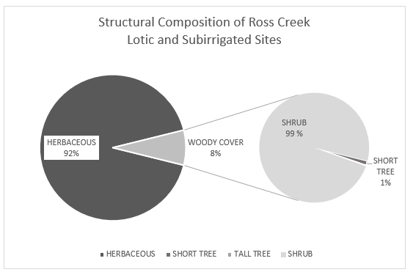
Findings: Riparian Ecology

Slide 36
Findings: Riparian Ecology

Slide 37
Climate Change & Resiliency
Silver sagebrush-Western wheatgrass
Wolf willow
Thorny buffaloberry
More climate change
Cottonwoods die out
Chokecherry
Plains Cottonwood-
No understory
Manitoba Maple-Chokecherry
Plains Cottonwood-
Healthy understory

Slide 38
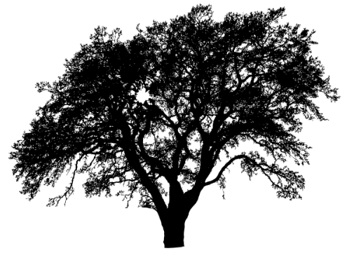
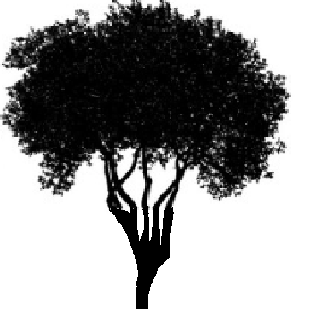
Climate Change Effects to Cottonwood Forests
Natural succession and/or climate change
Climate change
Plains Cottonwood
Manitoba maple
Chokecherry

Slide 39
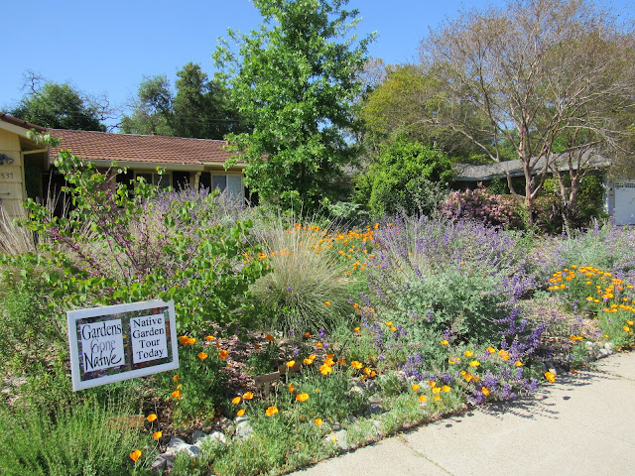
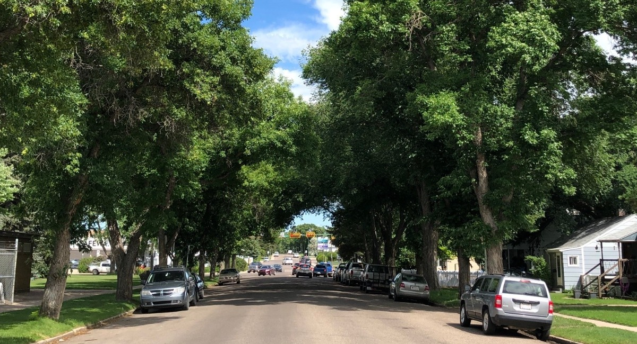
Climate Change Effects to the Urban Forest

Slide 40
Conclusions
Riparian forests contribute 25 % of Medicine Hat’s total tree canopy
Tree/shrub communities are organized by moisture, succession, and deer browsing
Structurally diverse communities are resilient to climate change
Ecological maps and manual provide guidance on appropriate species for riparian restoration

Slide 41
Conclusions
HOWEVER:
83 % of the SSR that could support trees/shrub is now grass
~50 % of Medicine Hat’s cottonwood forest lacks structural (and biological!) diversity
What to do???????

Slide 42
Tree/Shrub Seedlings
MHC produced hundreds of native seedlings for free to the public in April 2024:
silver sagebrush (Artemisia cana)
golden currant (Ribes aureum)
thorny buffaloberry (Shepherdia argentea)
Wood’s rose (Rosa woodsii)
chokecherry (Prunus virginiana)

Slide 43
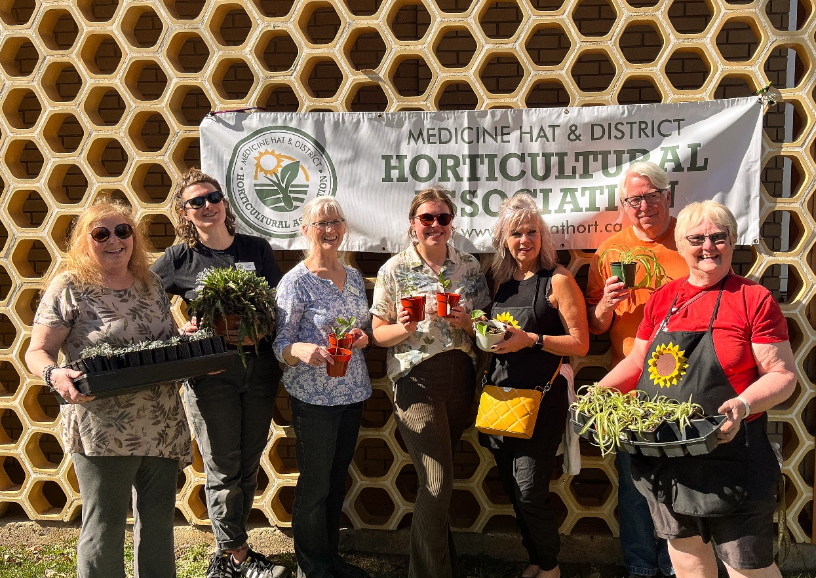
Tree/Shrub Seedlings

Slide 44
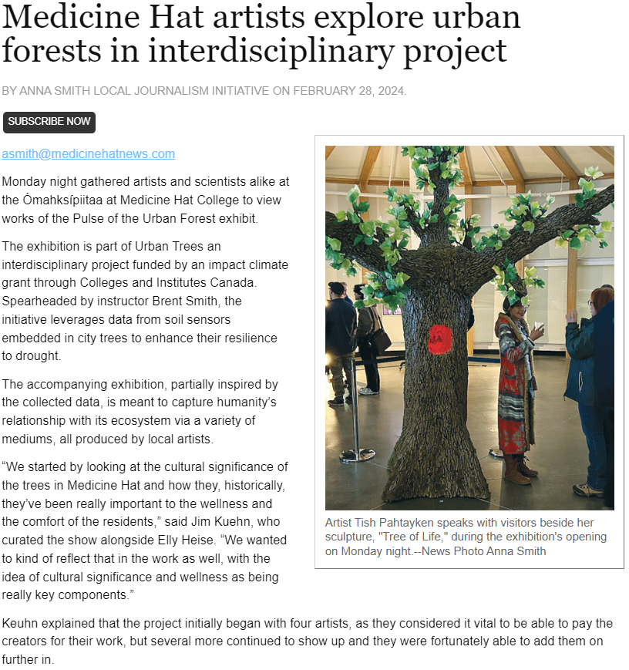
Cross-Disciplinary Collaboration

Slide 45
Thank You!
Summer students: Kate Zell, Abigail McBride
MHC faculty: Jim Kuehn

Slide 46
Future Work
Forbs for 2025:
Purple prairie clover (Petalostemon purpureum)
Prairie coneflower (Ratibida columnifera)
Blanketflower (Gaillardia aristata)
Blue flax (Linum lewisii)
Hairy golden aster (Heterotheca villosa)
Prairie onion (Allium textile)
Pincushion cactus (Coryphantha vivipara)
Trees/shrubs for 2025:
Wolf willow (Elaeagnus commutata
silver sagebrush (Artemisia cana)
golden currant (Ribes aureum)
thorny buffaloberry (Shepherdia argentea)
Wood’s rose (Rosa woodsii)
chokecherry (Prunus virginiana)
snowberry (Symphoricarpos occidentalis

Slide 47
Future Work
2023 LiDAR updates
City approval for riparian exclosures
Deer census (drone)
Riparian restoration trials
Gerry Ehlert memorial forest?

